Slide 1
“Biblical preaching tries to capture the perspective of the text lest it become a pretext. Until the preacher himself has been seized by what seized the writer, he will be unable to pass it on with passion and telling impact.”
Don Harbuck

Slide 2

To God be the Glory
in the Church

Slide 3
To God be the Glory
in the Preachers

Slide 4
“Biblical preaching tries to capture the perspective of the text lest it become a pretext. Until the preacher himself has been seized by what seized the writer, he will be unable to pass it on with passion and telling impact.”
Don Harbuck

Slide 5
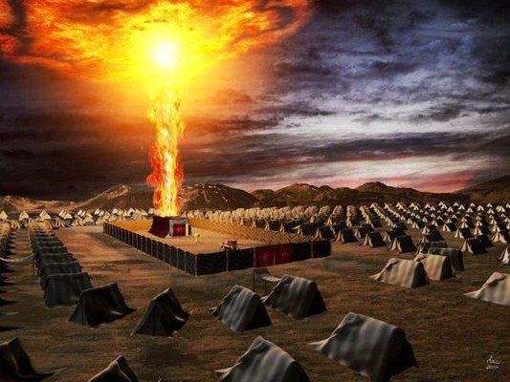
The
Story
of God’s Glory

Slide 6
Glory to God in our Preaching

Slide 7

Paul’s Goal:
God’s Glory

Slide 8
Paul’s Motivation:
Temple Building

Slide 9
Paul’s Place:
The Least

Slide 10
Paul’s Perspective:
A Gift

Slide 11
Paul’s Subject:
Jesus

Slide 12
Paul’s Value:

Slide 13
“The value we place on something determines the hardship we are willing to endure for it. We will expend enormous energy and resources to care for a person or a prized possession we value a great deal. Paul valued the gospel enough to go to prison for it.”
Klyne Snodgrass

Slide 14
Paul’s Value:
Ready to Suffer

Slide 15
Glory to God in our Preaching

Slide 16
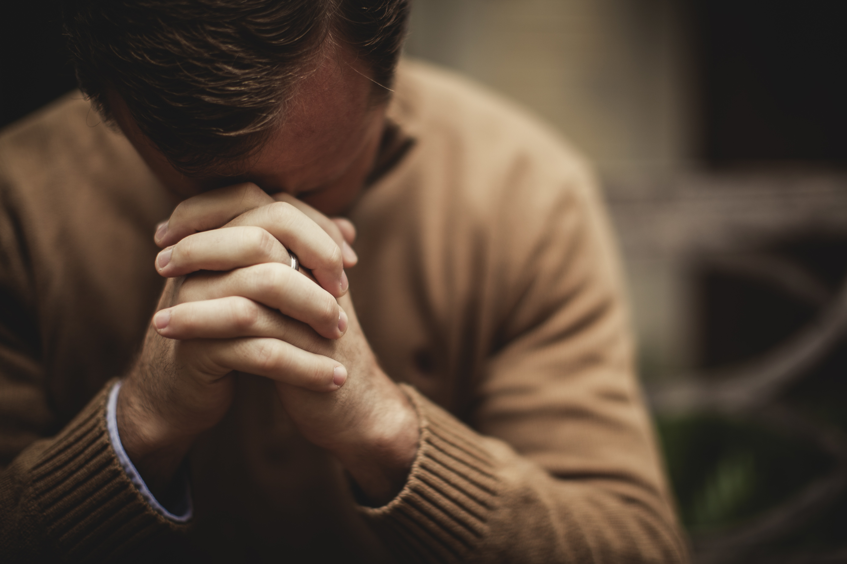
Glory to God in our Praying

Slide 17
Paul’s Basis:
Jesus Christ

Slide 18
Paul’s Addressee:
The Father of all

Slide 19
Paul’s Reason:
I’m not strong enough

Slide 20
Paul’s Extent:
Difficult
Impossible
Unfathomable

Slide 21
Paul’s Faith:
More than I can fathom

Slide 22
Glory to God in our Praying

Slide 23
To God be the Glory
in the Preachers

Slide 24
To God be the Glory
in the Church

