Slide 1
EPHESIANS

Slide 2
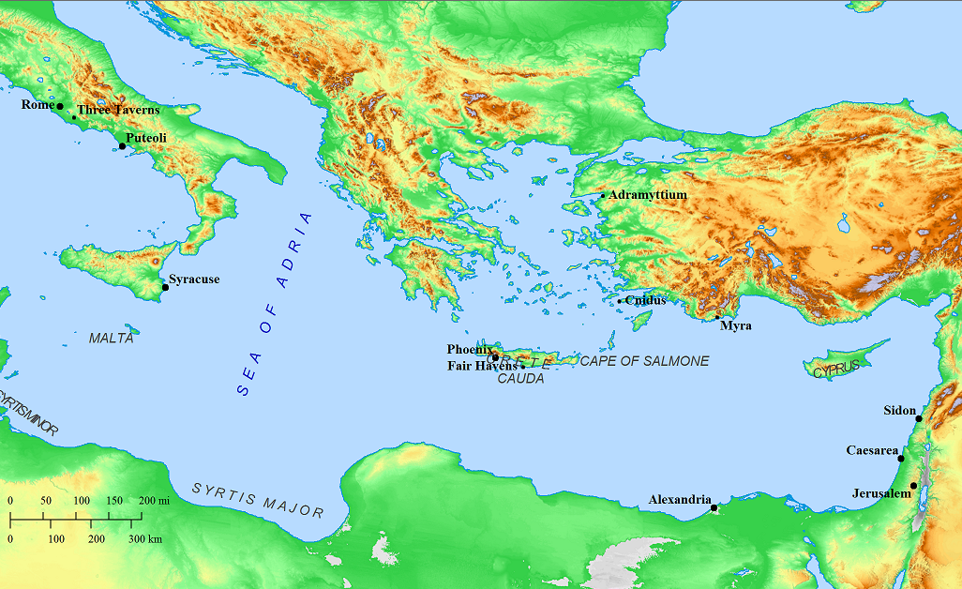

Slide 3
EPHESIANS
WHEN?
While in Prison
Ephesians 3:1 I, Paul, the prisoner of Christ Jesus
Ephesians 4:1 I, the prisoner of the Lord
Ephesians 6:20 I am an ambassador in chains
Colossians 4:18 Remember my imprisonment
Colossians 4:10 Aristarchus, my fellow prisoner
Philemon 1 Paul, a prisoner of Christ Jesus
Philemon 9 Paul, the aged, and now also a prisoner of Christ Jesus
Philemon 23 Epaphras, my fellow prisoner
Philippians 1:7, 13, 14, 17
my imprisonment
Philippians 1:13 the whole praetorian guard
Philippians 4:22 those of Caesar’s household
?
ROME

Slide 4
EPHESIANS
WHEN?
Same time as Colossians and Philemon
Paul’s messenger, Tychicus

Slide 5
EPHESIANS
WHEN?
Same time as Colossians and Philemon
Paul’s messenger, Tychicus
²¹ But that you also may know about my circumstances, how I am doing, Tychicus, the beloved brother and faithful minister in the Lord, will make everything known to you. ²² I have sent him to you for this very purpose, so that you may know about us, and that he may comfort your hearts.
⁷ As to all my affairs, Tychicus, our beloved brother and faithful servant and fellow bond-servant in the Lord, will bring you information. ⁸ For I have sent him to you for this very purpose, that you may know about our circumstances and that he may encourage your hearts
Ephesians 6
Colossians 4

Slide 6
EPHESIANS
WHEN?
Same time as Colossians and Philemon
Paul’s messenger, Tychicus
²¹ But that you also may know about my circumstances, how I am doing, Tychicus, the beloved brother and faithful minister in the Lord, will make everything known to you. ²² I have sent him to you for this very purpose, so that you may know about us, and that he may comfort your hearts.
⁷ As to all my affairs, Tychicus, our beloved brother and faithful servant and fellow bond-servant in the Lord, will bring you information. ⁸ For I have sent him to you for this very purpose, that you may know about our circumstances and that he may encourage your hearts
Ephesians 6
Colossians 4

Slide 7
EPHESIANS
WHEN?
Same time as Colossians and Philemon
Paul’s messenger, Tychicus
²¹ But that you also may know about my circumstances, how I am doing, Tychicus, the beloved brother and faithful minister in the Lord, will make everything known to you. ²² I have sent him to you for this very purpose, so that you may know about us, and that he may comfort your hearts.
⁷ As to all my affairs, Tychicus, our beloved brother and faithful servant and fellow bond-servant in the Lord, will bring you information. ⁸ For I have sent him to you for this very purpose, that you may know about our circumstances and that he may encourage your hearts
Ephesians 6
Colossians 4

Slide 8
EPHESIANS
WHEN?
Same time as Colossians and Philemon
Paul’s messenger, Tychicus
²¹ But that you also may know about my circumstances, how I am doing, Tychicus, the beloved brother and faithful minister in the Lord, will make everything known to you. ²² I have sent him to you for this very purpose, so that you may know about us, and that he may comfort your hearts.
⁷ As to all my affairs, Tychicus, our beloved brother and faithful servant and fellow bond-servant in the Lord, will bring you information. ⁸ For I have sent him to you for this very purpose, that you may know about our circumstances and that he may encourage your hearts
Ephesians 6
Colossians 4

Slide 9
EPHESIANS
WHEN?
Same time as Colossians and Philemon
Paul’s messenger, Tychicus
²¹ But that you also may know about my circumstances, how I am doing, Tychicus, the beloved brother and faithful minister in the Lord, will make everything known to you. ²² I have sent him to you for this very purpose, so that you may know about us, and that he may comfort your hearts.
⁷ As to all my affairs, Tychicus, our beloved brother and faithful servant and fellow bond-servant in the Lord, will bring you information. ⁸ For I have sent him to you for this very purpose, that you may know about our circumstances and that he may encourage your hearts
Ephesians 6
Colossians 4

Slide 10
EPHESIANS
WHEN?
Same time as Colossians and Philemon
Paul’s messenger, Tychicus
Geography of Colossae and Ephesus
²¹ But that you also may know about my circumstances, how I am doing, Tychicus, the beloved brother and faithful minister in the Lord, will make everything known to you. ²² I have sent him to you for this very purpose, so that you may know about us, and that he may comfort your hearts.
⁷ As to all my affairs, Tychicus, our beloved brother and faithful servant and fellow bond-servant in the Lord, will bring you information. ⁸ For I have sent him to you for this very purpose, that you may know about our circumstances and that he may encourage your hearts
Ephesians 6
Colossians 4

Slide 11
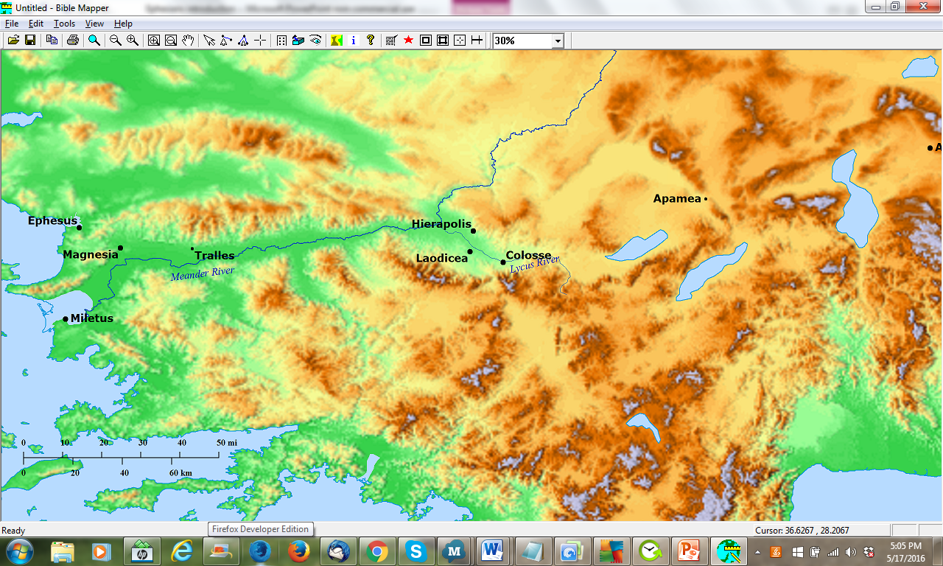
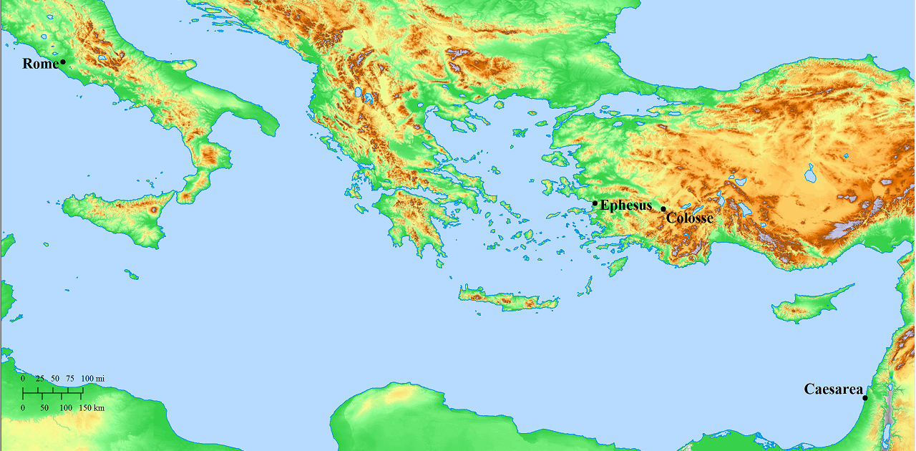
EPHESIANS
WHEN?
Same time as Colossians and Philemon
Paul’s messenger, Tychicus
Geography of Colossae and Ephesus
Via Egnatia
Via Appia
Thessalonica

Slide 12
EPHESIANS
WHEN?
Same time as Colossians and Philemon
Paul’s messenger, Tychicus
with Onesimus
²¹ But that you also may know about my circumstances, how I am doing, Tychicus, the beloved brother and faithful minister in the Lord, will make everything known to you. ²² I have sent him to you for this very purpose, so that you may know about us, and that he may comfort your hearts.
⁷ As to all my affairs, Tychicus, our beloved brother and faithful servant and fellow bond-servant in the Lord, will bring you information. ⁸ For I have sent him to you for this very purpose, that you may know about our circumstances and that he may encourage your hearts
Ephesians 6
Colossians 4

Slide 13
EPHESIANS
WHEN?
Same time as Colossians and Philemon
Paul’s messenger, Tychicus
with Onesimus
²¹ But that you also may know about my circumstances, how I am doing, Tychicus, the beloved brother and faithful minister in the Lord, will make everything known to you. ²² I have sent him to you for this very purpose, so that you may know about us, and that he may comfort your hearts.
⁷ As to all my affairs, Tychicus, our beloved brother and faithful servant and fellow bond-servant in the Lord, will bring you information. ⁸ For I have sent him to you… ⁹ and with him Onesimus, our faithful and beloved brother, who is one of your number.
¹⁰ I appeal to you for my child Onesimus, whom I have begotten in my imprisonment, ¹¹ who formerly was useless to you, but now is useful both to you and to me. ¹² I have sent him back to you in person
Ephesians 6
Colossians 4
Philemon

Slide 14
EPHESIANS
WHEN?
Same time as Colossians and Philemon
Paul’s messenger, Tychicus
with Onesimus
¹⁰ I appeal to you for my child Onesimus, whom I have begotten in my imprisonment, ¹¹ who formerly was useless to you, but now is useful both to you and to me. ¹² I have sent him back to you in person
⁷ As to all my affairs, Tychicus, our beloved brother and faithful servant and fellow bond-servant in the Lord, will bring you information. ⁸ For I have sent him to you… ⁹ and with him Onesimus, our faithful and beloved brother, who is one of your number.
Philemon
Colossians 4

Slide 15
EPHESIANS
WHEN?
Same time as Colossians and Philemon
Paul’s messenger, Tychicus
Paul’s companions
with Onesimus
²³ Epaphras, my fellow prisoner in Christ Jesus, greets you, ²⁴ as do Mark, Aristarchus, Demas, Luke, my fellow workers.
¹⁰ Aristarchus, my fellow
prisoner...
Barnabas’s cousin Mark…
¹¹ …Jesus who is called Justus… ¹² Epaphras, who is one of your number…
¹⁴ Luke, the beloved physician…and also Demas.
Philemon
Colossians 4

Slide 16
EPHESIANS
WHEN?
Same time as Colossians and Philemon
Paul’s messenger, Tychicus
Paul’s companions
with Onesimus
& Paul’s message to Archippus
¹ Paul, a prisoner of Christ Jesus, and Timothy our brother,
To Philemon our beloved brother and fellow worker, ² and to Apphia our sister, and to Archippus our fellow soldier, and to the church in your house…
¹⁷ Say to Archippus, “Take heed to the ministry which you have received in the Lord, that you may fulfill it.”
Philemon
Colossians 4

Slide 17

EPHESIANS
WHEN?
Same time as Colossians and Philemon
Paul’s messenger, Tychicus
Paul’s companions
with Onesimus
& Paul’s message to Archippus
¹ Paul, a prisoner of Christ Jesus, and Timothy our brother,
To Philemon our beloved brother and fellow worker, ² and to Apphia our sister, and to Archippus our fellow soldier, and to the church in your house…
¹⁷ Say to Archippus, “Take heed to the ministry which you have received in the Lord, that you may fulfill it.”
Philemon
Colossians 4

Slide 18
EPHESIANS
WHEN?
 |  | Ephesians |  | Colossians
All things are in Christ, who is the head of the body |  | 1:3-3:21 |  | 1:9-2:5
The body is to be built up, free from error and doctrines of men |  | 4:1-16 |  | 2:6-2:23
Put away sin; put on righteousness |  | 4:17-5:21 |  | 3:1-17
Instructions to household members… |  | 5:22-6:9 |  | 3:18-4:1
 | ...to wives |  | 5:22-24 |  | 3:18
 | ...to husbands |  | 5:25-33 |  | 3:19
 | ...to children |  | 6:1-3 |  | 3:20
 | ...to fathers |  | 6:4 |  | 3:21
 | ...to servants |  | 6:5-8 |  | 3:22-25
 | ...to masters |  | 6:9 |  | 4:1
Final exhortation, especially to pray, particularly on Paul’s behalf that he might preach the gospel |  | 6:10-20 |  | 4:2-6
Tychicus to make known Paul’s affairs to them |  | 6:21 |  | 4:7-8
Same time as Colossians and Philemon
Paul’s messenger, Tychicus
Paul’s companions
Similarity between Colossians and Ephesians
with Onesimus
& Paul’s message to Archippus

Slide 19
EPHESIANS
WHEN?
Ephesians
Colossians
Same time as Colossians and Philemon
Paul’s messenger, Tychicus
Paul’s companions
Similarity between Colossians and Ephesians
Be filled with the Spirit; speaking one to another in psalms and hymns and spiritual songs, singing and making melody with your heart to the Lord; giving thanks always for all things in the name of our Lord Jesus Christ to God, even the Father
Let the word of Christ dwell in you richly; in all wisdom teaching and admonishing one another with psalms and hymns and spiritual songs, singing with grace in your hearts unto God and whatsoever ye do, in word or in deed, do all in the name of the Lord Jesus, giving thanks to God the Father through him.

Slide 20
EPHESIANS
WHEN?
Ephesians
Colossians
Same time as Colossians and Philemon
Paul’s messenger, Tychicus
Paul’s companions
Similarity between Colossians and Ephesians
Be filled with the Spirit; speaking one to another in psalms and hymns and spiritual songs, singing and making melody with your heart to the Lord; giving thanks always for all things in the name of our Lord Jesus Christ to God, even the Father
Let the word of Christ dwell in you richly; in all wisdom teaching and admonishing one another with psalms and hymns and spiritual songs, singing with grace in your hearts unto God and whatsoever ye do, in word or in deed, do all in the name of the Lord Jesus, giving thanks to God the Father through him.

Slide 21
EPHESIANS
WHEN?
Ephesians
Colossians
Same time as Colossians and Philemon
Paul’s messenger, Tychicus
Paul’s companions
Similarity between Colossians and Ephesians
Be filled with the Spirit; speaking one to another in psalms and hymns and spiritual songs, singing and making melody with your heart to the Lord; giving thanks always for all things in the name of our Lord Jesus Christ to God, even the Father
Let the word of Christ dwell in you richly; in all wisdom teaching and admonishing one another with psalms and hymns and spiritual songs, singing with grace in your hearts unto God and whatsoever ye do, in word or in deed, do all in the name of the Lord Jesus, giving thanks to God the Father through him.

Slide 22
EPHESIANS
WHEN?
Ephesians
Colossians
Same time as Colossians and Philemon
Paul’s messenger, Tychicus
Paul’s companions
Similarity between Colossians and Ephesians
Be filled with the Spirit; speaking one to another in psalms and hymns and spiritual songs, singing and making melody with your heart to the Lord; giving thanks always for all things in the name of our Lord Jesus Christ to God, even the Father
Let the word of Christ dwell in you richly; in all wisdom teaching and admonishing one another with psalms and hymns and spiritual songs, singing with grace in your hearts unto God and whatsoever ye do, in word or in deed, do all in the name of the Lord Jesus, giving thanks to God the Father through him.

Slide 23
EPHESIANS
WHEN?
Ephesians
Colossians
Same time as Colossians and Philemon
Paul’s messenger, Tychicus
Paul’s companions
Similarity between Colossians and Ephesians
Be filled with the Spirit; speaking one to another in psalms and hymns and spiritual songs, singing and making melody with your heart to the Lord; giving thanks always for all things in the name of our Lord Jesus Christ to God, even the Father
Let the word of Christ dwell in you richly; in all wisdom teaching and admonishing one another with psalms and hymns and spiritual songs, singing with grace in your hearts unto God and whatsoever ye do, in word or in deed, do all in the name of the Lord Jesus, giving thanks to God the Father through him.

Slide 24
EPHESIANS
WHEN?
Ephesians
Colossians
Same time as Colossians and Philemon
Paul’s messenger, Tychicus
Paul’s companions
Similarity between Colossians and Ephesians
Be filled with the Spirit; speaking one to another in psalms and hymns and spiritual songs, singing and making melody with your heart to the Lord; giving thanks always for all things in the name of our Lord Jesus Christ to God, even the Father
Let the word of Christ dwell in you richly; in all wisdom teaching and admonishing one another with psalms and hymns and spiritual songs, singing with grace in your hearts unto God and whatsoever ye do, in word or in deed, do all in the name of the Lord Jesus, giving thanks to God the Father through him.

Slide 25
EPHESIANS
Ephesians | Colossians
WHEN?
Same time as Colossians and Philemon
Paul’s messenger, Tychicus
Paul’s companions
Similarity between Colossians and Ephesians
 | Ephesians |  | Colossians
1.1f | Παῦλος ἀπόστολος Χριστοῦ Ἰησοῦ διὰ θελήματος θεοῦ τοῖς ἁγίοις τοῖς οὖσιν [ἐν Ἐφέσῳ] καὶ πιστοῖς ἐν Χριστῷ Ἰησοῦ· χάρις ὑμῖν καὶ εἰρήνη ἀπὸ θεοῦ πατρὸς ἡμῶν | 1.1f | Παῦλος ἀπόστολος Χριστοῦ Ἰησοῦ διὰ θελήματος θεοῦ... τοῖς ἐν Κολοσσαῖς ἁγίοις καὶ πιστοῖς ἀδελφοῖς ἐν Χριστῷ· χάρις ὑμῖν καὶ εἰρήνη ἀπὸ θεοῦ πατρὸς ἡμῶν.
1.4 | ἁγίους καὶ ἀμώμους κατενώπιον αὐτοῦ | 1.22b | ἁγίους καὶ ἀμώμους καὶ ἀνεγκλήτους κατενώπιον αὐτοῦ
1.7a | ἐν ᾧ ἔχομεν τὴν ἀπολύτρωσιν | 1.14a | ἐν ᾧ ἔχομεν τὴν ἀπολύτρωσιν
1.7b | διὰ τοῦ αἵματος αὐτοῦ | 1.20 | διὰ τοῦ αἵματος τοῦ σταυροῦ αὐτοῦ
1.7c | τὴν ἄφεσιν τῶν παραπτωμάτων | 1.14b | τὴν ἄφεσιν τῶν ἁμαρτιῶν
1.8 | ἐν πάσῃ σοφίᾳ καὶ φρονήσει | 1.9c | ἐν πάσῃ σοφίᾳ καὶ συνέσει πνευματικῇ
1.9 | τὸ μυστήριον τοῦ θελήματος αὐτοῦ | 1.9b | τὴν ἐπίγνωσιν τοῦ θελήματος αὐτοῦ
1.10 | τὰ ἐπὶ τοῖς οὐρανοῖς καὶ τὰ ἐπὶ τῆς γῆς | 1.20 | εἴτε τὰ ἐπὶ τῆς γῆς εἴτε τὰ ἐν τοῖς οὐρανοῖς
1.11f | ποτὲ ὑμεῖς τὰ ἔθνη ἐν σαρκί...ἀπηλλοτριωμένοι τῆς πολιτείας τοῦ Ἰσραὴλ | 1.21 | καὶ ὑμᾶς ποτε ὄντας ἀπηλλοτριωμένους καὶ ἐχθροὺς
1.13 | ὑμεῖς ἀκούσαντες τὸν λόγον τῆς ἀληθείας, τὸ εὐαγγέλιον τῆς σωτηρίας ὑμῶν | 1.5 | ἣν προηκούσατε ἐν τῷ λόγῳ τῆς ἀληθείας τοῦ εὐαγγελίου
1.15 | ἀκούσας τὴν καθ’ ὑμᾶς πίστιν ἐν τῷ κυρίῳ Ἰησοῦ καὶ τὴν ἀγάπην τὴν εἰς πάντας τοὺς ἁγίους | 1.4 | ἀκούσαντες τὴν πίστιν ὑμῶν καὶ τὴν ἀγάπην ἣν ἔχετε εἰς πάντας τοὺς ἁγίους
1.16 | οὐ παύομαι εὐχαριστῶν ὑπὲρ ὑμῶν μνείαν ποιούμενος ἐπὶ τῶν προσευχῶν μου | 1.9a | οὐ παυόμεθα ὑπὲρ ὑμῶν προσευχόμενοι καὶ αἰτούμενοι
1.18 | τίς ὁ πλοῦτος τῆς δόξης | 1.27 | τί τὸ πλοῦτος τῆς δόξης
1.21 | ὑπεράνω πάσης ἀρχῆς καὶ ἐξουσίας καὶ δυνάμεως καὶ κυριότητος | 1.16 | εἴτε θρόνοι εἴτε κυριότητες εἴτε ἀρχαὶ εἴτε ἐξουσίαι
1.22f | καὶ αὐτὸν ἔδωκεν κεφαλὴν ὑπὲρ πάντα τῇ ἐκκλησίᾳ, ἥτις ἐστὶν τὸ σῶμα αὐτοῦ | 1.18 | καὶ αὐτός ἐστιν ἡ κεφαλὴ τοῦ σώματος, τῆς ἐκκλησίας
2.1 | Καὶ ὑμᾶς ὄντας νεκροὺς τοῖς παραπτώμασιν καὶ ταῖς ἁμαρτίαις ὑμῶν | 2.13a | καὶ ὑμᾶς νεκροὺς ὄντας τοῖς παραπτώμασιν
2.2f | ἐν αἷς ποτε περιεπατήσατε κατὰ τὸν αἰῶνα τοῦ κόσμου τούτου, κατὰ τὸν ἄρχοντα τῆς ἐξουσίας τοῦ ἀέρος, τοῦ πνεύματος τοῦ νῦν ἐνεργοῦντος ἐν τοῖς υἱοῖς τῆς ἀπειθείας· ἐν οἷς καὶ ἡμεῖς πάντες ἀνεστράφημέν ποτε ἐν ταῖς ἐπιθυμίαις τῆς σαρκὸς ἡμῶν, ποιοῦντες τὰ θελήματα τῆς σαρκὸς καὶ τῶν διανοιῶν, καὶ ἤμεθα τέκνα φύσει ὀργῆς | 3.6f | δι’ ἃ ἔρχεται ἡ ὀργὴ τοῦ θεοῦ [ἐπὶ τοὺς υἱοὺς τῆς ἀπειθείας]· ἐν οἷς καὶ ὑμεῖς περιεπατήσατέ ποτε ὅτε ἐζῆτε ἐν τούτοις.
2.5 | καὶ ὄντας ἡμᾶς νεκροὺς τοῖς παραπτώμασιν συνεζωοποίησεν τῷ Χριστῷ | 2.13b | καὶ ὑμᾶς νεκροὺς ὄντας τοῖς παραπτώμασιν...συνεζωοποίησεν ὑμᾶς σὺν αὐτῷ
2.13fff | ἐγενήθητε ἐγγὺς ἐν τῷ αἵματι τοῦ Χριστοῦ. Αὐτὸς γάρ ἐστιν ἡ εἰρήνη ἡμῶν, ὁ ποιήσας τὰ ἀμφότερα ἓν ... ἵνα τοὺς δύο κτίσῃ ἐν αὑτῷ εἰς ἕνα καινὸν ἄνθρωπον ποιῶν εἰρήνην, καὶ ἀποκαταλλάξῃ τοὺς ἀμφοτέρους ἐν ἑνὶ σώματι τῷ θεῷ διὰ τοῦ σταυροῦ | 1.20ff | καὶ δι’ αὐτοῦ ἀποκαταλλάξαι τὰ πάντα εἰς αὐτόν, εἰρηνοποιήσας διὰ τοῦ αἵματος τοῦ σταυροῦ αὐτοῦ, [δι’ αὐτοῦ] εἴτε τὰ ἐπὶ τῆς γῆς εἴτε τὰ ἐν τοῖς οὐρανοῖς. Καὶ ὑμᾶς ποτε ὄντας ἀπηλλοτριωμένους καὶ ἐχθροὺς τῇ διανοίᾳ ἐν τοῖς ἔργοις τοῖς πονηροῖς, νυνὶ δὲ ἀποκατηλλάγητε ἐν τῷ σώματι τῆς σαρκὸς αὐτοῦ διὰ τοῦ θανάτου, παραστῆσαι ὑμᾶς ἁγίους καὶ ἀμώμους καὶ ἀνεγκλήτους κατενώπιον αὐτοῦ
2.15 | τὸν νόμον τῶν ἐντολῶν ἐν δόγμασιν | 2.14 | χειρόγραφον τοῖς δόγμασιν
3.2 | τὴν οἰκονομίαν τῆς χάριτος τοῦ θεοῦ τῆς δοθείσης μοι εἰς ὑμᾶς | 1.25 | τὴν οἰκονομίαν τοῦ θεοῦ τὴν δοθεῖσάν μοι εἰς ὑμᾶς
3.4f | τῷ μυστηρίῳ τοῦ Χριστοῦ, ὃ ἑτέραις γενεαῖς οὐκ ἐγνωρίσθη | 1.26a | τὸ μυστήριον τὸ ἀποκεκρυμμένον ἀπὸ τῶν αἰώνων καὶ ἀπὸ τῶν γενεῶν
3.5 | ὡς νῦν ἀπεκαλύφθη τοῖς ἁγίοις ἀποστόλοις αὐτοῦ καὶ προφήταις ἐν πνεύματι | 1.26b | νῦν δὲ ἐφανερώθη τοῖς ἁγίοις αὐτοῦ
3.7a | οὗ ἐγενήθην διάκονος | 1.23 | οὗ ἐγενόμην ἐγὼ Παῦλος διάκονος
3.7b | κατὰ τὴν ἐνέργειαν τῆς δυνάμεως αὐτοῦ. | 1.29 | κατὰ τὴν ἐνέργειαν αὐτοῦ τὴν ἐνεργουμένην ἐν ἐμοὶ ἐν δυνάμει.
3.16 | τὸ πλοῦτος τῆς δόξης αὐτοῦ | 1.27 | τί τὸ πλοῦτος τῆς δόξης
3.17 | ἐν ἀγάπῃ ἐρριζωμένοι καὶ τεθεμελιωμένοι | 2.7 | ἐρριζωμένοι καὶ ἐποικοδομούμενοι ἐν αὐτῷ
4.1 | ἀξίως περιπατῆσαι τῆς κλήσεως | 1.10 | περιπατῆσαι ἀξίως τοῦ κυρίου
4.2 | ταπεινοφροσύνης καὶ πραΰτητος, μετὰ μακροθυμίας, ἀνεχόμενοι ἀλλήλων | 3.12f | ταπεινοφροσύνην, πραΰτητα, μακροθυμίαν, ἀνεχόμενοι ἀλλήλων
4.16 | ἐξ οὗ πᾶν τὸ σῶμα συναρμολογούμενον καὶ συμβιβαζόμενον διὰ πάσης ἁφῆς τῆς ἐπιχορηγίας κατ’ ἐνέργειαν ἐν μέτρῳ ἑνὸς ἑκάστου μέρους τὴν αὔξησιν τοῦ σώματος ποιεῖται | 2.19 | πᾶν τὸ σῶμα διὰ τῶν ἁφῶν καὶ συνδέσμων ἐπιχορηγούμενον καὶ συμβιβαζόμενον αὔξει τὴν αὔξησιν τοῦ θεοῦ
4.22ff | ἀποθέσθαι ὑμᾶς κατὰ τὴν προτέραν ἀναστροφὴν τὸν παλαιὸν ἄνθρωπον τὸν φθειρόμενον κατὰ τὰς ἐπιθυμίας τῆς ἀπάτης, 23 ἀνανεοῦσθαι δὲ τῷ πνεύματι τοῦ νοὸς ὑμῶν, 24 καὶ ἐνδύσασθαι τὸν καινὸν ἄνθρωπον τὸν κατὰ θεὸν κτισθέντα ἐν δικαιοσύνῃ καὶ ὁσιότητι τῆς ἀληθείας. | 3.9f | ἀπεκδυσάμενοι τὸν παλαιὸν ἄνθρωπον σὺν ταῖς πράξεσιν αὐτοῦ, καὶ ἐνδυσάμενοι τὸν νέον τὸν ἀνακαινούμενον εἰς ἐπίγνωσιν κατ’ εἰκόνα τοῦ κτίσαντος αὐτόν
4.25 | ἀποθέμενοι | 3.8a | ἀπόθεσθε
4.29 | πᾶς λόγος σαπρὸς ἐκ τοῦ στόματος ὑμῶν μὴ ἐκπορευέσθω | 3.8b | αἰσχρολογίαν ἐκ τοῦ στόματος ὑμῶν
4.32 | χαριζόμενοι ἑαυτοῖς καθὼς καὶ ὁ θεὸς ἐν Χριστῷ ἐχαρίσατο ὑμῖν. | 3.13 | καθὼς καὶ ὁ κύριος ἐχαρίσατο ὑμῖν οὕτως καὶ ὑμεῖς
5.3 | πορνεία δὲ καὶ ἀκαθαρσία πᾶσα ἢ πλεονεξία | 3.5a | πορνείαν, ἀκαθαρσίαν, πάθος, ἐπιθυμίαν κακήν, καὶ τὴν πλεονεξίαν
5.5 | πλεονέκτης, ὅ ἐστιν εἰδωλολάτρης | 3.5b | πλεονεξίαν ἥτις ἐστὶν εἰδωλολατρία
5.6 | διὰ ταῦτα γὰρ ἔρχεται ἡ ὀργὴ τοῦ θεοῦ ἐπὶ τοὺς υἱοὺς τῆς ἀπειθείας. | 3.6 | δι’ ἃ ἔρχεται ἡ ὀργὴ τοῦ θεοῦ [ἐπὶ τοὺς υἱοὺς τῆς ἀπειθείας]
5.15f | Βλέπετε οὖν ἀκριβῶς πῶς περιπατεῖτε, μὴ ὡς ἄσοφοι ἀλλ’ ὡς σοφοί, ἐξαγοραζόμενοι τὸν καιρόν | 4.5 | Ἐν σοφίᾳ περιπατεῖτε πρὸς τοὺς ἔξω, τὸν καιρὸν ἐξαγοραζόμενοι.
5.19f | λαλοῦντες ἑαυτοῖς [ἐν] ψαλμοῖς καὶ ὕμνοις καὶ ᾠδαῖς πνευματικαῖς, ᾄδοντες καὶ ψάλλοντες τῇ καρδίᾳ ὑμῶν τῷ κυρίῳ, εὐχαριστοῦντες πάντοτε ὑπὲρ πάντων ἐν ὀνόματι τοῦ κυρίου ἡμῶν Ἰησοῦ Χριστοῦ τῷ θεῷ καὶ πατρί | 3.16f | διδάσκοντες καὶ νουθετοῦντες ἑαυτοὺς ψαλμοῖς, ὕμνοις, ᾠδαῖς πνευματικαῖς ἐν χάριτι ᾄδοντες ἐν ταῖς καρδίαις ὑμῶν τῷ θεῷ· καὶ πᾶν ὅ τι ἐὰν ποιῆτε ἐν λόγῳ ἢ ἐν ἔργῳ, πάντα ἐν ὀνόματι κυρίου Ἰησοῦ, εὐχαριστοῦντες τῷ θεῷ πατρὶ δι’ αὐτοῦ.
5.22 | Αἱ γυναῖκες τοῖς ἰδίοις ἀνδράσιν ὡς τῷ κυρίῳ | 3.18 | Αἱ γυναῖκες, ὑποτάσσεσθε τοῖς ἀνδράσιν, ὡς ἀνῆκεν ἐν κυρίῳ.
5.25 | Οἱ ἄνδρες, ἀγαπᾶτε τὰς γυναῖκας | 3.19 | Οἱ ἄνδρες, ἀγαπᾶτε τὰς γυναῖκας
5.27 | ἵνα παραστήσῃ αὐτὸς ἑαυτῷ ἔνδοξον τὴν ἐκκλησίαν... ἵνα ᾖ ἁγία καὶ ἄμωμος. | 1.22a | παραστῆσαι ὑμᾶς ἁγίους καὶ ἀμώμους
6.1 | Τὰ τέκνα, ὑπακούετε τοῖς γονεῦσιν ὑμῶν ἐν κυρίῳ, τοῦτο γάρ ἐστιν δίκαιον | 3.20 | Τὰ τέκνα, ὑπακούετε τοῖς γονεῦσιν κατὰ πάντα, τοῦτο γὰρ εὐάρεστόν ἐστιν ἐν κυρίῳ.
6.4 | Καὶ οἱ πατέρες, μὴ παροργίζετε τὰ τέκνα ὑμῶν | 3.21 | Οἱ πατέρες, μὴ ἐρεθίζετε τὰ τέκνα ὑμῶν
6.5fff | Οἱ δοῦλοι, ὑπακούετε τοῖς κατὰ σάρκα κυρίοις μετὰ φόβου καὶ τρόμου ἐν ἁπλότητι τῆς καρδίας ὑμῶν ὡς τῷ Χριστῷ, μὴ κατ’ ὀφθαλμοδουλίαν ὡς ἀνθρωπάρεσκοι ἀλλ’ ὡς δοῦλοι Χριστοῦ ποιοῦντες τὸ θέλημα τοῦ θεοῦ ἐκ ψυχῆς, μετ’ εὐνοίας δουλεύοντες, ὡς τῷ κυρίῳ καὶ οὐκ ἀνθρώποις, εἰδότες ὅτι ἕκαστος, ἐάν τι ποιήσῃ ἀγαθόν, τοῦτο κομίσεται παρὰ κυρίου | 3.22ff | Οἱ δοῦλοι, ὑπακούετε κατὰ πάντα τοῖς κατὰ σάρκα κυρίοις, μὴ ἐν ὀφθαλμοδουλίᾳ ὡς ἀνθρωπάρεσκοι, ἀλλ’ ἐν ἁπλότητι καρδίας, φοβούμενοι τὸν κύριον. ὃ ἐὰν ποιῆτε, ἐκ ψυχῆς ἐργάζεσθε, ὡς τῷ κυρίῳ καὶ οὐκ ἀνθρώποις, εἰδότες ὅτι ἀπὸ κυρίου ἀπολήμψεσθε τὴν ἀνταπόδοσιν τῆς κληρονομίας. τῷ κυρίῳ Χριστῷ δουλεύετε·
6.9a | Καὶ οἱ κύριοι, τὰ αὐτὰ ποιεῖτε πρὸς αὐτούς, ἀνιέντες τὴν ἀπειλήν, εἰδότες ὅτι καὶ αὐτῶν καὶ ὑμῶν ὁ κύριός ἐστιν ἐν οὐρανοῖς | 4.1 | Οἱ κύριοι, τὸ δίκαιον καὶ τὴν ἰσότητα τοῖς δούλοις παρέχεσθε, εἰδότες ὅτι καὶ ὑμεῖς ἔχετε κύριον ἐν οὐρανῷ.
6.9b | προσωπολημψία οὐκ ἔστιν | 3.25 | καὶ οὐκ ἔστιν προσωπολημψία.
6.18ff | διὰ πάσης προσευχῆς καὶ δεήσεως προσευχόμενοι ἐν παντὶ καιρῷ ἐν πνεύματι, καὶ εἰς αὐτὸ ἀγρυπνοῦντες ἐν πάσῃ προσκαρτερήσει καὶ δεήσει περὶ πάντων τῶν ἁγίων, καὶ ὑπὲρ ἐμοῦ, ἵνα μοι δοθῇ λόγος ἐν ἀνοίξει τοῦ στόματός μου, ἐν παρρησίᾳ γνωρίσαι τὸ μυστήριον τοῦ εὐαγγελίου ὑπὲρ οὗ πρεσβεύω ἐν ἁλύσει, ἵνα ἐν αὐτῷ παρρησιάσωμαι ὡς δεῖ με λαλῆσαι. | 4.2ff | Τῇ προσευχῇ προσκαρτερεῖτε, γρηγοροῦντες ἐν αὐτῇ ἐν εὐχαριστίᾳ, προσευχόμενοι ἅμα καὶ περὶ ἡμῶν, ἵνα ὁ θεὸς ἀνοίξῃ ἡμῖν θύραν τοῦ λόγου, λαλῆσαι τὸ μυστήριον τοῦ Χριστοῦ, δι’ ὃ καὶ δέδεμαι, ἵνα φανερώσω αὐτὸ ὡς δεῖ με λαλῆσαι.
6.21f | Ἵνα δὲ καὶ ὑμεῖς εἰδῆτε τὰ κατ’ ἐμέ, τί πράσσω, πάντα γνωρίσει ὑμῖν Τυχικὸς ὁ ἀγαπητὸς ἀδελφὸς καὶ πιστὸς διάκονος ἐν κυρίῳ, ὃν ἔπεμψα πρὸς ὑμᾶς εἰς αὐτὸ τοῦτο ἵνα γνῶτε τὰ περὶ ἡμῶν καὶ παρακαλέσῃ τὰς καρδίας ὑμῶν. | 4.7f | Τὰ κατ’ ἐμὲ πάντα γνωρίσει ὑμῖν Τυχικὸς ὁ ἀγαπητὸς ἀδελφὸς καὶ πιστὸς διάκονος καὶ σύνδουλος ἐν κυρίῳ, ὃν ἔπεμψα πρὸς ὑμᾶς εἰς αὐτὸ τοῦτο, ἵνα γνῶτε τὰ περὶ ἡμῶν καὶ παρακαλέσῃ τὰς καρδίας ὑμῶν
6.24 | ἡ χάρις μετὰ πάντων τῶν ἀγαπώντων τὸν κύριον ἡμῶν Ἰησοῦν Χριστὸν | 4.18 | ἡ χάρις μεθ’ ὑμῶν.
51
“Passages”
with
similar language

Slide 26
EPHESIANS
WHEN?
 |  | Ephesians |  | Colossians
All things are in Christ, who is the head of the body |  | 1:3-3:21 |  | 1:9-2:5
The body is to be built up, free from error and doctrines of men |  | 4:1-16 |  | 2:6-2:23
Put away sin; put on righteousness |  | 4:17-5:21 |  | 3:1-17
Instructions to household members… |  | 5:22-6:9 |  | 3:18-4:1
 | ...to wives |  | 5:22-24 |  | 3:18
 | ...to husbands |  | 5:25-33 |  | 3:19
 | ...to children |  | 6:1-3 |  | 3:20
 | ...to fathers |  | 6:4 |  | 3:21
 | ...to servants |  | 6:5-8 |  | 3:22-25
 | ...to masters |  | 6:9 |  | 4:1
Final exhortation, especially to pray, particularly on Paul’s behalf that he might preach the gospel |  | 6:10-20 |  | 4:2-6
Tychicus to make known Paul’s affairs to them |  | 6:21 |  | 4:7-8
Same time as Colossians and Philemon
Paul’s messenger, Tychicus
Paul’s companions
Similarity between Colossians and Ephesians
Differences between Colossians and Ephesians

Slide 27
EPHESIANS
WHEN?
 |  | Ephesians |  | Colossians
All things are in Christ, who is the head of the body |  | 1:3-3:21 |  | 1:9-2:5
The body is to be built up, free from error and doctrines of men |  | 4:1-16 |  | 2:6-2:23
Put away sin; put on righteousness |  | 4:17-5:21 |  | 3:1-17
Instructions to household members… |  | 5:22-6:9 |  | 3:18-4:1
 | ...to wives |  | 5:22-24 |  | 3:18
 | ...to husbands |  | 5:25-33 |  | 3:19
 | ...to children |  | 6:1-3 |  | 3:20
 | ...to fathers |  | 6:4 |  | 3:21
 | ...to servants |  | 6:5-8 |  | 3:22-25
 | ...to masters |  | 6:9 |  | 4:1
Final exhortation, especially to pray, particularly on Paul’s behalf that he might preach the gospel |  | 6:10-20 |  | 4:2-6
Tychicus to make known Paul’s affairs to them |  | 6:21 |  | 4:7-8
Same time as Colossians and Philemon
Paul’s messenger, Tychicus
Paul’s companions
Similarity between Colossians and Ephesians
Differences between Colossians and Ephesians
the local problem at Colossae
When Paul is in Prison
    which prison?

Slide 28
EPHESIANS
From WHERE?
Ephesus
Onesimus’ likely destination
“Prepare a lodging”
Marcionite prologue
Caesarea
Onesimus’ likely destination
Rome
Likely the same imprisonment as Philippians
“Prisoner…in behalf of you Gentiles”

Slide 29
EPHESIANS
WHEN?
If from Ephesus
Date AD 52-55
If from Caesarea
Date AD 56-58
If from Rome
Date AD 60-64, probably earlier rather than later

Slide 30
EPHESIANS
To WHOM?
To Gentiles
2.11-13
2.17, 19
3.1
1.12
The church at Ephesus, made up of Jews
    Acts 18.19ff
    no mention of Gentiles or even proselytes
    Aquila and Priscilla
    Apollos and the 12 disciples
    In the synagogue, believing Jews opposed by unbelieving Jews
The idea that the letter was to the church at Ephesus
first seen in late 2nd century
Earliest testimony, was sent to Laodicea

Slide 31
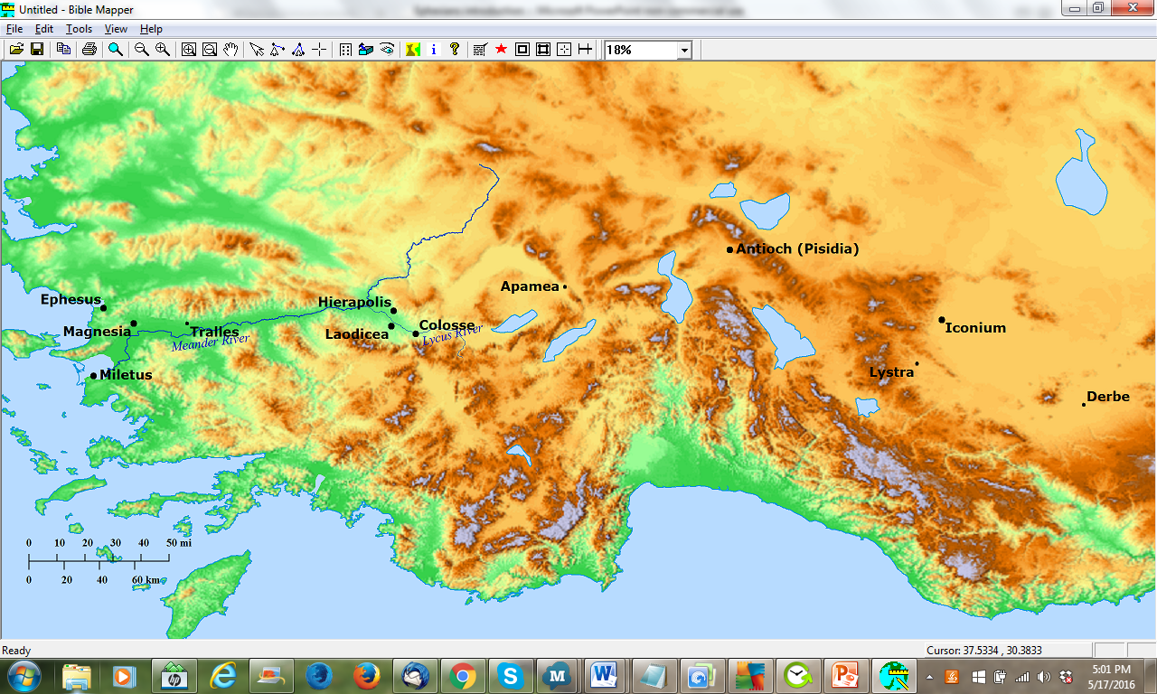
EPHESIANS
To WHOM?
To Gentiles
2.11-13
2.17, 19
3.1
1.12
The church at Ephesus, made up of Jews
    Acts 18.19ff
    no mention of Gentiles or even proselytes
    Aquila and Priscilla
    Apollos and the 12 disciples
    In the synagogue, believing Jews opposed by unbelieving Jews
The idea that the letter was to the church at Ephesus
first seen in late 2nd century
Earliest testimony, was sent to Laodicea
Why the discrepancy?

Slide 32
EPHESIANS
To WHOM?

Slide 33
EPHESIANS
To WHOM?
Pergamum
Thyatira
Smyrna
Sardis
3¹ For this reason I, Paul, the prisoner of Christ Jesus for the sake of you Gentiles— ² if indeed you have heard of the stewardship of God’s grace which was given to me for you; ³ that by revelation there was made known to me the mystery, as I wrote before in brief.
Philadelphia
Copy
Copy
Copy
Copy
Copy

Slide 34
EPHESIANS
To WHOM?
Marcion
Basil

Slide 35
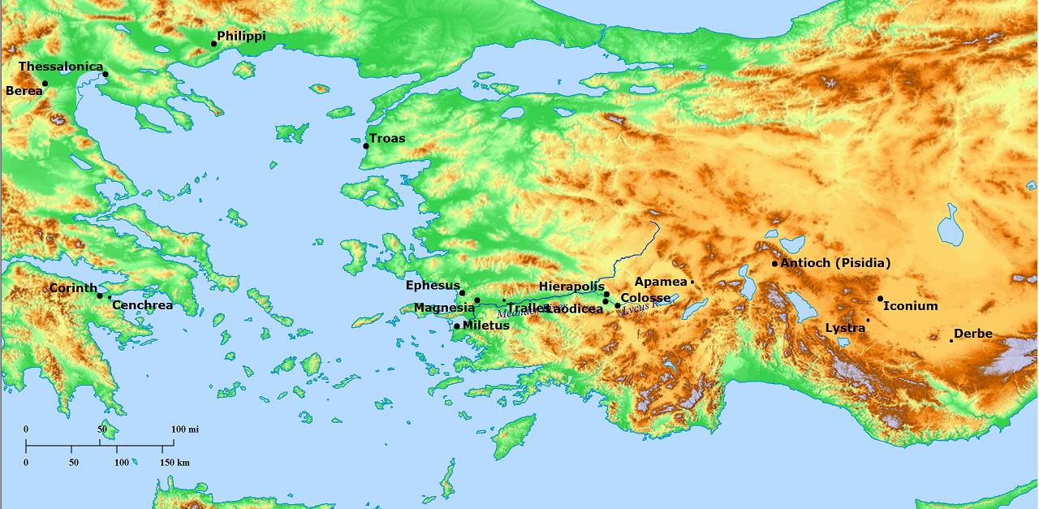
EPHESIANS
To WHOM?

Slide 36
EPHESIANS
The Message
Chapters 1-3 Look What God Has Done For You
chpt 1 blessings in Christ; you are God’s inheritance
chpt 2 you Gentiles were alienated, separated from God’s house,
but now you ARE God’s house!
chpt 3 (Paul’s interrupted prayer) I, Paul, have the great privilege of bringing this good news to you Gentiles
Chapters 4-6 Therefore, Walk Worthily of Your Calling
chpt 4:1-16 The Teachers: Gifts, whose teaching will produce unity, teaching you how to walk worthily
chpt 4:17-6:9 The Teaching: No longer walk as Gentiles walk
        Put on the new man, Don’t lie, Speak grace, be Kind, Be sexually pure, don’t participate in others’ sin, Be wise not drunk, Be filled with the spirit, wives submit to husbands, husbands love wives, children obey parents, fathers teach children, servants obey your masters, masters be kind to servants
chpt 6:10-20 Spiritual Armor
Dt. 4:20 “to be a people for His own possession”
Dt. 9:29 “they are Your people, even Your inheritance” (klēros)
1 Sam 10:1 “Has not the Lord anointed you a ruler over His inheritance?”
Objections to seeing a reference to the famous divider in the temple courts
“the wall in Jerusalem was still standing when Paul wrote this letter”
“it was probably unfamiliar to the average person in the churches around Ephesus.”
    Strabo (1st c. BC) mentioned the Temple
    Hecataeus (3rd c. BC) described it in detail
    Trophimus was an Ephesian! (Acts 21:27-29)
2:2 you formerly walked according to the course of this world
2:10 God afore prepared [good works] that we should walk in them
4:1 walk in a manner worthy of the calling
4:17 walk no longer just as the Gentiles also walk
5:2 walk in love
5:8 walk as children of Light
5:15 be careful how you walk

Slide 37
“Blessing”

Slide 38
“Redemption”

Slide 39
Elevated Themes
wealth
dispensation
heavens

Slide 40
Elevated Themes
wealth
wealth of his glory
rich in mercy
the wealth of his grace
unfathomable wealth of the Christ
surpassing wealth of his grace in kindness
wealth of the glory of his inheritance

Slide 41
Elevated Themes
wealth
dispensation

Slide 42
Elevated Themes
wealth
oikonomia
economia
economy
“a system of producing, distributing, and consuming wealth”

Slide 43
Elevated Themes
wealth
economy
“a system of producing, distributing, and consuming wealth”

Slide 44
Elevated Themes
wealth
economy
“a system of producing, dispensing, and consuming wealth”

Slide 45
Elevated Themes
wealth
dispensation
“a system of producing, dispensing, and consuming wealth”

Slide 46
Elevated Themes
wealth
dispensation
oikonomia = stewardship, estate management
oikonomos = steward, estate manager
Shebna (Isaiah 22.15)
“in charge of the royal household”
was about to be deposed from his oikonomia, i.e., his stewardship

Slide 47
Elevated Themes
wealth
dispensation
oikonomia = stewardship, estate management
oikonomos = steward, estate manager
Erastus
The oikonomos of the city of Corinth (Romans 16:23)

Slide 48
Elevated Themes
wealth
dispensation
oikonomia = stewardship, estate management
oikonomos = steward, estate manager
Joseph
In order to prepare Egypt for the coming famine, Pharaoh gave him the oikonomia
(Josephus, Antiquities 2, 89)

Slide 49
Elevated Themes
wealth
dispensation
oikonomia = stewardship, estate management
oikonomos = steward, estate manager
The Unrighteous Steward (Lk 16)
Was called to give account of his oikonomia (vs. 2)
He could no longer oikonomein (vs. 2)
The oikonomos said to himself, “what will I do?” (vs. 3)
What he did sheds light on his role as oikonomos; he managed the wealth

Slide 50
Elevated Themes
wealth
dispensation
oikonomia = stewardship, estate management
oikonomos = steward, estate manager
The Faithful Steward (Lk 12.42)
    the faithful oikonomos whom the Lord puts over the service of dispensing appropriate food allowances

Slide 51
Elevated Themes
wealth
dispensation
oikonomia = stewardship, estate management
oikonomos = steward, estate manager
    Paul uses this vocabulary to speak of the distribution of God’s wealth to those of His household

Slide 52
Elevated Themes
wealth
dispensation
oikonomia = stewardship, estate management
oikonomos = steward, estate manager
Paul, as an agent of the Lord, distributing the Lord’s wealth
    “the oikonomia of the grace of God that was given to me for you”
    (Ephesians 3.2)

Slide 53
Elevated Themes
wealth
dispensation
oikonomia = stewardship, estate management
oikonomos = steward, estate manager
The Lord Himself

Slide 54
Elevated Themes
having foreordained us to adoption
through Jesus Christ unto himself according to the good pleasure of his will,
unto praise of the glory of his grace which he graced us in the Beloved
One, in whom we have the redemption through his blood, the
forgiveness of the trespasses,
according to the wealth of his grace,
which he abundantly supplied to us in all wisdom and insight, having
made known to us the mystery of his will, according to his good pleasure, which he
planned in him unto an oikonomia
of the fullness of the times
wealth
dispensation
The Lord Himself

Slide 55
Elevated Themes
having foreordained us to adoption through Jesus Christ unto himself according to the good pleasure of his will, unto praise of the glory of his grace which he graced us in the Beloved One, in whom we have the redemption through his blood, the forgiveness of the trespasses, according to the wealth of his grace, which he abundantly supplied to us in all wisdom and insight, having made known to us the mystery of his will, according to his good pleasure, which he planned in him unto a dispensation of the fullness of the times
wealth
dispensation
The Lord Himself

Slide 56
Elevated Themes
having foreordained us to adoption through Jesus Christ unto himself according to the good pleasure of his will, unto praise of the glory of his grace which he graced us in the Beloved One, in whom we have the redemption through his blood, the forgiveness of the trespasses, according to the wealth of his grace, which he abundantly supplied to us in all wisdom and insight, having made known to us the mystery of his will, according to his good pleasure, which he planned in him unto a dispensation of the fullness of the times
wealth
dispensation
The Lord Himself

Slide 57
Elevated Themes
having foreordained us to adoption through Jesus Christ unto himself according to the good pleasure of his will, unto praise of the glory of his grace which he graced us in the Beloved One, in whom we have the redemption through his blood, the forgiveness of the trespasses, according to the wealth of his grace, which he abundantly supplied to us in all wisdom and insight, having made known to us the mystery of his will, according to his good pleasure, which he planned in him unto a dispensation of the fullness of the times
wealth
dispensation
The Lord Himself

Slide 58
Elevated Themes
wealth
dispensation
The Lord Himself
a planned distribution
at the appointed time planned in Christ, God’s grace would be distributed.
according to his good pleasure, which he planned in him unto a dispensation of the fullness of the times

Slide 59
Elevated Themes
wealth
dispensation
heavens
epouranios, adjective
ouranos, noun

Slide 60
Elevated Themes
wealth
dispensation
heavens
epouranios, adjective
2 Maccabees 3.39
God, “the one who has a heavenly dwelling”

Slide 61
Elevated Themes
wealth
dispensation
heavens
                But in Ephesians, epouranios
                is used as a substantive
Christ, seated at the right hand of God “in the epouranious”
(Eph 1.20)
is “in the heavens”

Slide 62
Elevated Themes
wealth
dispensation
heavens
spiritual things vs things of this earth
Colossians 3:2
  “the things above” vs “the things upon the earth”

Slide 63
Elevated Themes
wealth
dispensation
heavens
spiritual things vs things of this earth
blessings in the heavens (being made holy and blameless, adoption, being graced with grace, redemption, forgiveness of our trespasses) are in Christ.
God causes his sun to shine on the evil and the good and gives rain to the righteous and the unrighteous

Slide 64
Elevated Themes
wealth
dispensation
heavens
spiritual things vs things of this earth
blessings in the heavens (being made holy and blameless, adoption, being graced with grace, redemption, forgiveness of our trespasses) are in Christ.
THESE ARE THE EXALTED THINGS

Slide 65
Elevated Themes
God’s house
His inheritance 1:11, 18
His redeemed possession 1:14
His household 2:20
Ephesians 1:3-14
is a picture of God
dispensing heavenly wealth
to those of His house
in Christ
wealth
dispensation
of heavenly

Slide 66
We are God’s Inheritance
We inherit something
ASV we were made
a heritage
DR we also are called
by lot
RV we were made
a heritage
NET we too have been claimed
as God’s own possession
NIV we were also chosen
ESV we have obtained
an inheritance
NASB we have obtained
an inheritance
NKJV we have obtained
an inheritance
KJV we have obtained
an inheritance
CSB we have also received
an inheritance
HCSB We have also received
an inheritance
God’s house
His inheritance 1:11

Slide 67
God gets us
We get something
ASV we were made
a heritage
DR we also are called
by lot
RV we were made
a heritage
NET we too have been claimed
as God’s own possession
NIV we were also chosen
ESV we have obtained
an inheritance
NASB we have obtained
an inheritance
NKJV we have obtained
an inheritance
KJV we have obtained
an inheritance
CSB we have also received
an inheritance
HCSB We have also received
an inheritance

Slide 68
We are God’s Inheritance
ASV we were made
a heritage
DR we also are called
by lot
RV we were made
a heritage
NET we too have been claimed
as God’s own possession
NIV we were also chosen

Slide 69
We are God’s Inheritance
ἐν ᾧ καὶ ἐκληρώθημεν
in whom also we were allotted

Slide 70
We are God’s Inheritance
ἐν ᾧ καὶ ἐκληρόω
“allot”

Slide 71
We are God’s Inheritance
verb
klēroō
“allot”
noun
klēros
“lot”
“allotment”

Slide 72
We are God’s Inheritance
verb
klēroō
“allot”
noun
klēros
“lot”
“allotment”
Related to
klēronomos
“heir”
lot - law (?)
and
klēronomia
“inheritance”

Slide 73
We are God’s Inheritance
in whom also we were allotted
unto our being for the praise of his glory
Alford (translated):
  “followed…not by unto our having something,
  but by unto our being something,
  and thus pointing at something which
  ‘we’ are to become, not to possess.”

Slide 74
We are God’s Inheritance
in whom also we were allotted
result is our being something
concept of God’s inheritance in OT
they are Your people, even Your inheritance (Dt 9.29)
the Lord anointed you a ruler over His inheritance (1 Sam 10.1)
You have separated them from all the peoples of the earth as Your inheritance (1 Ki 8.53)
The people whom He has chosen for His own inheritance
(Ps 33.12)
That I may glory with Your inheritance (Ps 106.5)
they are Your people and Your inheritance (1 Ki 8.51)
I will abandon the remnant of My inheritance (2 Ki 21.14)
O God, You confirmed Your inheritance (Ps 68.9)
Israel My inheritance (Is 19.25)
the remnant of His possession (Mic 7.18)
the Lord has taken you… to be a people for His own possession (Dt 4.20)
In most of these, the LXX has klēronomia

Slide 75
We are God’s Inheritance
in whom also we were allotted
result is our being something
concept of God’s inheritance in OT
Lord God, do not destroy Your people, even Your inheritance (Dt 9.26)
they are Your people, even Your inheritance (Dt 9.29)
the Lord has taken you… to be a people for His own possession (Dt 4.20)
LXX klēros

Slide 76
We are God’s Inheritance
in whom also we were allotted
result is our being something
concept of God’s inheritance in OT
the Lord has taken you… to be a people for His own possession (Dt 4.20)
LXX egklēros

Slide 77
We are God’s Inheritance
in whom also we were allotted
result is our being something
concept of God’s inheritance in OT
Numbers 18.24, of the Levites
“…therefore I have said concerning them,
‘They shall have no inheritance among the sons of Israel.’”
ou klēronomēsousin klēron
= they shall not inherit a lot

Slide 78
We are God’s Inheritance
in whom also we were allotted
result is our being something
concept of God’s inheritance in OT
Joshua 17.4
…“The Lord commanded Moses to give us an inheritance among our brothers.” So according to the command of the Lord he gave them an inheritance among their father’s brothers.
klēronomia
klēros

Slide 79
We are God’s Inheritance
in whom also we were allotted
result is our being something
concept of God’s inheritance in OT
2 points:
God’s people as God’s inheritance is a well established idea
There is precedent for using the word group klēro- for God’s inheritance.

Slide 80
We are God’s Inheritance
in whom also we were allotted
in whom also we were allotted
unto our being for the praise of his glory
result is our being something
concept of God’s inheritance in OT
Overall context of Ephesians 1
Eph 1.14…unto redemption of the possession unto praise of his glory
Eph 1.18…what is the wealth of the glory of his inheritance in the saints

Slide 81
We are God’s Inheritance
in whom also we were allotted
result is our being something
concept of God’s inheritance in OT
Overall context of Ephesians 1
Eph 1.14 which is a seal of
our inheritance
Eph 1.14…unto redemption of the possession unto praise of his glory
Eph 1.18…what is the wealth of the glory of his inheritance in the saints

Slide 82
We are God’s Inheritance
in whom also we were allotted
OR
result is our being something
concept of God’s inheritance in OT
Overall context of Ephesians 1
Eph 1.14 which is a seal of
our inheritance
Eph 1.14…unto redemption of the possession unto praise of his glory
Eph 1.18…what is the wealth of the glory of his inheritance in the saints

Slide 83
We are God’s Inheritance
in whom also we were allotted
result is our being something
concept of God’s inheritance in OT
Overall context of Ephesians 1
Eph 1.14 which is a seal of the
our inheritance
Eph 1.14…unto redemption of the possession unto praise of his glory
inheritance of us
obj. genitive
inheritance of money
The money is the thing that is inherited,
not the thing that inherits
Eph 1.18…what is the wealth of the glory of his inheritance in the saints

Slide 84
We are God’s Inheritance
in whom also we were allotted
result is our being something
concept of God’s inheritance in OT
Overall context of Ephesians 1
Eph 1.14 which is a seal of the
inheritance of us
Eph 1.14…unto redemption of the possession unto praise of his glory
God had been deprived of this allotment
because of our sin
However, in Christ,
God redeems his possession
Eph 1.18…what is the wealth of the glory of his inheritance in the saints

Slide 85
Elevated Themes
God’s house
His inheritance 1:11, 18
His redeemed possession 1:14
His household 2:20
Ephesians 1:3-14
is a picture of God
dispensing heavenly wealth
to those of His house
in Christ
wealth
of heavenly
dispensation

Slide 86
Elevated Themes
God’s house
His inheritance 1:11, 18
His redeemed possession 1:14
His household 2:20
wealth
God has sealed
his inheritance,
his possession,
to himself
of heavenly
dispensation

Slide 87
The Sealing of God’s Inheritance
in whom we were allotted, having been predetermined according to a plan of the one who works all things according to the counsel of his will,

Slide 88
The Sealing of God’s Inheritance
in whom we were allotted, having been predetermined according to a plan of the one who works all things according to the counsel of his will,
3:11 according to a purpose from eternity which he made in Christ Jesus our Lord

Slide 89
The Sealing of God’s Inheritance
in whom we were allotted, having been predetermined according to a plan of the one who works all things according to the counsel of his will,
such that we who had previously
hoped in the Christ would be
to the praise of his glory,
Jews had long been hoping for the Messiah!
Notice, God’s plan would mean that Jews would be “to the praise of his glory”

Slide 90
The Sealing of God’s Inheritance
in whom we were allotted, having been predetermined according to a plan of the one who works all things according to the counsel of his will,
such that we who had previously
hoped in the Christ would be
to the praise of his glory,
in whom you also,
Gentiles!
Cf. 2:11ff, 2:19, 3:1 & 2:1-5

Slide 91
The Sealing of God’s Inheritance
in whom we were allotted, having been predetermined according to a plan of the one who works all things according to the counsel of his will,
such that we who had previously
hoped in the Christ would be
to the praise of his glory,
in whom you also,
having heard the word of the promise,
the good news of your salvation,
in whom you, having also believed,
were sealed by the promised Holy Spirit,
Gentiles who heard and believed were sealed

Slide 92
The Sealing of God’s Inheritance
in whom we were allotted, having been predetermined according to a plan of the one who works all things according to the counsel of his will,
such that we who had previously
hoped in the Christ would be
to the praise of his glory,
in whom you also,
having heard the word of the promise,
the good news of your salvation,
in whom you, having also believed,
were sealed by the promised Holy Spirit,
which is a seal of our inheritance,
unto redemption of the possession
unto praise of his glory.
The Holy Spirit is the seal of our (all of us, Jews & Gentiles) being inherited

Slide 93
The Sealing of God’s Inheritance
in whom we were allotted, having been predetermined according to a plan of the one who works all things according to the counsel of his will,
such that we who had previously
hoped in the Christ would be
to the praise of his glory,
in whom you also,
having heard the word of the promise,
the good news of your salvation,
in whom you, having also believed,
were sealed by the promised Holy Spirit,
which is a seal of our inheritance,
unto redemption of the possession
unto praise of his glory.
we Jews
God’s plan would mean that Jews would be
“to the praise of his glory”
you Gentiles
God’s plan would mean that all of us (Jews & Gentiles) would be
“to the praise of his glory”
all of us

Slide 94
The Sealing of God’s Inheritance
in whom we were allotted, having been predetermined according to a plan of the one who works all things according to the counsel of his will,
such that we who had previously
hoped in the Christ would be
to the praise of his glory,
in whom you also,
having heard the word of the promise,
the good news of your salvation,
in whom you, having also believed,
were sealed by the promised Holy Spirit,
which is a seal of our inheritance,
unto redemption of the possession
unto praise of his glory.
not the same word

Slide 95
The Sealing of God’s Inheritance
in whom we were allotted, having been predetermined according to a plan of the one who works all things according to the counsel of his will,
such that we who had previously
hoped in the Christ would be
to the praise of his glory,
in whom you also,
having heard the word of the promise,
the good news of your salvation,
in whom you, having also believed,
were sealed by the promised Holy Spirit,
which is a seal of our inheritance,
unto redemption of the possession
unto praise of his glory.
not the same word

Slide 96
The Sealing of God’s Inheritance
in whom we were allotted, having been predetermined according to a plan of the one who works all things according to the counsel of his will,
such that we who had previously
hoped in the Christ would be
to the praise of his glory,
in whom you also,
having heard the word of the promise,
the good news of your salvation,
in whom you, having also believed,
were sealed by the promised Holy Spirit,
which is a seal of our inheritance,
unto redemption of the possession
unto praise of his glory.
the usual word
arrabōn
BDAG: “first installment, deposit, down payment, pledge”
We’ll come back to this

Slide 97
The Sealing of God’s Inheritance
Ideas associated with sealing
  Identification
    e.g. a decree authenticated by a seal
    (1 Ki 21.8, Neh 10.1, Est 3.10, 8.8, 8.10, et al.).
  Protection
    marked and consequently spared
    (Rev 7.3f).
  Closing
    e.g. Jesus’ tomb being sealed (Mt 27.66).
    (Job 14.17, Deuteronomy 32.34, and Daniel 12.4.)
  “The seal thus yields a complex nexus of relations. Mixed in it are the motifs of power and authorisation, of legal validity and reliability, of the inviolate, closed and secret, of the costly and valuable.” (Fitzer, TDNT, vol. 7 p. 946).

Slide 98
The Sealing of God’s Inheritance
Ideas associated with sealing
  Identification
  Protection
  Closing
  “The seal thus yields a complex nexus of relations. Mixed in it are the motifs of power and authorisation, of legal validity and reliability, of the inviolate, closed and secret, of the costly and valuable.” (Fitzer, TDNT, vol. 7 p. 946).
consistent with language of possession (περιποίησις) and inheritance (κληρονομία)
“a people for God’s own possession (περιποίησιν)” (1 Pt 2.9f)

Slide 99
The Sealing of God’s Inheritance
Ideas associated with sealing
  Identification
  Protection
  Closing
  “The seal thus yields a complex nexus of relations. Mixed in it are the motifs of power and authorisation, of legal validity and reliability, of the inviolate, closed and secret, of the costly and valuable.” (Fitzer, TDNT, vol. 7 p. 946).
“the firm foundation of God stands, having this seal, the Lord knows them that are his” (2 Tim 2.19).
God has assured his inheritance in the saints to himself, having sealed it to himself by the Holy Spirit

Slide 100
The Sealing of God’s Inheritance
Ideas associated with sealing
  Identification
  Protection
  Closing
  “The seal thus yields a complex nexus of relations. Mixed in it are the motifs of power and authorisation, of legal validity and reliability, of the inviolate, closed and secret, of the costly and valuable.” (Fitzer, TDNT, vol. 7 p. 946).
Context of 2 Cor 1.20f
“the promises of God, in him is the yea”
“He who establishes us is God”
Context of 2 Cor 5.4f
“He who wrought us for this very thing is God

Slide 101
The Sealing of God’s Inheritance
Ideas associated with sealing
  Identification
  Protection
  Closing
  “The seal thus yields a complex nexus of relations. Mixed in it are the motifs of power and authorisation, of legal validity and reliability, of the inviolate, closed and secret, of the costly and valuable.” (Fitzer, TDNT, vol. 7 p. 946).
Ephesians 1.14
The sealing is unto the redemption of the possession
Cf. Romans 8.23

Slide 102
The Sealing of God’s Inheritance
Hebrew loanword
Hebrew ‘arabown, ‘erabôn
    Gen 38:17,18, 20, collateral Judah provided to Tamar, assuring payment
    cognate verb is ‘arab
      Gen. 43:9, Judah: “I will be surety” for Benjamin.
      Prov. 6:1, “if you have become surety for your neighbor”
      purpose is assurance; being part of final payment is not in view
Greek “first installment, deposit, down payment, pledge” (BDAG)
    In many extra-biblical contexts, Grk ἀρραβών is an initial payment, a down payment constituting a part of the full payment. (“earnest”)
    gives assurance to the recipient
    gives assurance to the giver
    But Paul uses this word of the Holy Spirit, in whom or by whom God’s people are sealed, i.e., authoritatively identified as belonging to God. or we could say, God’s inheritance is marked as belonging to Him.
Is God assuring to himself his allotment?
OR
Is God assuring to his allotment their redemption?
in whom we were allotted, having been predetermined according to a plan of the one who works all things according to the counsel of his will,
such that we who had previously
hoped in the Christ would be
to the praise of his glory,
in whom you also,
having heard the word of the promise,
the good news of your salvation,
in whom you, having also believed,
were sealed by the promised Holy Spirit,
which is a seal of our inheritance,
unto redemption of the possession
unto praise of his glory.
Modern Greek
αρραβών troth
αραβωνίζω is to become engaged
αρραβώνας is bethrothal
αρραβώνες engagement, betrothment, betrothal
αρραβωνιαστικός fiancé
αρραβωνιαστικιά fiancée

Slide 103
The Sealing of God’s Inheritance
in whom we were allotted, having been predetermined according to a plan of the one who works all things according to the counsel of his will,
such that we who had previously
hoped in the Christ would be
to the praise of his glory,
in whom you also,
having heard the word of the promise,
the good news of your salvation,
in whom you, having also believed,
were sealed by the promised Holy Spirit,
which is a seal of our inheritance,
unto redemption of the possession
unto praise of his glory.
Ezek 36.27, 37.14, 39.29
Joel 2.28
Mt 3.11, Lk 3.16
Jn 7.38f, 20.22
Ac 1.4f, 2.16f, 33, 38
From the days of the OT prophets, God’s people had anticipated a pouring out of God’s Spirit that would accompany the restoration of the kingdom

Slide 104
The Sealing of God’s Inheritance
in whom we were allotted, having been predetermined according to a plan of the one who works all things according to the counsel of his will,
such that we who had previously
hoped in the Christ would be
to the praise of his glory,
in whom you also,
having heard the word of the promise,
the good news of your salvation,
in whom you, having also believed,
were sealed by the promised Holy Spirit,
which is a seal of our inheritance,
unto redemption of the possession
unto praise of his glory.
So then Paul speaks of the Holy Spirit as that whereby God has sealed, i.e., identified and secured, his inheritance to himself.

Slide 105
EPHESIANS
on to chapter 2!

