Slide 2
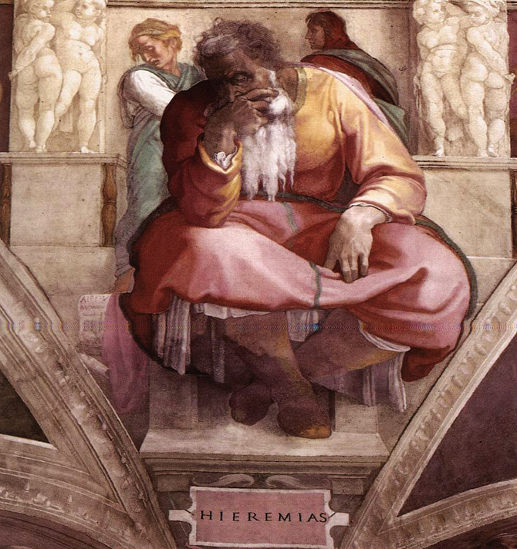
Jeremiah
His Life & Work

Slide 3
Jerusalem
587-586 B.C.

Slide 4
Josiah
#2
#1
#4
Jehoahaz
Eliakim
(Jehoiakim)
Mattaniah
(Zedekiah)
3 months
11 years
11 years
#3
Jehoachin
(Jeconiah)
3 months

Slide 6
Jeremiah
Lamenting the
Fall of Jerusalem

Slide 9
Jeremiah – The Man

Slide 10
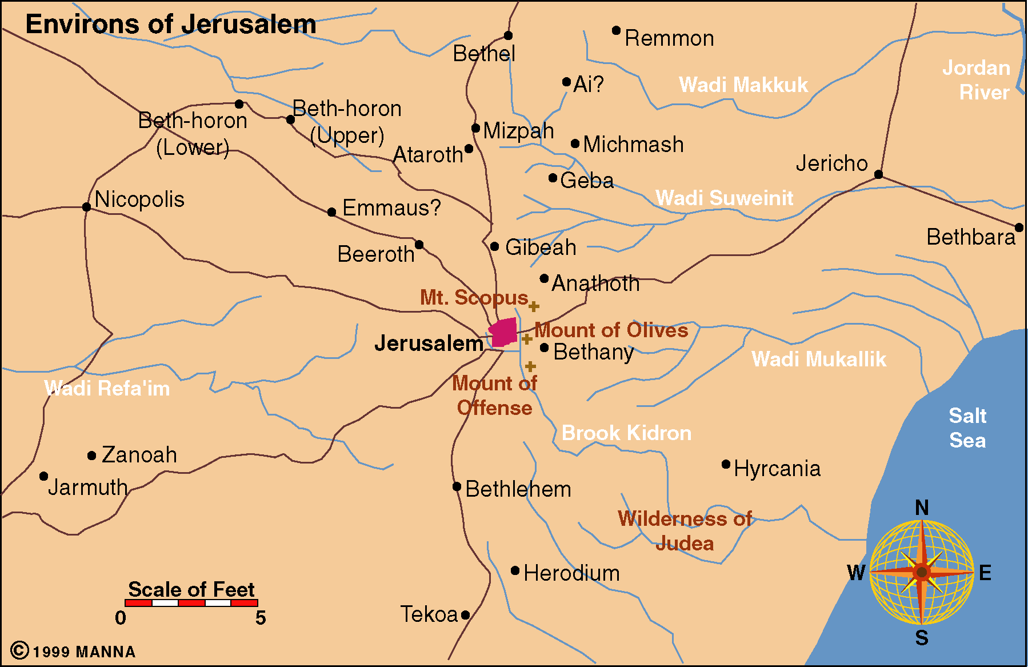

Slide 11
Jeremiah – The Man

Slide 12
Michelangelo’s Frescoes on the ceilings of the Sistine Chapel (c. 1512)

Slide 14
Jeremiah’s Message
Condemnation;
Invitation;
Consolation;
A message of encouragement to the exiles.
The Prophecies Of Jeremiah

Slide 16
Jeremiah’s Message
Figures & Symbols
The wearing, burial, and retrieval of a linen waistband (13:1-11).
A potter and a piece of clay (18:1-11).
The breaking of a clay jug in front of the religious leaders of Jerusalem (19:1-13).
The wearing of an oxen yoke and its subsequent breaking by a false prophet, Hananiah (27-28).
The purchase of a field in Anathoth for the price of seventeen silver shekels (32:6-15).

Slide 17
Jeremiah’s Response
“Oh, that my head were waters, and my eyes a fountain of tears, that I might weep day and night for the slain of the daughter of my people. Oh, that I had in the desert a travelers’ lodging place, that I might leave my people and go away from them!” (9:1-2)

Slide 18
Jeremiah’s Response

Slide 19
Jeremiah’s Character
Jeremiah was a sensitive man—a man of tears (cf. 9:1-2).
Jeremiah was a man of sympathy.
Jeremiah was a man of courage.
Jeremiah had overwhelming and unshak­able faith and conviction in God.
Jeremiah was a man of prayer.

Slide 20
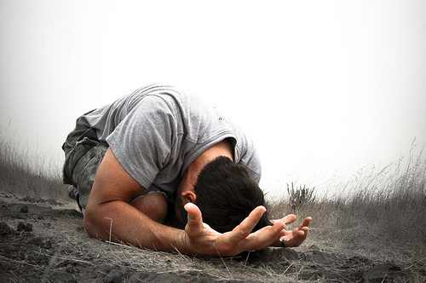
Jeremiah 20.7-13
Tough Prayers

Slide 21
Jeremiah’s Character
Jeremiah 20:7
“O LORD, you have deceived me, and I was deceived; you are stronger than I, and you have prevailed. I have become a laughingstock all the day; everyone mocks me.”
“O Lord, Thou has seduced me, and I am seduced; Thou hast raped me and I am overcome.” (Abraham Hechel)
Ray Stedman says about this cry that it “is on the verge of blasphemy!”

Slide 22
Conclusion
Even after his death, the Prophet Jeremiah was regarded as a wonderworker. Dust from his tomb was believed to cure snake-bite, and people continue today to pray to him for this purpose.
Many people believe that Jeremiah was commissioned by God to travel to Ireland, accompanied by his scribe Baruch and at least two of the “princesses” (Zedekiah’s daughters).

Slide 23
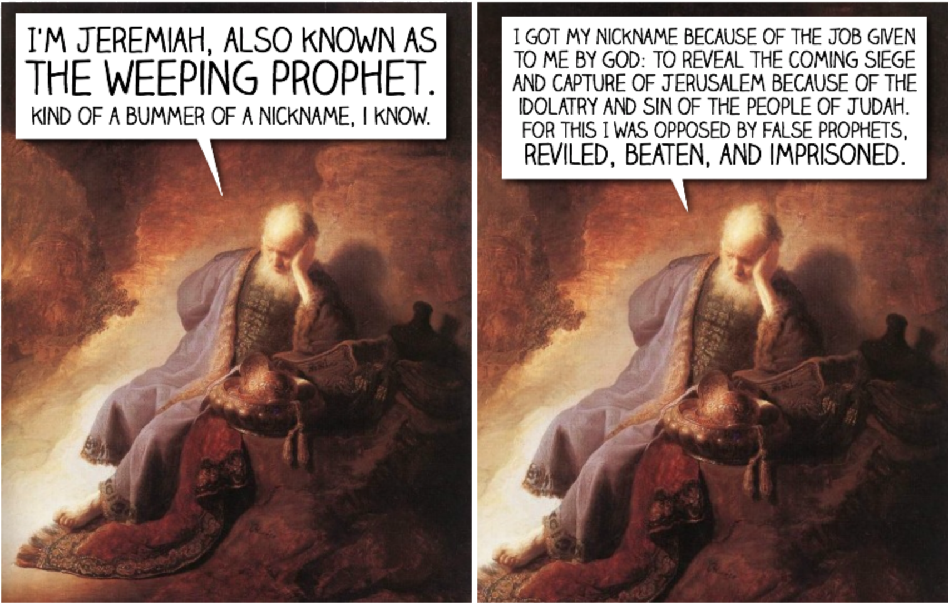

Slide 24
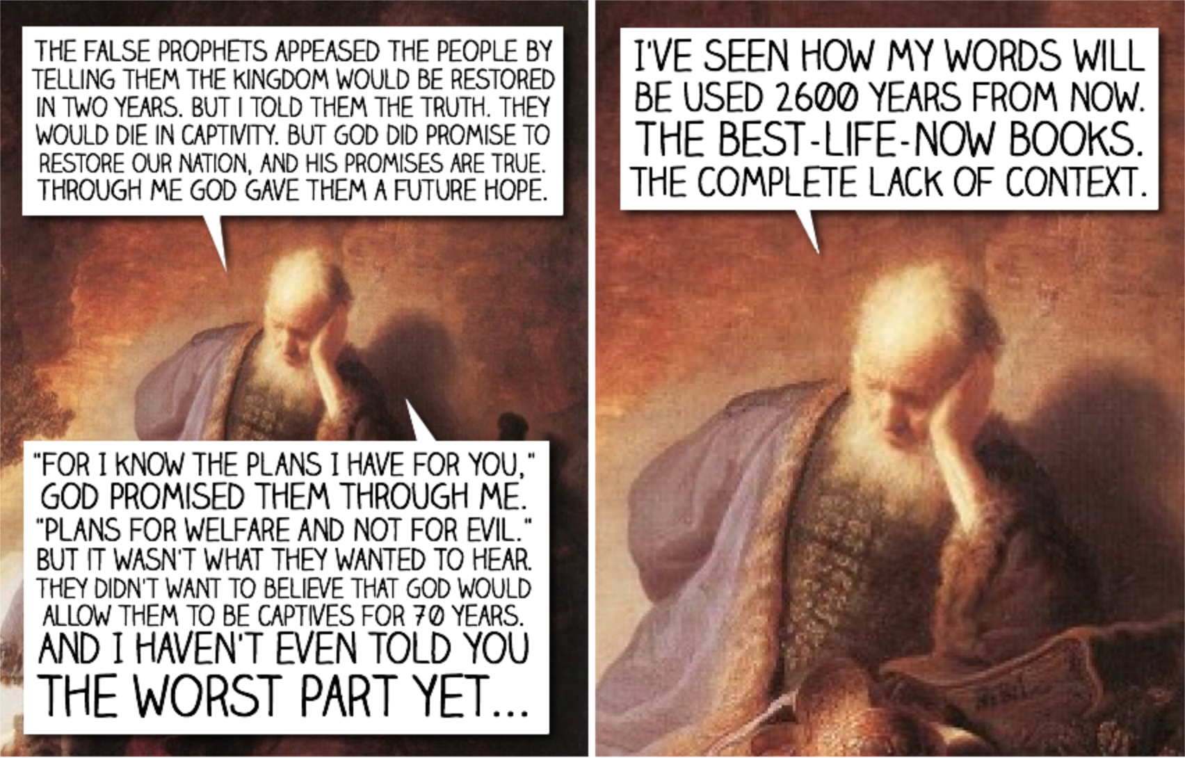

Slide 25
