Slide 1
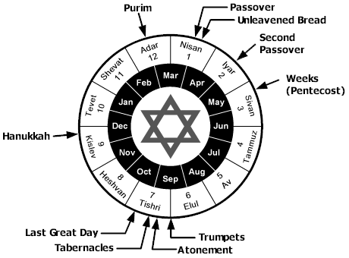
The Feasts of Israel
The Lord’s Appointed Times
(Leviticus 23)

Slide 2
Terms in Leviticus 23
מוֺעֵדִים (mo’edim, appointed times)
מִקְרָאֵי קוֹדֶשׁ (mikra’e qodesh, holy convocations)
חַג (chag, pilgrimage feast)

Slide 3
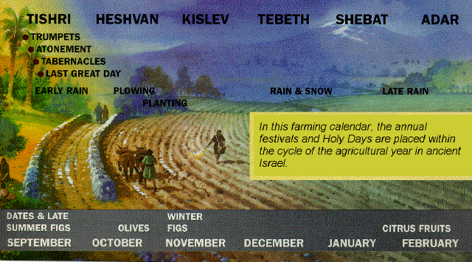
Israel’s Agricultural Year

Slide 4
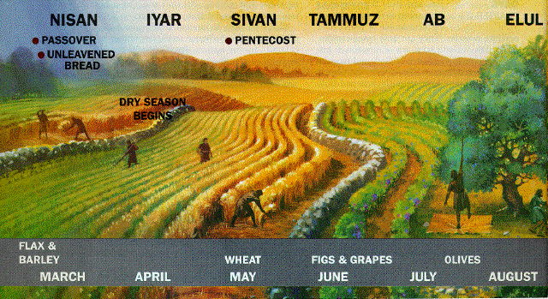
Israel’s Agricultural Year

Slide 5
Israel’s Agricultural Year

Slide 6
Divine Purposes
To keep in memory God's great redemptive acts of the past
To preserve national unity by focusing upon the central sanctuary and bringing people there to worship
To acknowledge God's continuing material provision in the present and to hope for His continuing provision in the future
And to serve as types of the redemption and provision God would make possible through the coming of His Son, Jesus Christ.

Slide 7
Common Features
All required “holy convocation(s)” for worship
All required observing Sabbath, except for what was necessary to carry out the feast, i.e. “no servile work”
Special offerings (offerings by fire) required in addition to regular offerings (Numbers 28-29)
Only three required all males to appear at the tabernacle (Passover/Unleavened Bread, Weeks, and Booths, the shalosh regalim)

Slide 8
The Lord’s Passover (Pesach)

Slide 9
And the blood shall be a sign for you on the houses where you live; and when I see the blood I will pass over you, and no plague will befall you to destroy you when I strike the land of Egypt. (Ex. 12:13, NASB).

Slide 10
Like flying birds so the Lord of hosts will protect Jerusalem. He will protect and deliver it; He will pass over (Heb. pasach) and rescue it. (Isaiah 31:5).

Slide 11
“For when the Lord goes through to smite the Egyptians, He will see the blood on the lintel and the two doorposts, and the Lord will protect the door and not let the Destroyer enter and smite your home.” (Ex. 12:23, NJPS)

Slide 12
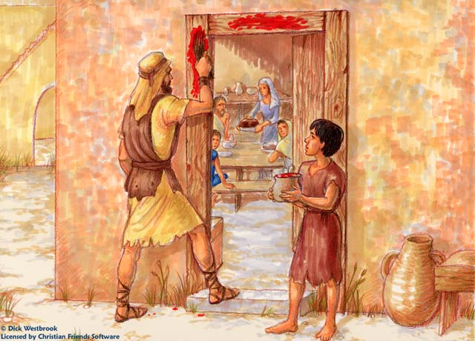
The Lord’s Passover

Slide 13
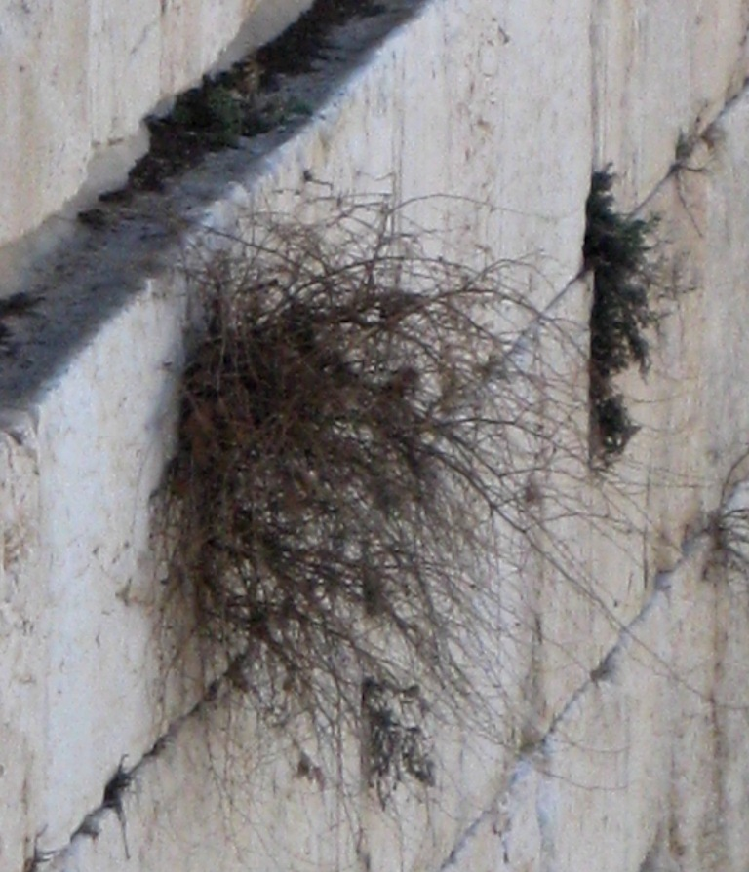

Slide 14
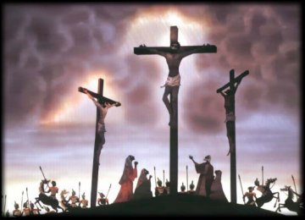
Our Passover, Jesus Christ

Slide 15
Our Passover, Jesus Christ
And He said to them, “I have earnestly desired to eat this Passover with you before I suffer; for I say to you, I shall never again eat it until it is fulfilled in the kingdom of God.” (Luke 22:15-16)

Slide 16
Our Passover, Jesus Christ
For Christ our Passover also has been sacrificed. Let us therefore celebrate the feast, not with old leaven, nor with the leaven of malice and wickedness, but with the unleavened bread of sincerity and truth. (1 Cor. 5:7-8)

Slide 17
Our Passover, Jesus Christ
A “Lamb” slain
The next day he *saw Jesus coming to him, and *said, “Behold, the Lamb of God who takes away the sin of the world! (John 1:29)

Slide 18
Our Passover, Jesus Christ
A perfect specimen
knowing that you were not redeemed with perishable things like silver or gold from your futile way of life inherited from your forefathers, but with precious blood, as of a lamb unblemished and spotless, the blood of Christ. (1 Pet. 1:18-19)

Slide 19
Our Passover, Jesus Christ
Prepared by “fire”
For it was fitting for Him, for whom are all things, and through whom are all things, in bringing many sons to glory, to perfect the author of their salvation through sufferings. (Hebrews 2:10)

Slide 20
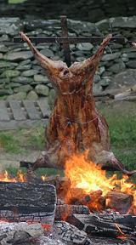
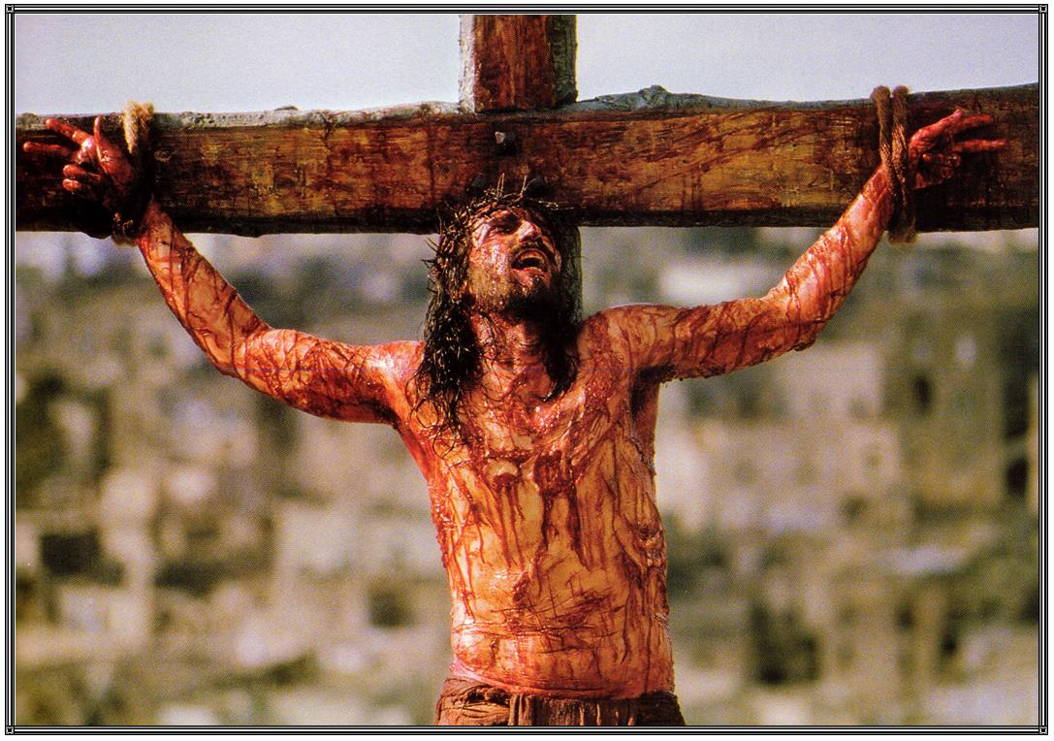
Our Passover, Jesus Christ

Slide 21
Our Passover, Jesus Christ
One offering for the whole family; thus not a bone broken
Be on guard for yourselves and for all the flock, among which the Holy Spirit has made you overseers, to shepherd the church of God which He purchased with His own blood. (Acts 20:28)
For these things came to pass, that the Scripture might be fulfilled, “Not a bone of Him shall be broken. (John 19:36)

Slide 22
Our Passover, Jesus Christ
Once offered for all
For by one offering He has perfected for all time those who are sanctified. (Heb. 10:14)

Slide 23
Our Passover, Jesus Christ
To save us from spiritual death
But God demonstrates His own love toward us, in that while we were yet sinners, Christ died for us. Much more then, having now been justified by His blood, we shall be saved from the wrath of God through Him. (Romans 5:8-9)

Slide 24
Our Passover, Jesus Christ
Only the circumcised have access to the protection of the Lamb
and in Him you were also circumcised with a circumcision made without hands, in the removal of the body of the flesh by the circumcision of Christ; having been buried with Him in baptism, in which you were also raised up with Him through faith in the working of God, who raised Him from the dead. (Colossians 2:11-12)

Slide 25
Our Passover, Jesus Christ
Must stay in the house covered by the blood
For the husband is the head of the wife, as Christ also is the head of the church, He Himself being the Savior of the body. (Ephesians 5:23)

Slide 26
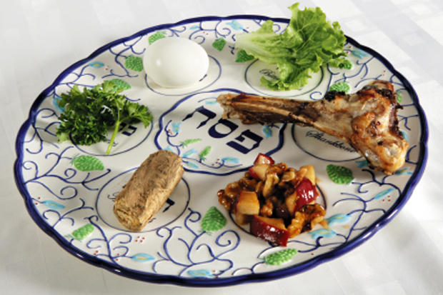
Modern Seder Plate

Slide 27
The Feast of Unleavened Bread

Slide 28
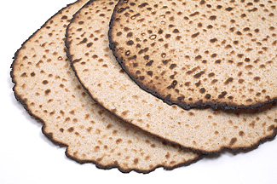
Unleavened Bread (Mazzoth)

Slide 29
The Feast of Unleavened Bread
You shall not eat leavened bread with it; seven days you shall eat with it unleavened bread, the bread of affliction (for you came out of the land of Egypt in haste), in order that you may remember all the days of your life the day when you came out of the land of Egypt. (Deut. 16:3)

Slide 30
The Feast of Unleavened Bread
And the Egyptians urged the people, to send them out of the land in haste, for they said, “We shall all be dead.” So the people took their dough before it was leavened, with their kneading bowls bound up in the clothes on their shoulders. (Ex. 12:33-34)

Slide 31
The Feast of Unleavened Bread
And you shall tell your son on that day, saying, ‘It is because of what the Lord did for me when I came out of Egypt.’ And it shall serve as a sign to you on your hand, and as a reminder on your forehead, that the law of the Lord may be in your mouth; for with a powerful hand the Lord brought you out of Egypt. Therefore, you shall keep this ordinance at its appointed time from year to year. (Ex. 13:8-10)

Slide 32
The Feast of Unleavened Bread
… on the first day you shall remove leaven from your houses (Ex. 12:15)
You shall not eat anything leavened; in all your dwellings you shall eat unleavened bread. (Ex. 12:20)

Slide 33
The Feast of Unleavened Bread
On the first day shall be a holy convocation; you shall do no laborious work. ‘And on the seventh day you shall have a holy convocation; you shall do no laborious work. (Num. 28:17,25)

Slide 34
The Feast of Unleavened Bread
“Three times in a year all your males shall appear before the Lord your God in the place which He chooses, at the Feast of Unleavened Bread and at the Feast of Weeks and at the Feast of Booths, and they shall not appear before the Lord empty-handed. Every man shall give as he is able, according to the blessing of the Lord your God which He has given you. (Deut. 16:16-17)

Slide 35
A NT Application
Clean out the old leaven, that you may be a new lump, just as you are in fact unleavened. For Christ our Passover also has been sacrificed. Let us therefore celebrate the feast, not with old leaven, nor with the leaven of malice and wickedness, but with the unleavened bread of sincerity and truth. (1 Cor. 5:7-8)

Slide 36
First fruits (Re’shit Qatsir)
(First fruits—Omer waved
the day after the Sabbath

Slide 37
First fruits (Reishit Katsir)
On the day after the Sabbath the priest waves a sheaf (Heb. ‘omer) of grain
Initiates thanksgiving for God’s provision through the beginning of the barley harvest
A lamb is also offered as a burnt offering along with flour and wine
Offering must precede consumption of the newly-gathered harvest

Slide 38
First fruits in the NT
Christ is "the first fruits of them that are asleep.“ (1 Cor. 15:20)
Christians possess "the first fruits of the Spirit" (Rom. 8:23)
And if the first piece of dough (Gr. aparche) be holy, the lump is also; (Rom. 11:16)
James affirms that Christians are, as it were, the "first fruits" of His creatures (Jas. 1:17-18)

Slide 39
First fruits in the NT
Epaenetus bears the distinction of being "the first convert to Christ from Asia" (Rom. 16:5)
The 144,000 are said to have "been purchased from among men as first fruits to God and to the Lamb.“ (Rev. 14:4)

Slide 40
Weeks (Shevuot, Qatsir, Bikkurim)

Slide 41
Weeks (Shevuot, Qatsir, Bicurim)
Occurs 50 days after the presentation of the sheaf offering (cf. Greek term Pentecost)
Expresses thanksgiving for God’s provision through the grain harvest
Remember the poor
Commemorates the giving of the Law at Sinai?

Slide 42
Weeks (Shevuot, Qatsir, Bicurim)
A wave offering of two leavened loaves are presented along with seven lambs, one bull, and two rams as burnt offerings with their grain and wine
Also one male goat for sin and two male lambs for peace offerings (given to priests)
A festive meal shared with family, the Levites, and the poor (Deut. 16:9-12)

Slide 43
Weeks in the NT
On the Day of Pentecost (Ac. 2) repentance and remission of sins began to be preached beginning at Jerusalem (Lk. 24:44ff).
Does the OT feast typify the ingathering of people into the kingdom? The inauguration of the new covenant?

Slide 44
Trumpets (Yom Teru’ah)

Slide 45
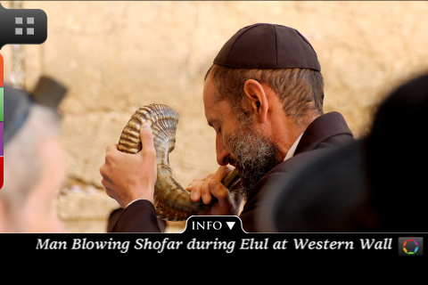
Trumpets (Yom Teru’ah)

Slide 46
Trumpets (Yom Teruah)
On the first day of the 7th month trumpets (shofarim) were blown to announce this special month (the month of both the Day of Atonement and the Feast of Booths)
Special offerings included one bullock, one ram, and seven he-lambs, with proper meal offerings, together with a he-goat for a sin offering
Today it is called Rosh Hashanah, New Year

Slide 47
Trumpets in the NT
The inauguration of the eternal kingdom is attended by the sounding of “trumpets” (1 Thes. 4:16; 1 Cor. 15)

Slide 48
Booths (Succoth, Asiph)

Slide 49
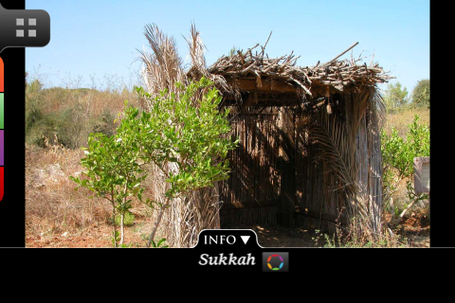
Booth (Sukkah)

Slide 50
Booths (Succoth, Asiph)
Celebrated on the 7th month, 15th day to commemorate the wilderness wanderings
The people gathered fronds from beautiful trees and rejoiced before the Lord
The people lived in booths for the week
A final acknowledgement of God’s blessings in the summer harvest (‘Asiph)

Slide 51
“Seven days you shall celebrate a feast to the Lord your God in the place which the Lord chooses, because the Lord your God will bless you in all your produce and in all the work of your hands, so that you shall be altogether joyful. (Deut. 16:15)

Slide 52
“...so that your generations may know that I had the sons of Israel live in booths when I brought them out from the land of Egypt.”
…built goodly houses and dwelt therein; where their herds and flocks, their silver and their gold, and all that they had, multiplied” (Deut 8:9,12-13)

Slide 53
Israel’s Agricultural Year

Slide 54
Then it will come about that any who are left of all the nations that went against Jerusalem will go up from year to year to worship the King, the LORD of hosts, and to celebrate the Feast of Booths. And it will be that whichever of the families of the earth does not go up to Jerusalem to worship the King, the LORD of hosts, there will be no rain on them.

Slide 55
And if the family of Egypt does not go up or enter, then no rain will fall on them; it will be the plague with which the LORD smites the nations who do not go up to celebrate the Feast of Booths. This will be the punishment of Egypt, and the punishment of all the nations who do not go up to celebrate the Feast of Booths.

Slide 56
Insight into a Claim of Jesus
“Now on the last day, the great day of the feast, Jesus stood and cried out, saying, ‘If anyone is thirsty, let him come to Me and drink. He who believes in Me, as the Scripture said, “From his innermost being will flow rivers of living water.”’ But this He spoke of the Spirit, whom those who believed in Him were to receive; for the Spirit was not yet given, because Jesus was not yet glorified.” (John 7:37-39)

Slide 57
“...these harvest celebrations both praise God the Creator and the Sustainer for the harvest and recount the great saving deed of God in praise of him as their Lord and Guide. These two pictures of God are intertwined in the Scriptures, and they are juxtaposed in the worship of Yahweh. The picture of God the Creator promotes his power, wisdom, and majesty. The picture of God the Redeemer reveals his mercy, love, and immanence.

Slide 58
The merciful God of redemption is neither opposed to himself nor to the universe he has created. That he is Creator means he has the power to accomplish his will; that he is Redeemer means that he has the will and the motive to act for the deliverance and the welfare of his people. Both images of God are essential to see clearly the God who exists and loves.

