Slide 2

Lessons
from
Leviticus
You shall be holy, for I
the LORD God am holy!
Leviticus 19:2

Slide 3
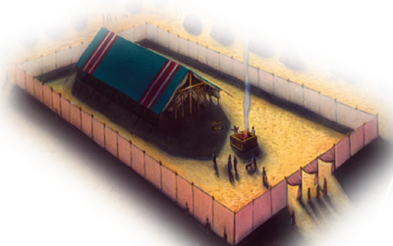
Leviticus Neglected
Considered boring by many; detailed sacrifices, long lists of laws, etc.
Neglected in our daily Bible reading
Leviticus is for us today! Romans 15:4
“Leviticus used to be the
first book that Jewish
children studied in the
synagogue.” (Wenham, vii)

Slide 4
The Book of Leviticus
Laws of the Offerings (1-7)
Laws of the Priests (8-10)
Laws of Purity (11-15)
Day of Atonement (16)
Laws of Holiness (17-20)
Laws of the Priests (21-22)
Appointed Times (23-25)
Penalties and Vows (26-27)

Slide 5
The Book of Leviticus
Author: Moses
Lev. 1:1; Matt. 8:4; Luke 2:22-24; Romans 10:5
Occasion: Israel at Mt. Sinai during a one-month period
Exodus 40:17; Lev. 7:38; 25:1; 26:46; 27:34; Numbers 1:1
Theme: “Holy Living” – “Set Apart for God”
Leviticus 11:44-45
“Holy” is found 92 times in the book (ESV)

Slide 6
You Shall Be Holy!
Definition:
OT = kădăsh
“poss. orig. idea of separation, withdrawal.” (BDB)
The Hebrew word has the core meaning of “to be set apart, apartness, separate.” (BDB)
“The meaning ‘to separate’ is favored by many scholars, but the fact that qdsh rarely, if ever, occurs in a secular sense makes any positive conclusion in this regard difficult because of the limited evidence on which to base philological comparison.” (TWOT)

Slide 7
You Shall Be Holy!
Definition:
OT = kădăsh
To summarize:
The noun holy should be understood as “something which is separate or set-apart (devoted) for a specific purpose.”
The verb to make holy or to be holy means “to separate something for a particular purpose,” and the adjective holy is something that has been set apart or separated for a particular purpose.
The practical, tangible concept of separation is at the core of the Hebrew word holy.

Slide 8
You Shall Be Holy!
Definition:
NT = hagios
The NT family of cognate forms is found in several grammatical modes more than 275 times.
“ἅγιος, (from τό ἀγός religious awe, reverence; ἄζω, ἅζομαι, to venerate, revere, especially the gods, parents (Curtius, § 118)), rare in secular authors; very frequent in the sacred writings; in the Sept. for קָדושׁ;” (Thayer)
#2 in Thayer’s definition list says about the word, “set apart for God, to be, as it were, exclusively His.”

Slide 9
You Shall Be Holy!
Definition:
NT = hagios
Holy in the NT corresponds exactly to its Hebrew equivalent in the OT.
Saints, or “holy ones” (Greek tous hagious), were set apart for God.
“They are a separated community.” (Evans)

Slide 10
You Shall Be Holy!
Holiness in the Old Testament
The Sabbath Day was made holy by God. Genesis 2:1-3
The place where God is present is holy. Exodus 3:1-5
“The Holy One of Israel!” Isaiah 43:3

Slide 11
You Shall Be Holy!
Holiness in the New Testament
Our bodies are said to be “a temple of the Holy Spirit”. 1 Cor. 6:19-20
Separation from things which contaminate. 2 Cor. 6:16 – 7:1
Sexual holiness and purity. 1 Thess. 4:1-7
Another warning about sexual purity. Eph. 5:1-5
The call to be Holy. 1 Peter 1:14-16
An example of the kind of holy life to which we are called. 1 Peter 1:22-23
The discipline of holiness. Hebrews 12:10-14
Admonition to continue in holiness. Revelation 22:11

Slide 12
You Shall Be Holy!
Holiness in the book of Leviticus
“’Be holy, for I am holy’ (11:44-45; 19:2; 20:26) could be termed the motto of Leviticus. Certainly ‘holy,’ ‘clean,’ ‘unclean’ and cognate words are among the most common in the book.” (Wenham, 18)
“The term ‘holy’ and its cognate terms e.g., ‘sanctify,’ ‘holiness,’ occur 152 times in Leviticus (about 20 percent of the total occurrences in the OT). (Wenham, 18 [footnote 25])

Slide 13
You Shall Be Holy!
The Holiness Code in Leviticus:
Instructions about separating from creatures which can and cannot be eaten. ch.11
Instructions about remaining separated from contact with the sanctuary after childbirth. ch.12
Instructions for people who have a rash, swelling, infection, skin disease, sore, an itch, white spots, and mildew in clothing. ch.13
A discussion of “the law of the leprous persons for the day of his cleansing.” ch.14
The separations that are necessary in the event of a bodily discharge. ch.15

Slide 14
You Shall Be Holy!
The Holiness Code in Leviticus:
Instructions regarding the Day of Atonement. ch.16
The commandments of separation (holiness). ch.17
Detailed instruction on sexual holiness. ch.18
Miscellaneous laws of separation, beginning with the admonition to “be holy, for I, the Lord your God, am holy!” ch.19
Separation instructions regarding the worship of Molech, (20:2), and mediums and necromancers. ch.20

Slide 15
You Shall Be Holy!
The Holiness Code in Leviticus:
This section closes with the giving of specific instructions for the priests in their dress, conduct and work as priests, along with some additional miscellaneous instructions concerning separation. chs. 21-22
“This survey of the use of the terms for holiness, cleanness, and uncleanness has demonstrated the importance of these ideas for understanding Leviticus. I have suggested that cleanness is the natural state of most creatures. Holiness is a state of grace to which men are called by God, and it is attained through obeying the law and carrying out rituals such as sacrifice. Uncleanness is a substandard condition to which men descend through bodily processes and sin. Every Israelite had a duty to seek release from uncleanness through washing and sacrifice, because uncleanness was quite incompatible with the holiness of the covenant people.” (Wenham, 23)

Slide 16
You Shall Be Holy!
God’s people can and must live like God … God, not man, is our standard of living
Ephesians 4:24; Hebrews 12:10; 2 Peter 1:4
“New Testament theology makes full use of the idea of holiness. All Christians are holy, ‘saints’ in most English translations …. Peter urges his readers to make the motto of Leviticus their own: ‘Be holy, for I am holy’ (1 Pet. 1:16). The mention of God is a theme that unites the ethics of Old and New Testaments (cf. Matt. 5:48; 1 Cor. 11:1).” (Wenham, 25)

Slide 17
You Shall Be Holy!
Personal Holiness in the 21st Century
In the Bible, to be holy is to be separate, distinct, different
Many of us have grown up during a time and place in history when this did not present an especially big challenge
THIS IS RAPIDLY CHANGING!
Postmodernism!

Slide 18
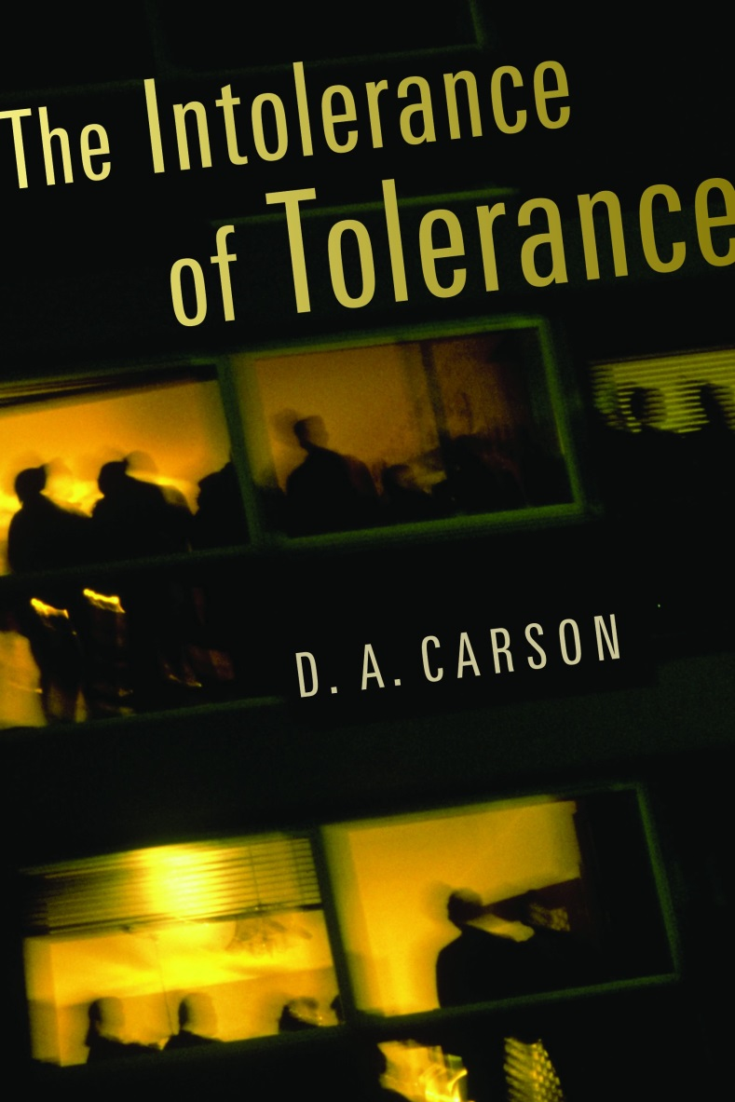


Slide 19
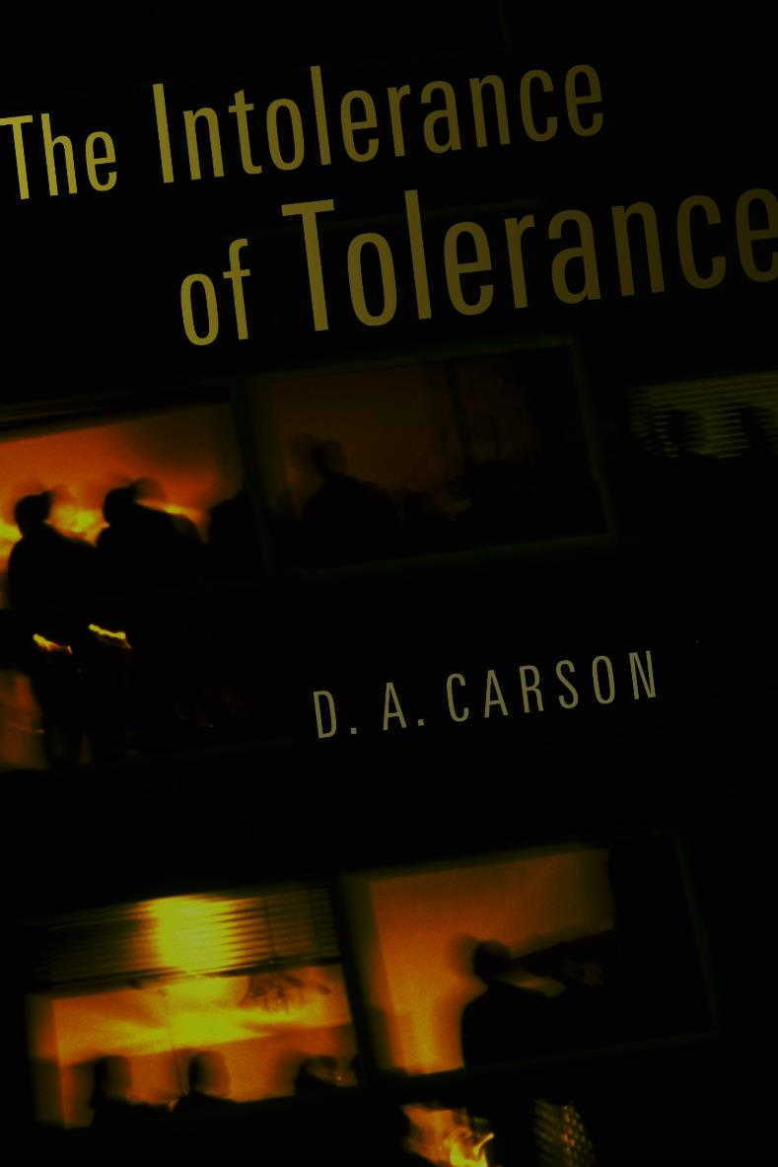

Postmodernism?
“Postmodernism is essentially a mid-to-late 20th century theory of knowledge which states that there is not real knowledge – at least not in the objective, external world that can be perceived by the human senses.” (Wayne Jackson, Christian Courier, October 2000)

Slide 20
Postmodernism?
There are no absolutes!
All beliefs are equally valid – therefore criticism of any belief is forbidden!
Deconstruction!
Distrust of all existing “universal discourses,” including the Bible
“We can’t take what was written to people 2,000 years ago and apply it to our time – when we read the NT we are just reading other people’s mail!”
History may be rewritten to meet the needs of any particular group!

Slide 21
You Shall Be Holy!
Personal Holiness in the 21st Century
Some “battles” we have had to fight in recent years in order to maintain holiness:
In the Field of Entertainment
TV … Movies … Music … Shows … Internet … Video Games … etc.
Personal Behavior
Our speech … Conduct with opposite gender … Pornography … etc.
Work & Worship of the Local Church
Instrumental music … Monetary support of human institutions … “Positive” vs. “negative” preaching … “Formal” vs. “informal” services & attire … etc.

Slide 22
You Shall Be Holy!
Personal Holiness in the 21st Century
Some “battles” we are going to have to prepare for and be prepared to fight in order to maintain holiness
Is there a standard of absolute truth?
“Latter-day revelation?”
Is homosexuality a sin?
What about homosexual marriage?
Women in leadership roles in the local church?
Is the NT message valid for Christians today?
Are emotions a valid barometer of spirituality?
Postmodernism!

Slide 23
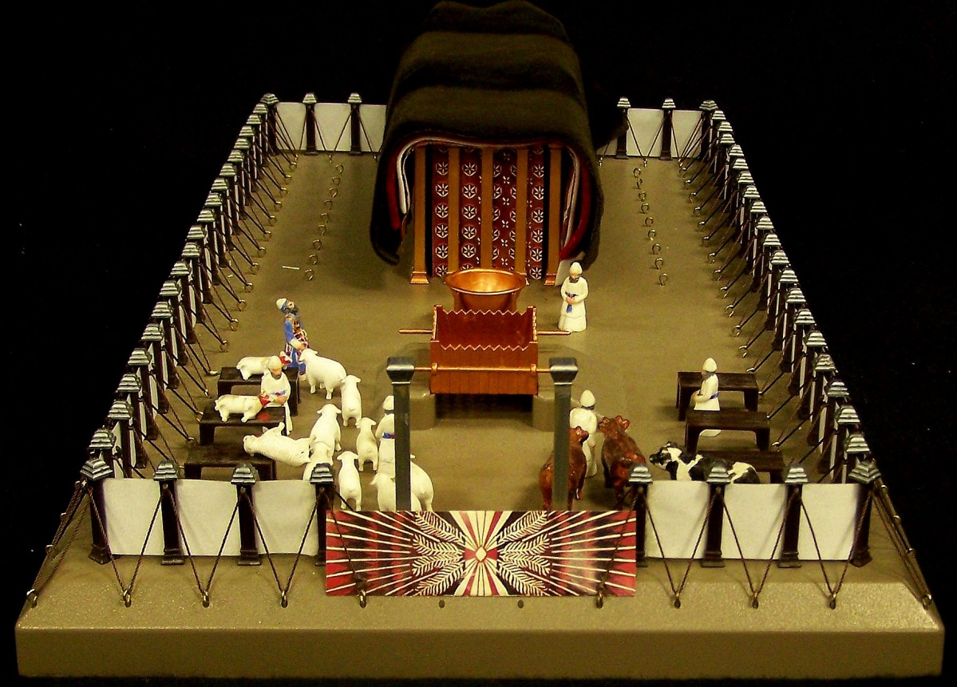
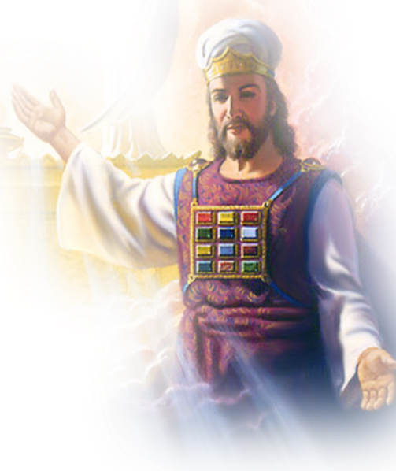
Lessons
from
Leviticus
You shall be holy, for I
the LORD God am holy!
Leviticus 19:2

