Slide 1
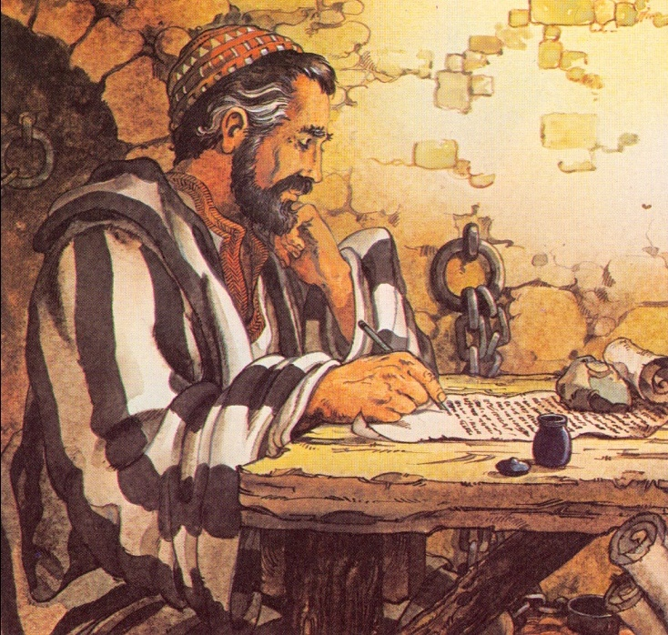
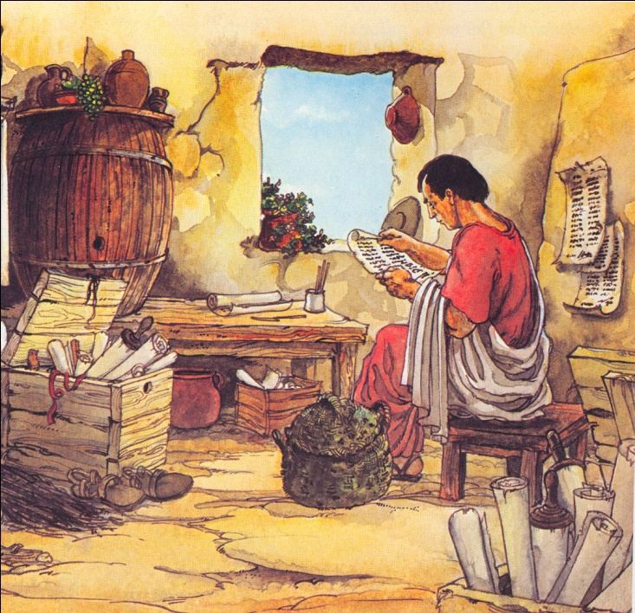
Paul’s Letters to
Timothy and Titus
Presented by Jeff Archer from Huntsville, AL - jrarcher@knology.net
at SITS Conference March 4, 2010

Slide 2


Paul’s Letters to
Timothy and Titus
1 Timothy
2 Timothy
Titus
“Paul”
“Paul”
“Paul”
“an apostle of Jesus Christ”
“an apostle of Jesus Christ”
“a servant of God and an apostle of Jesus Christ”
Author
“by the commandment of God our Savior and the Lord Jesus Christ, our hope”
“by the will of God, according to the promise of life which is in Christ Jesus”
“according to the faith of God’s elect and the acknowledgement of the truth which is according to godliness”

Slide 3
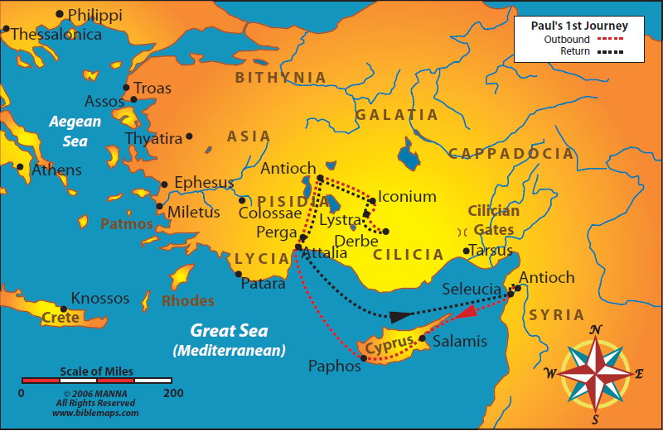
Paul’s “work to which I have called them”
Went where the gospel had not yet been preached.
Traveled with a group.
Left men behind to establish new converts.
Sent out men to check on churches newly established.
Sent his companions carrying his letters.

Slide 4
Paul’s Letters to
Timothy and Titus
1 Timothy
2 Timothy
Titus
“Paul”
“Paul”
“Paul”
“to Timothy”
“to Timothy”
“to Titus”
Recipient
“my true son in the faith”
“my beloved son”
“my true son in our common faith”

Slide 5
Paul’s Letters to
Timothy and Titus
1 Timothy
2 Timothy
Titus
“Paul”
“Paul”
“Paul”
“to Timothy”
“to Timothy”
“to Titus”
Date
63 AD
65 to 67 AD
63 AD

Slide 6
Paul’s Letters to
Timothy and Titus
1 Timothy
“ . . . remain in Ephesus that you may charge some . . .
Occasion

Slide 7
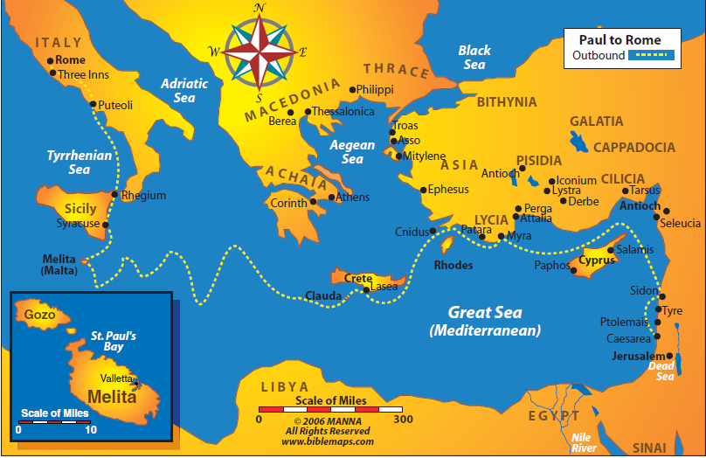

Slide 8
Paul’s Letters to
Timothy and Titus
1 Timothy
“ . . . remain in Ephesus that you may charge some . . . I write so that you may know how you ought to conduct yourself in the house of God, which his the church of the living God, the pillar and ground of the truth ”
“ . . . remain in Ephesus that you may charge some . . .
Occasion

Slide 9
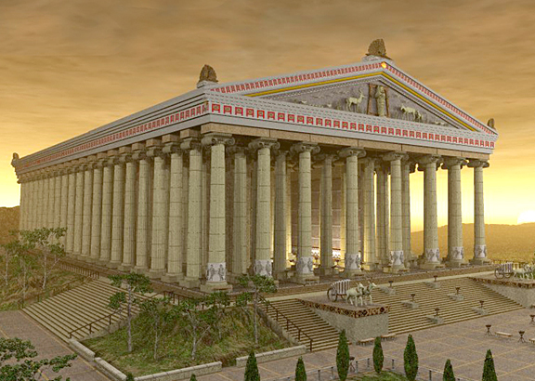
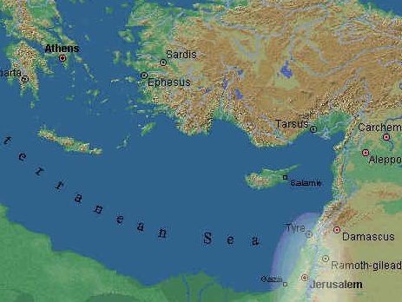
The House
of Diana
The House
of God

Slide 10
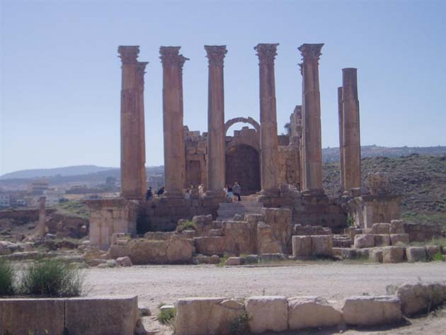
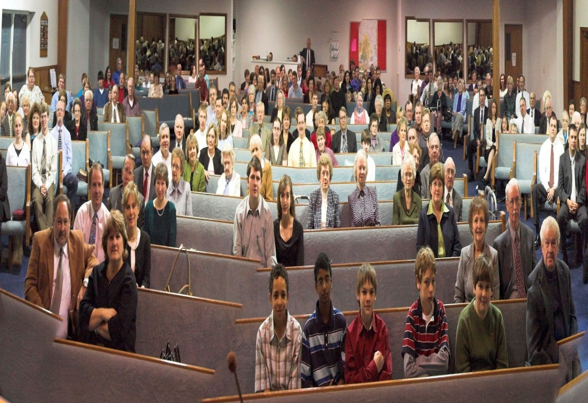
The House
of Diana
The House
of God
The church
of the
living God

Slide 11
Paul’s Letters to
Timothy and Titus
1 Timothy
“ . . . remain in Ephesus that you may charge some . . . I write so that you may know how you ought to conduct yourself in the house of God, which his the church of the living God, the pillar and ground of the truth ”
Occasion
Titus
“For this reason I left you in Crete, that you should set in order the things that are lacking . . .”

Slide 13
Paul’s Letters to
Timothy and Titus
1 Timothy
“ . . . remain in Ephesus that you may charge some . . . I write so that you may know how you ought to conduct yourself in the house of God, which his the church of the living God, the pillar and ground of the truth ”
Occasion
2 Timothy
Titus
“For this reason I left you in Crete, that you should set in order the things that are lacking . . .”

Slide 15
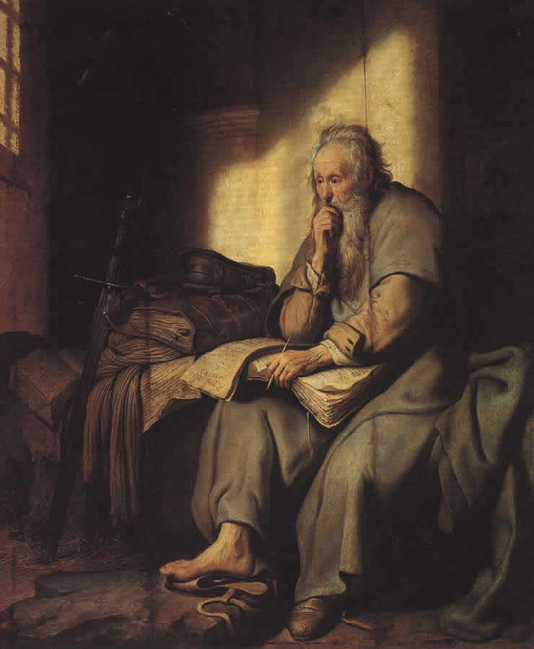

Slide 16
Paul’s Letters to
Timothy and Titus
1 Timothy
“ . . . remain in Ephesus that you may charge some . . . I write so that you may know how you ought to conduct yourself in the house of God, which his the church of the living God, the pillar and ground of the truth ”
Occasion
2 Timothy
“stir up . . . hold fast . . . be strong . . . consider . . . remember . . . Preach the word! . . . be watchful . . . endure . . . do the work . . . fulfill your ministry”
Titus
“For this reason I left you in Crete, that you should set in order the things that are lacking . . .”

Slide 17
Paul’s Letters to
Timothy and Titus
Error
Truth
“fables and endless genealogies . . . idle talk . . . blaspheme . . . doctrines of demons . . Lies . . . profane and old wives tales . . . commandments of men . . .”
“truth”
“the word”
“sound doctrine”
“the faith”

