Slide 1
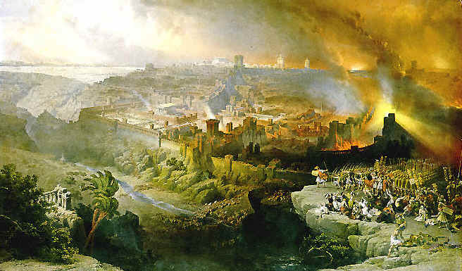
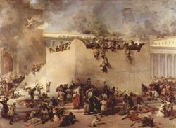
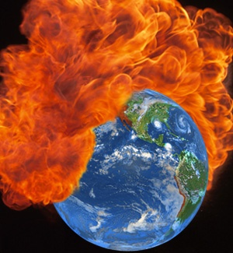
2 Peter 3
End of the Universe
Or
Destruction of Jerusalem?

Slide 2
The dispensational view
I am not going to spend time on the dispensational view
It mostly relies on other passages
In 2 Pt. 3, it has many similarities to the amillennial view
The main difference deals with whether the universe will be annihilated or remade.

Slide 3

Begin by reading 2 Pt. 3:1-15.
A summary of each position
Appendices 1-2
Page 140

Slide 4
Why take an EOU interpretation?
Page 121
A literal reading of the text
The language is similar to OT prophecies, but not the application.
After all, prophecy is about future events.

Slide 5
Why take an EOU interpretation?
Page 121
God does not count time like we do
And He wants us to always live in expectancy of the end.
Surely God always gives people an end to look forward to!

Slide 6
Why take an EOU interpretation?
Page 121
Peter clearly defined “earth” as “planet Earth” in v. 5.
Planet Earth is our “present earth” of v. 7
This is the earth that will be burned up in v. 10
Elements means physical elements, v. 10.

Slide 7
Why take an EOU interpretation?
Page 121
The church CANNOT BE the “new heavens and earth” of Isaiah.
The church had already been established.
Surely everyone understands this from Acts 2 and Joel 2!
So, Peter must have been using Isaiah’s terms to refer to something else.

Slide 8
Why take an EOU interpretation?
Page 121
The DOJ interpretation makes way too much of the DOJ.
The language is too extreme in 2 Pt. 3 to refer to the DOJ.
Even if does refer to the DOJ superficially, it extends to a description of the EOU.

Slide 9
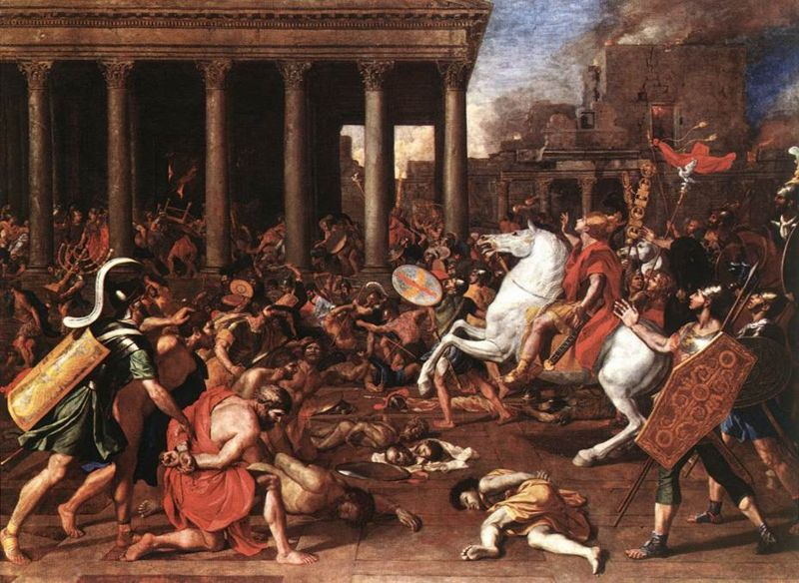
Answering objections to the DOJ view
Similar language, different application
Prophecy is about future events
This is assumption.
But assumptions always go in favor of continuity.
The DOJ was still future to the readers of 2 Pt.
Page 121

Slide 10
Answering objections to the DOJ view
Is the language of 2 Pt. 3 too extreme for a DOJ interpretation?
Is the EOU “the only possible interpretation” of such language? (Oberst 199). Page 126
Then what about …
Isaiah 13:10 For the stars of heaven and their constellations Will not flash forth their light; The sun will be dark when it rises And the moon will not shed its light.
Does this describe simultaneous supernovas and eclipses?

Slide 11
Answering objections to the DOJ view
Language too extreme for a DOJ?
EOU “the only possible interpretation”?
Then what about … Page 127
Isaiah 34:9 Its streams will be turned into pitch, And its loose earth into brimstone, And its land will become burning pitch. 34:10 It will not be quenched night or day; Its smoke will go up forever. … 34:11 But pelican and hedgehog will possess it, And owl and raven will dwell in it …
Does this describe an eternally burning earth ruled by pelicans in fire-proof suits?

Slide 12
Answering objections to the DOJ view
God does not count time like we do
He wants us to live in expectancy.
God always gives people an end to look forward to!
Page 121
Such hermeneutics would render Bible interpretation impossible.
I have “the desire to depart and be with Christ for that is very much better” (Php. 1:23).
“Blessed are the dead who die in the Lord from now on! … that they may rest from their labors, for their deeds follow with them” (Rev. 14:13).

Slide 13
Establishing a time frame
From 1 Peter 4:7 (page 128ff.)
The end of all things is (lit. has drawn) near.
“Near” engizo, means nearness in place or time
Greek reference works are unanimous
Commentaries are unanimous
Translations are unanimous
Some commentaries accept that Peter was serious…
And conclude Peter was mistaken
Or that it does refer to the DOJ
Many commentators explain it away

Slide 14
Establishing a time frame
From 1 Peter 4:7 (page 128ff.)
The end of all things is (lit. has drawn) near.
Does engizo mean “near in time”?
Jesus predicted “the end of the age” at the DOJ
Matthew 24:3,6,13, 33-34
1 Peter said the end of all things was near
2 Peter 3 refers to an end
Why not the same end that was near in 1 Peter?

Slide 15
Establishing a time frame
From 1 Peter 4:7 (page 128ff.)
The end of all things is (lit. has drawn) near.
Does engizo mean “near in time”?
That’s what the word means
But could it refer to “accessibility,” like having a pencil at hand?
It doesn’t mean “accessible”
The context gives a time frame
It is TIME for judgment to begin … (1 Pt. 4:17)

Slide 16
Establishing a time frame
From 1 Peter 4:7 (page 128ff.)
The end of all things is (lit. has drawn) near.
Does engizo mean “near in time”?
What does it mean in …
Mt. 3:2; 4:17 “Repent, for the kingdom of heaven is at hand” (lit. draws near)?
Mk. 1:15 … the time is fulfilled, and the kingdom of God is at hand …
Mt. 21:34… the harvest time drew near
Mt. 24:33-34 … near, right at the door … this generation …

Slide 17
Establishing a time frame
Page 103, 145
Luke 21:8 “Many will come saying … the time is near. Do not go after them.”
Jesus then proceeds to tell them how they would know the time really WAS near.
1 Peter 4:7, The end of all things is near.
If Peter said it was “near” but hasn’t happened for 2,000 years, what was he?
Lk. 21:8; Deut 18:22

Slide 18
Establishing a time frame
From 1 Peter 4:7 (page 131)
The end of all things is (lit. has drawn) near.
Does engizo mean “near in time”?
By saying “No” are we giving aid and support to a new breed of scoffers?
Bertrand Russell and Albert Schweitzer
Bart Ehrman
Ridicules the first century Christian beliefs that “the end of the world as we know it was already at hand’”

Slide 19
Establishing a time frame
From 1 Peter 4:7 (page 131)
The end of all things is (lit. has drawn) near.
Does engizo mean “near in time”?
By saying “No” are we giving aid and support to a new breed of scoffers?
Gerald Sigal
“No amount of Christian theological acrobatics will ever solve the problems engendered by the historical reality that a promised imminent fulfillment made 2000 years ago did not occur as expected by the NT”

Slide 20
Establishing a time frame
2 Peter 1:16-18
All synoptics
16 …we made known to you the power and coming of our Lord Jesus Christ …
17 For when … “This is my beloved Son…”
18 … on the holy mountain …
(pages 105-106)
Lk. 9:27 Some standing here not die until they see the kingdom of God
Mk. 9:1 [same plus] come with power
Mt. 16:27-28 Son of Man come in the glory of His father … angels … to repay deeds … some standing there…

Slide 21
Establishing a time frame
Matthew, Mark, and Luke all predict a powerful event right before relating the Transfiguration.
This powerful event is described as a coming of the Lord coming in “this generation” (i.e., the 1st century).
2 Pt. 1:16-18 tells about a powerful coming of the Lord right before referencing Peter’s eyewitness testimony of the Transfiguration
Why wouldn’t it be the same coming?

Slide 22
Establishing a time frame
The point of the Transfiguration?
Two representatives of the Law and Prophets: Moses and Elijah
Jesus, the head of a new covenant
Jesus’ glory shines above the Law and Prophets
The Law and the Prophets (representatively) disappear
Jesus alone is left standing.
But this is connected with Jesus’ coming in power!

Slide 23
Establishing a time frame
The point of the Transfiguration was that the Old would DISAPPEAR and only Jesus would be left.
Peter says the Transfiguration was proof of the powerful coming of the Lord (2 Pt. 1:16-18).
Therefore, the powerful coming of the Lord in 2 Pt. 1:16-18 was a time when the Old would disappear and only Jesus would be left.
So when 2 Pt. 3 describes something disappearing, and looking for something new, it is describing the same thing.
This was fulfilled in the DOJ.

Slide 24
Establishing a time frame
Pages 117-118, 133-134
From 2 Pt. 3:12,14
Looking for and hastening, v. 12.
YOU look for, v. 14.
The DOJ was unarguably
A coming of the Lord
2 Peter 3:4,10,12
Matthew 24:30, (42)

Slide 25
Establishing a time frame
Pages 117-118, 133-134
From 2 Pt. 3:12,14
Looking for and hastening, v. 12.
YOU look for, v. 14.
But why would they look for an EOU before a DOJ?
If the EOU came before the DOJ then there would be prophecy left unfulfilled.
Jesus would be a false prophet.

Slide 26
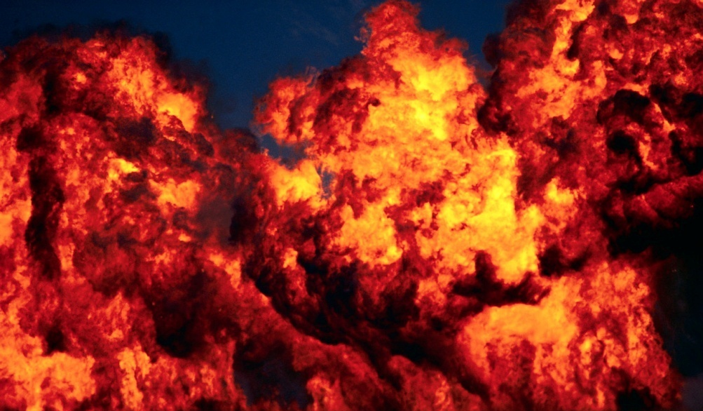
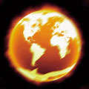
Answering objections to the DOJ view
Earth means planet throughout as in v. 5.
Elements means physical elements, v. 10.
Page 121
Does it mean “planet” in v. 13?
How do we know it means physical elements?
Page 122

Slide 27
What does “heavens and earth” mean?
Must this refer to the physical universe throughout?
Certainly presumption is in favor of the first usage.
But if it refers to the physical universe in v. 13, then we will have a new physical universe.
This is certainly not in accordance with Isaiah’s usage
or the spiritual nature of the NT kingdom.

Slide 28
What does “heavens and earth” mean?
Must this refer to the physical universe throughout? Pages 121-122
Doesn’t Scripture use physical illustrations of spiritual truths often?
Isaiah compared the church to a “new heavens and earth” (65:17; 66:22).
Why can’t Peter refer to the destruction of old Israel as an end to the heavens and earth?

Slide 29
What does “heavens and earth” mean?
It is even true that OT Israel was formed out of water! (Page 122)
Isa. 51:15 “For I am the Lord your God, who stirs up the sea and its waves roar … (16) I have put My words in your mouth and have covered you with the shadow of My hand, to establish the heavens, to found the earth, and to say to Zion, ‘You are My people.’ ”
2 Pt. 3:4 …, all continues just as it was from the beginning of creation.” 3:5 For when they maintain this, it escapes their notice that by the word of God the heavens existed long ago and the earth was formed out of water and by water,
Notes:
Now whether Isaiah was foretelling the new covenant era in this passage as Homer Hailey thinks, or whether His reminding them of how He had formed old covenant Israel, it matters little to the parallel to 2 Pt. 3. In Isa. 51:6 the heavens and earth are said to pass away. Surely this is metaphoric OT prophecy concerning the DOJ. Hailey says v. 6 refers to the passing of the old order. I agree.

Slide 30
What does “heavens and earth” mean?
It is even true that OT Israel was formed out of water! (Page 122)
God brought Israel up out of the (Red) sea, Isa. 63:11.
God baptized Israel in the Red Sea and brought them up out of it, 1 Cor. 10:1-2

Slide 31
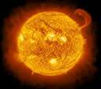
What does “heavens and earth” mean?
It was the ungodly who were destroyed in the Flood not the universe. (Page 110)
We live on the same planet under the same stars.
The world of the ungodly perished in the Flood.
The world of the ungodly perished in the DOJ.

Slide 32
What does “heavens and earth” mean?
This is apocalyptic imagery. (Page 111)
Confirmed by quoting Isa. 65:17; 66:22 in v. 13.
Isaiah 34:1-4 … against all nations …
V. 4 … all the host of heaven shall be dissolved, and the heavens shall be rolled together as a scroll…
Isaiah 51:4-6 … O My nation …
51:6 Lift up your eyes to the heavens, look at the earth beneath; the heavens will vanish like smoke, the earth will wear out like a garment …

Slide 33
What does “heavens and earth” mean?
This is apocalyptic imagery. (Page 111)
Isa. 65:17 “For behold, I create new heavens and a new earth; And the former things will not be remembered or come to mind.
What “former things”?
Is it not the old heavens and earth?
Why would they “not be remembered”?
They had been destroyed!
Isa 51:6; Daniel 7:26-27; 2 Pt. 3

Slide 34
What does “heavens and earth” mean?
This is apocalyptic imagery. (Page 111)
Haggai 2:6 “…Once more in a little while, I am going to shake the heavens and the earth, the sea also and the dry land. (7) ‘I will shake all the nations; and they will come with the wealth of all nations, and I will fill this house with glory,’ says the Lord of hosts.
Messianic!
Hebrews 12:26 quotes this passage
Heb. 12:27 … denotes the removing of those things which can be shaken, as of created things, …
28 … we are receiving a kingdom which cannot be shaken …
Notes:
Surely this refers to the destroying of the old and the powerful bringing in of the new!

Slide 35
What does “heavens and earth” mean?
This is apocalyptic imagery. (Page 111)
In apocalyptic language the DOJ is spoken of as affecting the entire heavens and earth.
Matthew 24:7 “For nation will rise against nation, and kingdom against kingdom …
24:21 “For then there will be a great tribulation, such as has not occurred since the beginning of the world until now, nor ever will.
Is this the specific promise the mockers are scoffing at with the words “all continues just as it was from the beginning of creation,” v. 4?

Slide 36
What does “heavens and earth” mean?
This is apocalyptic imagery. (Page 111)
In apocalyptic language the DOJ is spoken of as affecting the entire heavens and earth.
Matthew 24:27 … the coming of the Son of Man be. 24:29 “But immediately after the tribulation of those days the sun will be darkened, and the moon will not give its light, and the stars will fall from the sky, and the powers of the heavens will be shaken.

Slide 37
What does “heavens and earth” mean?
This is apocalyptic imagery. (Page 112)
Zeph. 3:8 … To assemble kingdoms, To pour out on them My indignation, All My burning anger; For all the earth will be devoured by the fire of My zeal. 3:9 “For then I will give to the peoples purified lips, That all of them may call on the name of the Lord, To serve Him shoulder to shoulder.
Another destruction of the old to create the new.

Slide 38
What does “heavens and earth” mean?
This is apocalyptic imagery. (Page 114)
Rev. 3:10 … the hour of testing, that hour which is about to come upon the whole world, to test those who dwell on the earth. 3:11 ‘I am coming quickly; hold fast what you have, so that no one will take your crown.

Slide 39
What does “heavens and earth” mean?
This is apocalyptic imagery. (Page 114)
The Temple’s representation of the heavens and earth
“…the measures of the tabernacle proved to be an imitation of the system of the world … that third part … is, as it were, a Heaven peculiar to God … the twenty cubits, is … sea and land…”
Josephus, Antiquities, 3.6.4

Slide 40
What does “heavens and earth” mean?
This is apocalyptic imagery. (Page 114)
The Temple’s representation of the heavens and earth
“…the tabernacle … made in way of imitation and representation of the universe … the land and the sea … heaven … planets … the four elements … …” [repeated and explained]
Josephus, Antiquities, 3.7.7

Slide 41
What does “heavens and earth” mean?
This is apocalyptic imagery. (Page 116)
“Earth” affected in the DOJ
The Jewish problem
Say they are Jews and are not
Rev. 2:9; 3:9
Their judgment would affect the “whole world” and “those who dwell on the earth”: Rev. 3:10
It was coming quickly: Rev. 3:11

Slide 42
What does “heavens and earth” mean?
This is apocalyptic imagery. (Pages 118-119)
What are the “new heavens and earth”?
Not a new planet and skies, but a new covenant people
Isaiah 65:17 … I create new heavens and a new earth ; And the former things will not be remembered or come to mind. (18) … I create Jerusalem …
Hebrews 12:22 But you have come to … the heavenly Jerusalem …

Slide 43
What does “heavens and earth” mean?
This is apocalyptic imagery. (Pages 118-119)
What are the “new heavens and earth”?
If the new heavens and earth are the church, the new covenant people of God, Isaiah 65:17; Hebrews 12:22
What is the old heavens and earth which in Peter’s day was still the “present heavens and earth”?
The old covenant people of God!

Slide 44
What does “heavens and earth” mean?
This is apocalyptic imagery. (Page 117)
What are the “new heavens and earth”?
Peter refers to “His promise” of a new heavens and earth
The only place this is promised is Isaiah 65:17; 66:22
But the promise of Isaiah concerns the new covenant people of God
Therefore, Peter is talking about the new covenant people of God

Slide 45
What does “heavens and earth” mean?
This is apocalyptic imagery. (Page 119)
Connection between old and new
In Isaiah 62-66, the old is destroyed and the new is created.
In Joel 2:28-32, the DOJ is connected to bringing in the new
Since Peter wrote before the destruction of the old …
Why wouldn’t he be referring to the same thing as Isaiah and Joel?

Slide 46
What are “the elements”?
Definition of stoicheia, v. 10 (Page 115)
“Basic components of something, elements” (BDAG).
Anything basic
Can be the four elements: earth, wind, fire, water
Can refer to the “atoms”
Can be the sun, moon, and stars, esp. the stars
Can refer to basic teachings of something

Slide 47
What are “the elements”?
How is it used in the NT? (Page 115)
Galatians 4:3 So also we, while we were children, were held in bondage under the elemental things of the world.
4:9 … how is it that you turn back again to the weak and worthless elemental things …
Colossians 2:8 See to it that no one takes you captive through philosophy and empty deception, according to the tradition of men, according to the elementary principles of the world, rather than according to Christ.
2:20 If you have died with Christ to the elementary principles of the world …

Slide 48
What are “the elements”?
How is it used in the NT? (Page 115)
Hebrews 5:12 For though by this time you ought to be teachers, you have need again for someone to teach you the elementary principles of the oracles of God, and you have come to need milk and not solid food.
It’s use is consistent throughout the NT.
“Elements of the world” used 3 times!

Slide 49
What are “the elements”?
What if it means “atoms” or “celestial bodies? (Page 115)
Why would it differ from …
Isaiah 34:4 All the stars of the heavens will be dissolved and the sky rolled up like a scroll; all the starry host will fall like withered leaves from the vine, like shriveled figs from the fig tree.
Many other passages are NOT physically literal!
Josephus says the Temple represented “the four elements” and the stars of heaven.

Slide 50
Answering objections to the DOJ view
They didn’t need to look for the church, it had already existed for thirty years.
Acts 2:17 says Pentecost fulfilled the prophecy of Joel
Pages 121-122
They weren’t, but for the powerful confirmation of God’s kingdom.
Pentecost was the beginning of the fulfillment of Joel’s prophecy, which is exactly the point.
The end of it’s fulfillment was the DOJ.

Slide 51
The DOJ: A powerful coming of the Lord
Page 118
Childhood & maturity of the church
Eph. 4:11-16
1 Cor. 13:8-13
Miracles in the “last days” of the Mosaic dispensation and the infancy of the church: Joel 2; Acts 2:17
Full grown when the full knowledge was revealed and the miracles ceased
When? At the DOJ, Joel 2; Acts 2:19-20

Slide 52
The DOJ: A powerful coming of the Lord
Page 118
Childhood and maturity of the church
Church looked on as a sect of Judaism: Acts 28:22
Disciples had a hard time leaving the old behind: Acts 15; Galatians
They were still “receiving” the kingdom: Heb. 12:28

Slide 53
The DOJ: A powerful coming of the Lord
Daniel 7:18-28
Romans 1:4
18 …the saints … receive the kingdom…
19-21 … the horn was waging war with the saints and overpowering them…
22 … judgment was passed in favor of the saints and they took possession of the kingdom …
[Jesus] through the Spirit of holiness was declared with power to be the Son of God by his resurrection from the dead …
Of course, He was already the Son of God
But this confirmed it in a powerful way!

Slide 54
The DOJ interpretation honors the prophets
2 Pt. 3 is based on the prophets (page 33ff.)
The prophets foretold the coming of the Messianic kingdom
If the prophets foretold the EOU, what about…
Matthew 5:18 “For truly I say to you, until heaven and earth pass away, not the smallest letter or stroke shall pass from the Law until all is accomplished.”

Slide 55
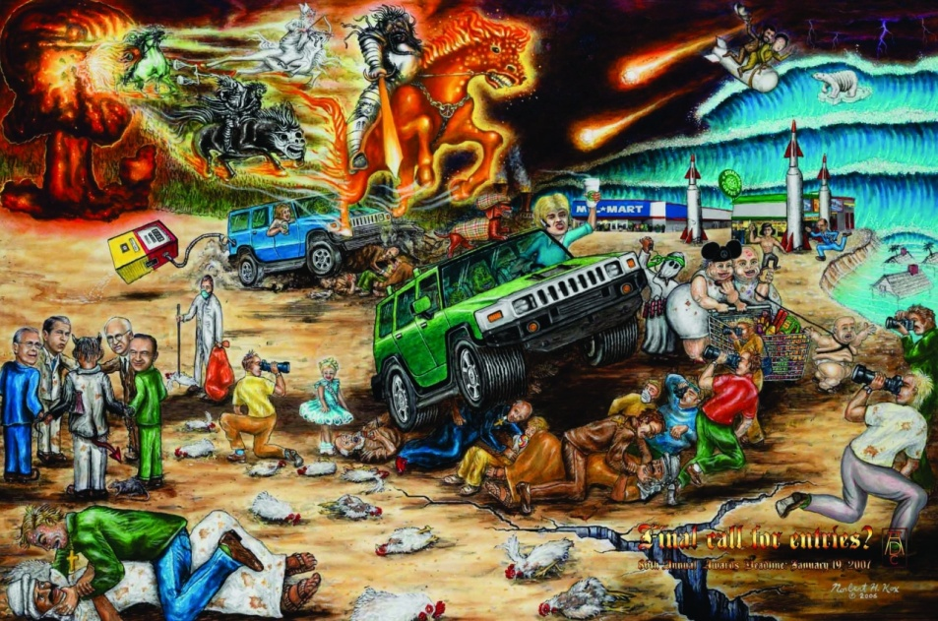
2008 reasons the Lord will come in 2008

Slide 56
Just kidding!

Slide 57
Top Ten Reasons I think 2 Peter 3 refers to the DOJ
Pages 123ff
It is more consistent with the OT prophets.
It translates apocalyptic language more consistently.
It honors the meaning of Isaiah’s prophecy.
I believe God can tell time, and that he makes time statements humans can understand.

Slide 58
Top Ten Reasons I think 2 Peter 3 refers to the DOJ
Pages 33ff
It answers critics of the inspiration of Scriptures.
It has a more Scriptural definition of “last days” and similar expressions.
It doesn’t make sense to “look for” (vv. 12,14) the EOU before the DOJ.
Hastening the DOJ makes more sense than hastening the EOU.

Slide 59
Top Ten Reasons I think 2 Peter 3 refers to the DOJ
Pages 33ff
The DOJ has a close and better contextual connection to the Transfiguration.
It sets a better stage for understanding the power of the scoffers.

Slide 60
Why I think 2 Peter 3 refers to the DOJ
Not because I have everything figured out in this chapter.
Not because the EOU view seems exceedingly unreasonable to me.
But because of the preponderance of the evidence.

Slide 61
Difference in approaches
Page 138
Treatment of apocalyptic language.
The EOU position sees a disjunction in OT and NT use of apocalyptic language.
The DOJ position sees complete continuity.
Emphasis on a first century context.

Slide 62
How do I decide…?
Page 138
Not on newness or oldness.
But with a Berean attitude: Acts 17:11.
Weigh all the arguments.
Decide where the preponderance of the evidence lies.
Accept the pain.
The pain of hours of (daily) study.
The pain of changing.
Consider the Reformation and Restoration movements

Slide 63
What difference does it make?
Pages 138-139
In regard to righteous living, judgment, and the afterlife
No significant difference that I can see
In regard to interpreting the rest of the Bible
EOU interpretation affects our view of the prophets and Mt. 5:18.
DOJ interpretation affects our view of eschatology.

