Slide 1
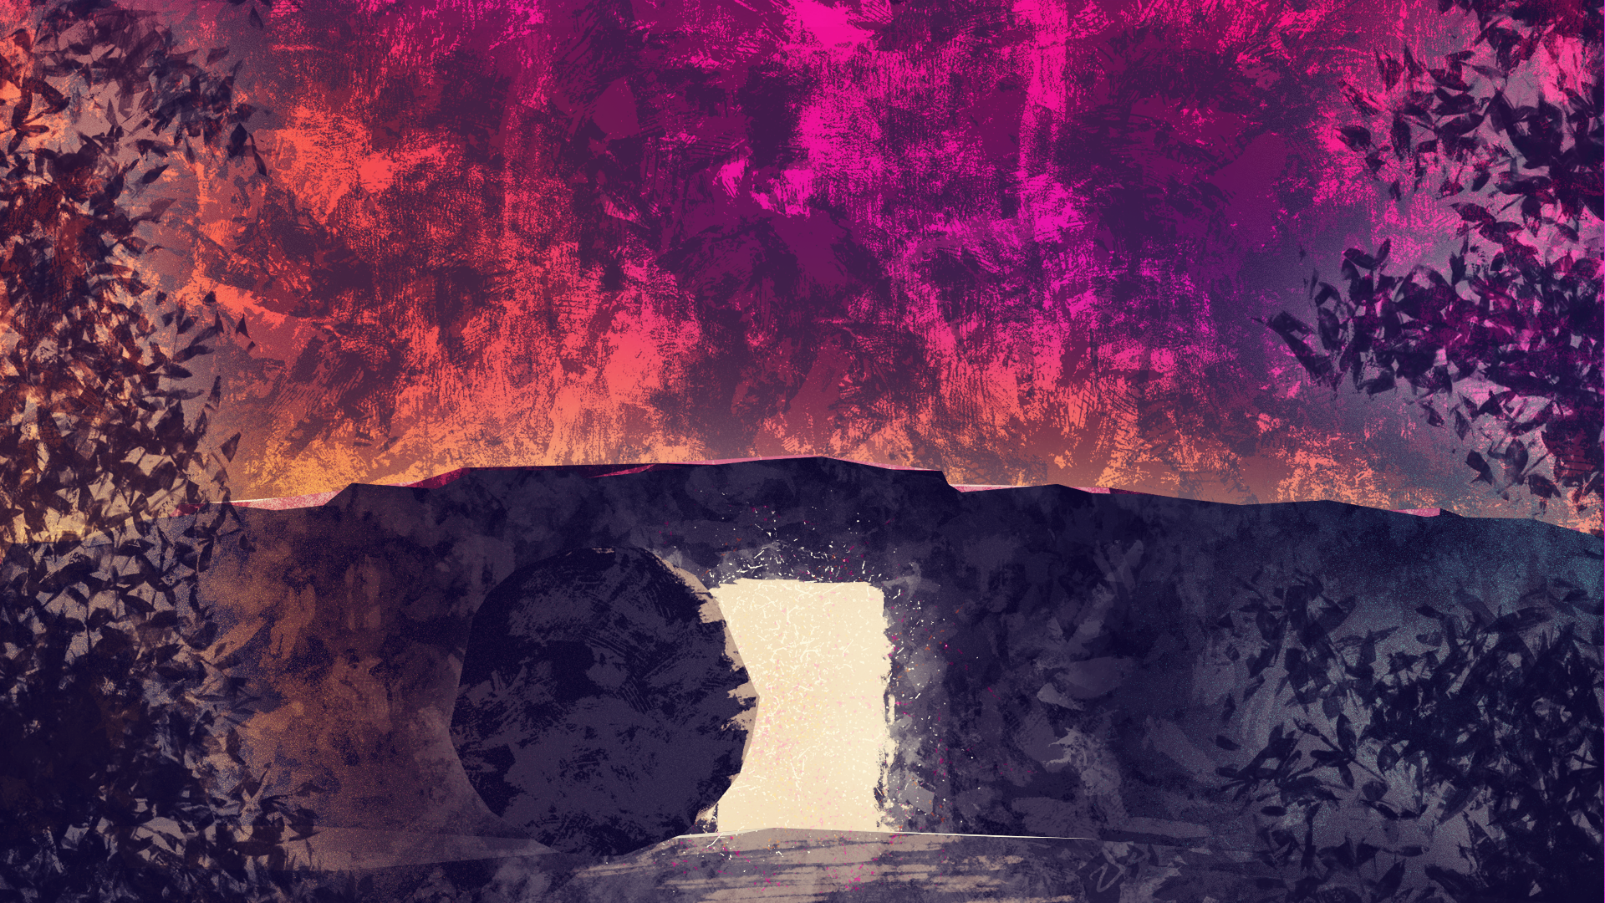
The Case Against the Resurrection
Disclaimers
I, Chase Byers, believe that Jesus Christ of Nazareth rose from the dead.
Ecclesiastes 12:12-13
“But beyond these, my son, be warned: there is no end to the making of many books, and much study wearies the body. When all has been heard, the conclusion of the matter is this: fear God and keep his commands, because this is for all humanity.”
SITS Conference 2024

Slide 2
Summary of theories
Theft Theory (1st CE)
Swoon Theory (7th & 18th CE)
Fabrication Theory (19th CE)
Wrong Tomb Theory (20th CE)
Hallucination/Visions Theory (20th CE)
Memory Distortion Theory (21st CE)
pg. 1

Slide 3
Theft Theory (1st CE)
Basics of the Theory
History of the Theory
  a rumor created by chief priests, spread by guards (Matt. 28:11-15)
  Graverobbers.
  Jesus’ family
  The gardener
“This is He whom His disciples secretly stole away, that it might be said He had risen again, or the gardener abstracted, that his lettuces might come to no harm from the crowds of visitants.” (Tertullian, De Spectaculis, ch. 30)
pg. 2-3

Slide 4
Theft Theory (1st CE)
Objections to the Theory
  Matthew’s use of “to this day” (Mt. 28:15)
  The guards at the tomb.
  The disciple’s willingness to take a lie like this to the grave.
  We must ignore the eyewitness testimony.
Mary Magdalene (Jn. 20:10–18)
To the other women (Matt. 28:8–10)
Cleopas and another disciple on the road to Emmaus (Lk. 24:13–32)
Eleven disciples and others (Lk. 24:33–49)
To ten apostles and others, with Thomas absent (Jn 20:19–23)
Thomas and the other apostles (Jn 20:26–30)
Seven apostles (Jn 21:1–14)
The disciples (Matt. 28:16–20)
The apostles at the Mt of Olives before his ascension (Lk. 24:50–52; Ac. 1:4–9)
pg. 3-5

Slide 5
SWOON THEORY (7th & 18th CE)
Basics of the Theory
History of the Theory
  The Quran & the Ahmadiyya Muslims
  Germans Karl Bahrdt & Karl Venturini
˹They were condemned˺ for breaking their covenant, rejecting Allah’s signs, killing the prophets unjustly, and for saying, “Our hearts are unreceptive!”—it is Allah Who has sealed their hearts for their disbelief, so they do not believe except for a few — and for their denial and outrageous accusation against Mary, and for boasting, “We killed the Messiah, Jesus, son of Mary, the messenger of Allah.” But they neither killed nor crucified him—it was only made to appear so. Even those who argue for this ˹crucifixion˺ are in doubt. They have no knowledge whatsoever—only making assumptions. They certainly did not kill him. Rather, Allah raised him up to Himself. And Allah is Almighty, All-Wise.
(Surah IV 155-58)
pg. 5-6

Slide 6
SWOON THEORY (7th & 18th CE)
“At Rome the scourging of citizens had been forbidden from very early times. Unprivileged persons, and especially slaves, were scourged in a variety of ways, of which the flagellum was the worse. It was a “knout” or “cat,” with lashes of knotted cord, or even wire; like the ἀστραγαλωτὴ of the Greeks, it might be loaded with knuckle-bones or other cruel aggravations.” (Smith, Wayte, Marindin)
Objections to the Theory
  The multiples parts of crucifixion undoubtedly points to Jesus’ death.
    “Then Pilate took Jesus and had him flogged.” (John 19:1)
“For they say that the bystanders were struck with amazement when they saw them lacerated with scourges even to the innermost veins and arteries, so that the hidden inward parts of the body, both their bowels and their members, were exposed to view”
(Eusebius, Ecclesiastical History, 4.15).
“Hereupon our rulers supposing, as the case proved to be, that this was a sort of divine fury in the man, brought him to the Roman procurator; where he was whipped till his bones were laid bare;” (Josephus, The War of the Jews, 303-304)
pg. 6-7

Slide 7

SWOON THEORY (7th & 18th CE)
“The crown of thorns was in all probability from the Zizyphus spina Christi (the nâbk of the Arabs), which grows abundantly in Palestine, fringing the banks of the Jordan. This plant would be very suitable for the purpose, having flexible branches, with leaves very much resembling the ivy leaf in their colour, and with many sharp thorns. The pain arising from the pressure of these sharp thorns upon the head must have been excruciating.”
(Bickersteth, The Gospel According to St. Mark, pg. 305)
Objections to the Theory
  The multiples parts of crucifixion undoubtedly points to Jesus’ death.
    “Then Pilate took Jesus and had him flogged.” (John 19:1)
    “They dressed him in a purple robe, twisted together a crown of thorns, and put it on him. And they began to salute him, “Hail, king of the Jews!” They were hitting him on the head with a stick and spitting on him.” (Mark 15:17-19)
pg. 7

Slide 8
SWOON THEORY (7th & 18th CE)
Objections to the Theory
  The multiples parts of crucifixion undoubtedly points to Jesus’ death.
    “Then Pilate took Jesus and had him flogged.” (John 19:1)
    “They dressed him in a purple robe, twisted together a crown of thorns, and put it on him. And they began to salute him, “Hail, king of the Jews!” They were hitting him on the head with a stick and spitting on him.” (Mark 15:17-19)
    “They led him out to crucify him. They forced a man coming in from the country, who was passing by, to carry Jesus’s cross. He was Simon of Cyrene...” (Mark 15:20b-21)
pg. 7-8

Slide 9
SWOON THEORY (7th & 18th CE)
Objections to the Theory
  The multiples parts of crucifixion undoubtedly points to Jesus’ death.
    “They shouted, ‘Take him away! Take him away! Crucify him!’ Pilate said to them, ‘Should I crucify your king?’ ‘We have no king but Caesar!’ the chief priests answered. Then he handed him over to be crucified.” (John 19:15-16)
“In 1968 a significant archaeological discovery was made in a suburb of Jerusalem: an ossuary with the skeletal remains of a man named Yehochanan who had been crucified. Yehochanan had been nailed to an upright beam of wood through the ankle, but the nail hit a knot in the wood and bent, making it difficult to be removed after his death. And so a chunk of the wood was broken off, and Yehochanan was buried with wood and nail still attached to the ankle bone.”
(Ehrman, The New Testament: A Historical Introduction to the Early Christian Writings, pg. 156.)
Jesus was nailed to a cross.
The Roman soldiers determine Jesus is dead.
The Roman soldiers pierce his side.
(John 19:34)
Jesus dies on the cross.
pg. 8-9

Slide 10
SWOON THEORY (7th & 18th CE)
Objections to the Theory
  The multiples parts of crucifixion undoubtedly points to Jesus’ death.
  Even if he survived, could he have recovered enough from these injuries in only 3 days?
  The apostle’s following a liar and broken man.
pg. 9-10

Slide 11
FABRICATION THEORY (19th CE)
“Now, if the history of the life of Jesus be of mythical formation, inasmuch as it embodies the vivid impression of the original idea which the first Christian community had of their founder, this history, though unhistorical in its form, is nevertheless a faithful representation of the idea of the Christ. If instead of this, the history be legendary—if the actual external facts are given in a distorted and often magnified form—are represented in a false light and embody a false idea,—then, on the contrary, the real tenor of the life of Jesus is lost to us.”
(Strauss, The Life of Jesus, pgs. 59-62)
“…that the adherents of Jesus, from their hopelessness, which is both unanimously attested by the narratives, and is in perfect accordance with the nature of the case, here rise to the rank of impartial witnesses. If they had expected a resurrection of Jesus and we had then been called upon to believe it on their testimony alone: there would certainly be a possibility and perhaps also a probability, if not of an intentional deception, yet of an involuntary self-delusion on their part; but this possibility vanishes in proportion as the disciples of Jesus lost all hope after his death.”
(Strauss, The Life of Jesus, pgs. 735-744)
“But the further these narratives were propagated by tradition, the more must the difference between the locality of the resurrection itself and the appearances of the risen one, be allowed to fall out of sight as inconvenient; and since the locality of the death and resurrection was not transferable, the appearances were gradually placed in the same locality as the resurrection,—in Jerusalem, which as the more brilliant theatre and the seat of the first Christian Church, was especially appropriate for them.”
(Strauss, The Life of Jesus, pgs. 735-744)
Basics of the Theory
History of the Theory
  David Strauss (1835)
  Rudolf Bultmann
  Jesus Seminar
  Tearing down eyewitness testimony
“It is impossible to repristinate a past world picture by sheer resolve, especially a mythical world picture, now that all of our thinking is irrevocably formed by science. A blind acceptance of New Testament mythology would be simply arbitrariness; to make such acceptance a demand of faith would be to reduce faith to a work.”
(Bultmann, New Testament and Mythology, pg.3)
pg. 10-11

Slide 12
FABRICATION THEORY (19th CE)
Objections to the Theory
  The dating of 1 Corinthians.
  Not enough time passed for a legend to develop.
  Conversions of Skeptics, response to unreliable eyewitness testimony.
  If this is a “legendary” story, they made it very “unlegendary”.
    Female witnesses
“any evidence which a woman [gives] is not valid... A robber is qualified to give the same evidence as a woman”
(Talmud, Rosh Hashannah 1.8)
“let not the testimony of women be admitted … it is probable they may not speak the truth, either out of hope of gain, or fear of punishment”
(Josephus, Antiquities, 4.8.15)
“Most decidedly must a considerable interval of time be required for such a complete transformation of a whole history by popular tradition, when the series of legends are formed in the same territory where the heroes actually lived and wrought. Here one cannot imagine how such a series of legends could arise in an historical age, obtain universal respect, and supplant the historical recollection of the true character and connexion of their heroes' lives in the minds of the community, if eyewitnesses were still at hand, who could be questioned respecting the truth of the recorded marvels. Hence, legendary fiction, as it likes not the clear present time, but prefers the mysterious gloom of grey antiquity, is wont to seek a remoteness of age, along with that of space, and to remove its boldest and more rare and wonderful creations into a very remote and unknown land.” (Müller, Voices of the Church, pg. 194)
pg. 11-15

Slide 13
FABRICATION THEORY (19th CE)
“So, departing quickly from the tomb with fear and great joy, they ran to tell his disciples the news. Just then Jesus met them and said, “Greetings! ” They came up, took hold of his feet, and worshiped him. Then Jesus told them, “Do not be afraid. Go and tell my brothers to leave for Galilee, and they will see me there.” (Mt. 28:8-10)
“Returning from the tomb, they reported all these things to the Eleven and to all the rest. Mary Magdalene, Joanna, Mary the mother of James, and the other women with them were telling the apostles these things. But these words seemed like nonsense to them, and they did not believe the women. Peter, however, got up and ran to the tomb. When he stooped to look in, he saw only the linen cloths. So he went away, amazed at what had happened. (Luke 24:9-12)
Objections to the Theory
  The dating of 1 Corinthians.
  Not enough time passed for a legend to develop.
  Conversions of Skeptics, response to unreliable eyewitness testimony.
  If this is a “legendary” story, they made it very “unlegendary”.
    Female witnesses
    The Apostles’ reactions
“When it was evening on that first day of the week, the disciples were gathered together with the doors locked because they feared the Jews. Jesus came, stood among them, and said to them, “Peace be with you.” (John 20:19)
pg. 11-15

Slide 14
Wrong Tomb theory (20th CE)
Basics of the Theory
History of the Theory
  Kirsopp Lake (1907)
“He is not here.” (Mark 16:6).
“It is seriously a matter for doubt whether the women were really in a position to be quite certain that the tomb which they visited, was that in which they had seen Joseph of Arimathaea, buried the Lord’s body. The neighborhood of Jerusalem is full of rock-tombs, and it would not be easy to distinguish one from another, without careful notes. So far as their frame of mind at the time of the burial was concerned, the women were certainly not fit to take notes. They had spent the day in watching the dying agony of their Master, and it is not in human nature at such a time calmly to consider a question of locality. Moreover, it is very doubtful if they were close to the tomb at the moment of burial. As was shown in chapters ii. and iv., it is likely that they were watching from a distance, and that Joseph of Arimathaea was a representative of the Jews, rather than of the disciples. If so, they would have a limited power to distinguish between one rock-tomb and another close to it. The possibility, therefore, that they came to the wrong tomb is to be reckoned with, and it is important because it supplies the natural explanation of the fact that whereas they had seen the tomb closed, they found it open.”
(Lake, The Historical Evidence for the Resurrection of Jesus Christ, pg. 250)
pg. 15-16

Slide 15
Wrong Tomb theory (20th CE)
Objections to the Theory
  The women knew where Jesus was.
  The men also said, “He is Risen!”
  An easy mistake to correct.
  Ignore eyewitness accounts
  Disciples dying for their beliefs
pg. 16

Slide 16
Hallucinations/visions theory (20th CE)
Or “doubt” theory
Basics of the Theory
History of the Theory
  Rudolph Bultmann
  David Strauss
  Bart Ehrman
“The historian can perhaps to some extent account for that faith [in the resurrection] from the personal intimacy which the disciple had enjoyed with Jesus during his earthly life and so reduce the resurrection appearances to a series of subjective visions.”
(Bultmann, Kerygma & Myth, pg. 42)
“Thus the faith in Jesus 7 as the Messiah, which by his violent death had received a fatal shock, was subjectively restored, by the instrumentality of the mind, the power of imagination, and nervous excitement.”
(Strauss, The Life of Jesus, pgs. 414-431)
pg. 16-17

Slide 17
Hallucinations/visions theory (20th CE)
Or “doubt” theory
Objections to the Theory
  Hallucinations don’t work this way.
“Hallucinations are individual occurrences. By their very nature only one person can see a given hallucination at a time. They certainly aren’t something which can be seen by a group of people. Neither is it possible that one person could somehow induce an hallucination in somebody else. Since an hallucination exists only in this subjective, personal sense, it is obvious that others cannot witness it.”
(Dr. Gary Collins, in Gary Habermas and J. P. Moreland, Immortality: The Other Side of Death, pg. 60)
pg. 17

Slide 18
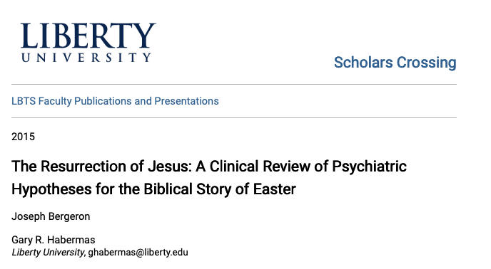
Hallucinations/visions theory (20th CE)
Or “doubt” theory
Objections to the Theory
  Hallucinations don’t work this way.
  The disciples were not doing anything to warrant a hallucination.
“Hallucinations are personal perceptions of objects or events by the physical senses without external stimulus or physical referent. A hallucination is a symptom, not a diagnosis. The presence of hallucinatory symptoms, therefore, mandates consideration of their etiology and the kinds of medical pathology that would account for their occurrence. Hallucinations can be classified in three types of etiology: Psychophysiologic, arising from alteration of brain structure and function; Psychobiochemical, due to neurotransmitter disturbances; and Psychodynamic, arising from intrusion of the unconscious into the conscious mind.”
pg. 18-19

Slide 19

Memory distortion theory (21st CE)
Basics of the Theory
pg. 18

Slide 20
Memory distortion theory (21st CE)
History of the Theory
  Who is Bart Ehrman?
    From believer to blasphemer
“Moreover, I came to think that my earlier views of inspiration were not only irrelevant, they were probably wrong. For the only reason (I came to think) for God to inspire the Bible would be so that his people would have his actual words; but if he really wanted people to have his actual words, surely he would have miraculously preserved those words, just as he had miraculously inspired them in the first place. Given the circumstance that he didn't preserve the words, the conclusion seemed inescapable to me that he hadn't gone to the trouble of inspiring them.”
(Ehrman, Misquoting Jesus, pg. 211)
pg. 18-19

Slide 21
Memory distortion theory (21st CE)
History of the Theory
  Who is Bart Ehrman?
    From believer to blasphemer
    Summary of beliefs
      Views on Jesus
      Views on death & burial of Jesus
“I don’t know of any instance where we have a verified account of anybody being buried in the afternoon of their crucifixion in a known tomb. So how likely is it that they made an exception in the case of Jesus?”
pg. 19-20

Slide 22
Memory distortion theory (21st CE)
History of the Theory
  Ehrman’s theory in Jesus Before the Gospels
“We—whether as individuals or as members of a collective—“remember” the past because of its value in the present. Otherwise we have no reason even to think about the past—whether it is our own past lives and experiences or the lives and experiences of our society. And—this is the key point I am trying to make—sometimes, often, or always our memories of the past are distorted precisely because of the demands of the present.”
“Here, though, is my ultimate point, both for this chapter and for the entire book: this invention of memories of Jesus is not simply a modern phenomenon. It has always been going on. From the very earliest of times. As far back as we have recorded memories of Jesus, we have widely disparate accounts of his words and deeds. And the events of his life. And the events of the lives of those who knew him.”
pg. 20

Slide 23
Memory distortion theory (21st CE)
History of the Theory
  Ehrman’s different findings on kinds of “memory”
    Episodic & Semantic Memory
    Group memory
    Suggestion memory
    “filling in the gaps”
    Distorted memory
    Flashbulb vs gist memory
“Jesus’s Sermon on the Mount in Matthew chapters 5–7 was recorded about fifty years after he would have delivered the sermon. But can we assume he delivered it? If he did so, did he speak the specific words now found in the sermon (all three chapters of them) while sitting on a mountain addressing the crowds? On that occasion did he really say, “Blessed are the poor in spirit, for theirs is the Kingdom of Heaven,” and “Beware of false prophets, who come to you in sheep’s clothing but inwardly are ravenous wolves,” and “Everyone who hears these words of mine and does them will be like a wise man who built his house on a rock”? Or did he say things sort of like that on the occasion? Or did he say something sort of like that on some other occasion—any occasion at all? Which is the gist and which is the detail?”
pg. 21-23

Slide 24
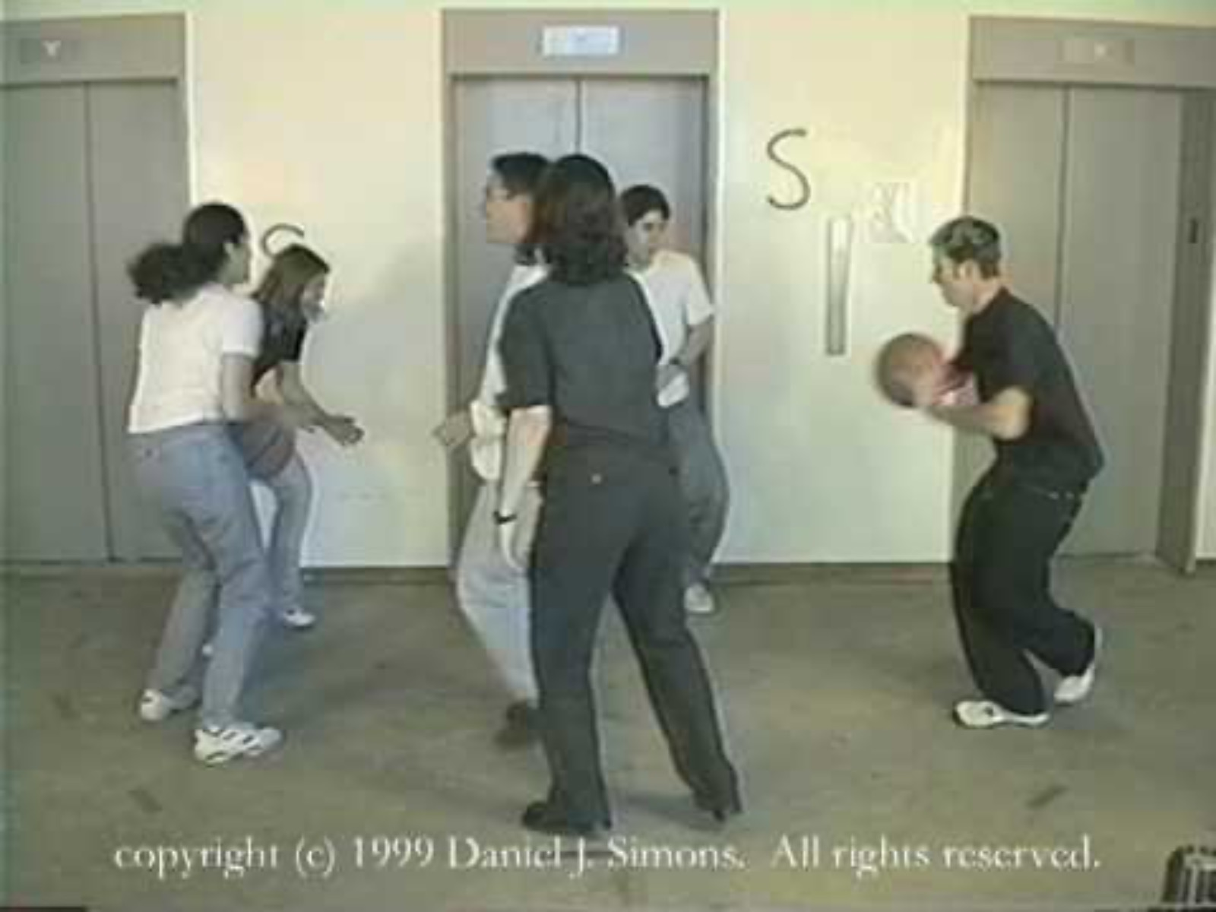
Memory distortion theory (21st CE)
History of the Theory
  Various studies that Ehrman cites
pg. 23

Slide 25
Memory distortion theory (21st CE)
History of the Theory
  Various studies that Ehrman cites
  Ehrman largely subscribes to the Legendary/Myth theories of Jesus Resurrection.
“And so to return to my question: is it possible that some people—many people—see “invented” traditions about Jesus, or “distorted” memories of what happened in his life, when they are looking for them, in books from outside the New Testament? But that when the books are inside the New Testament they are not looking for such things and so don’t see them?”
pg. 23-24

Slide 26
Memory distortion theory (21st CE)
Objections to the Theory
  There is no comparing what the early disciples and eyewitnesses of Jesus saw.
  When weighed against all the evidence and the eyewitnesses, this theory seems improbable.
  Ehrman’s worldview dismisses plenary inspiration of the Scriptures.
  Ehrman’s begins with conjecture that leads to his conclusions.
  An over exaggeration of textual criticism.
“The more I studied the manuscript tradition of the New Testament, the more I realized just how radically the text had been altered over the years at the hands of scribes, who were not only conserving scripture but also changing it. To be sure, of all the hundreds of thousands of textual changes found among our manuscripts, most of them are completely insignificant, immaterial, of no real importance for anything other than showing that scribes could not spell or keep focused any better than the rest of us.”
(Ehrman, Misquoting Jesus, pg. 207)
pg. 24-26

Slide 27
Memory distortion theory (21st CE)
Objections to the Theory
  Recreation of the story of Jesus in the 7 critic accepted Pauline letters.
    7 critic accepted Pauline letters are: Romans, 1-2 Corinthians, Galatians, Philippians, 1 Thessalonians, Philemon.
pg. 26-27

Slide 28
Events of the Gospel Narratives | Found in 7 Critic Accepted Pauline Letters
FAMILY
Born of Mary (a virgin) | Galatians 4:4
Descendant of King David | Romans 1:3
(Father): Joseph / Bro.: James, Joseph, Simon, Judas | 1 Corinthians 9:5; Galatians 1:19
Bethlehem / Nazareth | Acts 22:28
INTRO TO THE GOSPELS
John the Baptist | Acts 13:24
MINISTRY OF JESUS: Galilee / Samaria/ Judea
Teaching (sermons, parables) | 1 Corinthians 7:10; 11:23; Acts 20:35
Miracles (signs, healings, etc.) | 2 Corinthians 12:12; Rom. 15:19
12 Apostles | 1 Corinthians 15:5
Peter, John, etc. | Gal. 1-2; 1 Cor. 1; 15:5
EVENTS SURROUNDING DEATH & RES.
Enters Jerusalem | 1 Thessalonians 2:14-15
Betrayal by Judas | 1 Thessalonians 2:14-15
Eats the Lord’s Supper | 1 Corinthians 11:23
Arrested & Tried before High Priest | 1 Thessalonians 2:14-15
Brought to Pilate & Herod | Acts 13:28
Crucified | 1 Cor. 2:2; 1:18; Phil. 2:8; Gal. 3:13
Buried by Joseph & Nicodemus | 1 Corinthians 15:4
Rose on the 1st day | Romans 1:4; 1 Cor. 15; 16:1; 1 Thess. 4:14
Appeared to disciples | 1 Corinthians 15
Ascended to the Father | Phil. 2:9; Romans 8:34

Slide 29
Conclusion
“naturalistic” explanations sound pretty miraculous
Jesus was a real person.
Jesus was crucified.
Jesus was buried in a tomb.
People saw a post-mortem Jesus walking around and interacted with him.
how is this possible?
”He is risen.”
pg. 27-28

Slide 30
The Case Against the Resurrection
SITS Conference 2024

