Slide 2
The Case for the Resurrection
And the angel answered and said unto the women, Fear not ye: for I know that ye seek Jesus, which was crucified. He is not here: for he is risen, as he said. Come, see the place where the Lord lay. And go quickly, and tell his disciples that he is risen from the dead; and, behold, he goeth before you into Galilee; there shall ye see him: lo, I have told you. And they departed quickly from the sepulchre with fear and great joy; and did run to bring his disciples word. And as they went to tell his disciples, behold, Jesus met them, saying, All hail. And they came and held him by the feet, and worsh ipped him.
"Taking all the evidence together, it is not too much to say that there is no historic incident better or more variously supported than the resurrection of Christ. Nothing but the antecedent assumption that it must be false could have suggested the idea of deficiency in the proof of it." - B. F. Westcott

Slide 3
The Case for the Resurrection
And the angel answered and said unto the women, Fear not ye: for I know that ye seek Jesus, which was crucified. He is not here: for he is risen, as he said. Come, see the place where the Lord lay. And go quickly, and tell his disciples that he is risen from the dead; and, behold, he goeth before you into Galilee; there shall ye see him: lo, I have told you. And they departed quickly from the sepulchre with fear and great joy; and did run to bring his disciples word. And as they went to tell his disciples, behold, Jesus met them, saying, All hail. And they came and held him by the feet, and worsh ipped him.
Jesus’ death, burial, and resurrection were predicted by the prophets and Jesus himself

Slide 4
Prophecies of the Betrayal, Trial, and Crucifixion of Jesus
Sold for 30 pieces of silver Zech. 11:12 Mt. 26:14,15
The money to be cast to potter Zech. 11:13 Mt. 27:3-10
His disciples to forsake Him Zech. 13:7 Mk. 14:27
Silent before accusers Isa. 53:7 Mt. 27:12-14
Wounded and bruised Isa. 53:5 Mt. 27:12-14
Hands and feet pierced Ps. 22:16 Lk. 23:33
Crucified with thieves Isa. 53:12 Mk. 15:27,28
Prayed for persecutors Isa. 53:12 Lk. 23:34
People shook heads at Him Ps. 22:7 Mt. 27:39
He was ridiculed Ps. 22:7 Mt. 27:41,43
The people were astonished Ps. 22:17 Lk. 23:35
Garments parted/lots cast Ps. 22:18 Jn. 19:24
He cried unto God Ps. 22:1 Mt. 27:46
Bones were not broken Ps. 34:20 Jn. 19:33,36
Side to be pierced Zech. 12:10 Jn. 19:34,37
Buried in a rich man’s tomb Isa. 53:9 Mt. 27:57-60

Slide 5
Matthew 16:21 KJV
From that time forth began Jesus to shew unto his disciples, how that he must go unto Jerusalem, and suffer many things of the elders and chief priests and scribes, and be killed, and be raised again the third day.

Slide 6
The Case for the Resurrection
And the angel answered and said unto the women, Fear not ye: for I know that ye seek Jesus, which was crucified. He is not here: for he is risen, as he said. Come, see the place where the Lord lay. And go quickly, and tell his disciples that he is risen from the dead; and, behold, he goeth before you into Galilee; there shall ye see him: lo, I have told you. And they departed quickly from the sepulchre with fear and great joy; and did run to bring his disciples word. And as they went to tell his disciples, behold, Jesus met them, saying, All hail. And they came and held him by the feet, and worsh ipped him.
Jesus’ death, burial, and resurrection were predicted by the prophets and Jesus himself
The death and burial of Jesus
  Pre-crucifixion events

Slide 7
Luke 22:39-44 ESV
And he came out and went, as was his custom, to the Mount of Olives, and the disciples followed him . . . And being in agony he prayed more earnestly; and his sweat became like great drops of blood falling down to the ground.

Slide 8
“Every attempt imaginable has been used by modern scholars to explain away this phrase, apparently under the mistaken impression that this just doesn’t happen. A great deal of effort could be saved by consulting medical literature. Though very rare, the phenomenon of Hematidrosis, or bloody sweat, is well documented. Under great emotional stress, tiny capillaries in the sweat glands can break, thus mixing blood with sweat. This process alone could have produced marked weakness and possible shock.”
- C. Truman Davis
“The Passion of Christ From A Medical Point of View”,Arizona Medicine, March, 1965, p. 185

Slide 9
Matthew 26:47-50 ESV
While he was still speaking, Judas came, one of the twelve, and with him a great crowd with swords and clubs, from the chief priests and the elders of the people . . . And he came up to Jesus at once and said, “Greetings, Rabbi!” And he kissed him. Jesus said to him, “Friend, do what you came to do.” Then they came up and laid hands on Jesus and seized him . . . Then all the disciples left him and fled.

Slide 10
Mark 14:55-59 NASB
Now the chief priests and the whole Council kept trying to obtain testimony against Jesus to put Him to death, and they were not finding any. For many were giving false testimony against Him, but their testimony was not consistent. Some stood up and began to give false testimony against Him, saying, "We heard Him say, 'I will destroy this temple made with hands, and in three days I will build another made without hands.'" Not even in this respect was their testimony consistent.

Slide 11
Matthew 26:67-68 NASB
Then they spat in His face and beat Him with their fists; and others slapped Him, and said, "Prophesy to us, You Christ; who is the one who hit You?"

Slide 12
Matthew 27:24-26 ESV
So when Pilate saw that he was gaining nothing, but rather that a riot was beginning, he took water and washed his hands before the crowd, saying, “I am innocent of this man's blood; see to it yourselves.” . . . and having scourged Jesus, delivered him to be crucified.

Slide 13
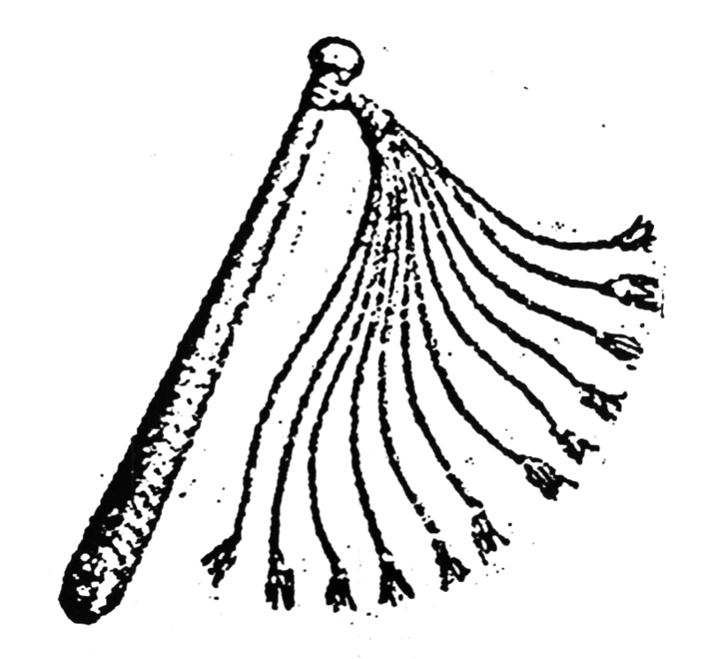

Slide 14
    "The heavy whip is brought down with full force again and again across the shoulders, back and legs. At first the heavy thongs cut through the skin only. Then, as the blows continue, they cut deeper into the subcutaneous tissues, producing first an oozing of blood from the capillaries and veins of the skin, and finally spurting arterial bleeding from vessels in the underlying muscles. The small balls of lead first produce large, deep bruises which are broken open by subsequent blows. Finally, the skin is hanging in long ribbons and the entire area is an unrecognizable mass of torn, bleeding tissues. When it is determined by the centurion in charge that the prisoner is near death, the beating is finally stopped.“
    - C Truman Davis
    “The Passion of Christ From A Medical Point of View”,Arizona Medicine, March, 1965, p. 185

Slide 15
John 19:1-6 KJV
Then Pilate therefore took Jesus, and scourged him . . . Pilate therefore went forth again, and saith unto them, Behold, I bring him forth to you, that ye may know that I find no fault in him. Then came Jesus forth, wearing the crown of thorns, and the purple robe. And Pilate saith unto them, Behold the man! When the chief priests therefore and officers saw him, they cried out, saying, Crucify him, crucify him. Pilate saith unto them, Take ye him, and crucify him: for I find no fault in him.

Slide 16
Matthew 27:27-31 ESV
Then the soldiers of the governor took Jesus into the governor's headquarters. . . And they stripped him and put a scarlet robe on him, and twisting together a crown of thorns, they put it on his head and put a reed in his right hand. And kneeling before him, they mocked him, saying, “Hail, King of the Jews!” And they spit on him and took the reed and struck him on the head. And when they had mocked him, they stripped him of the robe and put his own clothes on him and led him away to crucify him.

Slide 17
John 19:16-17 ESV
. . . so they took Jesus, and he went out, bearing his own cross, to the place called The Place of a Skull, which in Aramaic is called Golgotha.

Slide 18
The Case for the Resurrection
And the angel answered and said unto the women, Fear not ye: for I know that ye seek Jesus, which was crucified. He is not here: for he is risen, as he said. Come, see the place where the Lord lay. And go quickly, and tell his disciples that he is risen from the dead; and, behold, he goeth before you into Galilee; there shall ye see him: lo, I have told you. And they departed quickly from the sepulchre with fear and great joy; and did run to bring his disciples word. And as they went to tell his disciples, behold, Jesus met them, saying, All hail. And they came and held him by the feet, and worsh ipped him.
Jesus’ death, burial, and resurrection were predicted by the prophets and Jesus himself
The death and burial of Jesus
  Pre-crucifixion events
  The crucifixion

Slide 19
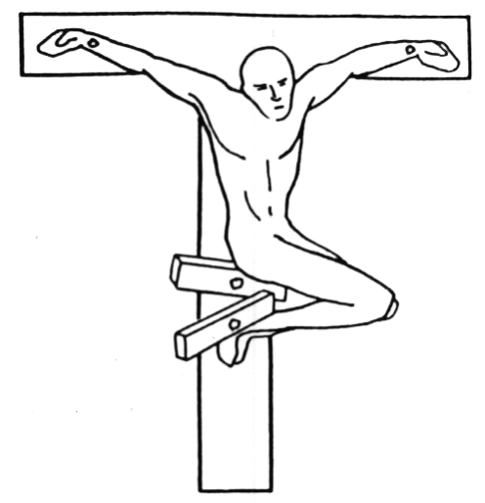

Slide 20
    "Hanging by his arms, the pectoral muscles are paralyzed and the intercostal muscles are unable to act. Air can be drawn into the lungs, but cannot be exhaled. (The victim) fights to raise himself in order to get even a short breath.“
    - C Truman Davis
    “The Passion of Christ From A Medical Point of View”, Arizona Medicine, March, 1965, p. 185

Slide 21
John 20:24-28 NASB
But Thomas . . . said to them, "Unless I see in His hands the imprint of the nails, and put my finger into the place of the nails, and put my hand into His side, I will not believe." After eight days His disciples were again inside, and Thomas with them. Jesus came, the doors having been shut, and stood in their midst and said, "Peace be with you." Then He said to Thomas, "Reach here with your finger, and see My hands; and reach here your hand and put it into My side; and do not be unbelieving, but believing." Thomas answered and said to Him, "My Lord and my God!"

Slide 22
"Both the heel bones were found transfixed by a large iron nail. The shins were found intentionally broken. Death caused by crucifixion."
- N. Haas
“Anthropological Observations on the Skeletal Remains from Giv’ at ha-Mivtar", Israel Exploration Journal

Slide 23
The Case for the Resurrection
And the angel answered and said unto the women, Fear not ye: for I know that ye seek Jesus, which was crucified. He is not here: for he is risen, as he said. Come, see the place where the Lord lay. And go quickly, and tell his disciples that he is risen from the dead; and, behold, he goeth before you into Galilee; there shall ye see him: lo, I have told you. And they departed quickly from the sepulchre with fear and great joy; and did run to bring his disciples word. And as they went to tell his disciples, behold, Jesus met them, saying, All hail. And they came and held him by the feet, and worsh ipped him.
Jesus’ death, burial, and resurrection were predicted by the prophets and Jesus himself
The death and burial of Jesus
  Pre-crucifixion events
  The crucifixion
  Post-crucifixion events

Slide 24
John 19:31-37 ESV
Since it was the day of Preparation, and so that the bodies would not remain on the cross on the Sabbath . . . the Jews asked Pilate that their legs might be broken and that they might be taken away. So the soldiers came and broke the legs of the first, and of the other who had been crucified with him. But when they came to Jesus and saw that he was already dead, they did not break his legs. But one of the soldiers pierced his side with a spear, and at once there came out blood and water . . . these things took place that the Scripture might be fulfilled: “Not one of his bones will be broken.” And again another Scripture says, “They will look on him whom they have pierced.”

Slide 25
The Case for the Resurrection
And the angel answered and said unto the women, Fear not ye: for I know that ye seek Jesus, which was crucified. He is not here: for he is risen, as he said. Come, see the place where the Lord lay. And go quickly, and tell his disciples that he is risen from the dead; and, behold, he goeth before you into Galilee; there shall ye see him: lo, I have told you. And they departed quickly from the sepulchre with fear and great joy; and did run to bring his disciples word. And as they went to tell his disciples, behold, Jesus met them, saying, All hail. And they came and held him by the feet, and worsh ipped him.
Jesus’ death, burial, and resurrection were predicted by the prophets and Jesus himself
The death and burial of Jesus
  Pre-crucifixion events
  The crucifixion
  Post-crucifixion events
  Final confirmation of death

Slide 26
Mark 15:43-45 ESV
Joseph of Arimathea, a respected member of the council, who was also himself looking for the kingdom of God, took courage and went to Pilate and asked for the body of Jesus. Pilate was surprised to hear that he should have already died. And summoning the centurion, he asked him whether he was already dead. And when he learned from the centurion that he was dead, he granted the corpse to Joseph.

Slide 27
Death by crucifixion at the hands of the Romans was an extremely efficient method of execution, as the following incident will prove: "True, there is a recorded instance of a victim being taken down from a cross and surviving. The Jewish historian Josephus, who had gone over to the Roman side in the rebellion of 66 A.D., discovered three of his friends being crucified. He asked the Roman general Titus to reprieve them, and they were immediately removed from their crosses. Still, two of the three died anyway, even though they apparently had been crucified only a short time. In Jesus’ case, however, there were additional complications of scourging and exhaustion, to say nothing of the great spear thrust that pierced his rib cage and probably ruptured his pericardium. Romans were grimly efficient about crucifixions: victims did not escape with their lives."
- Paul l. Maier
The First Easter, p.112

Slide 28
The Case for the Resurrection
And the angel answered and said unto the women, Fear not ye: for I know that ye seek Jesus, which was crucified. He is not here: for he is risen, as he said. Come, see the place where the Lord lay. And go quickly, and tell his disciples that he is risen from the dead; and, behold, he goeth before you into Galilee; there shall ye see him: lo, I have told you. And they departed quickly from the sepulchre with fear and great joy; and did run to bring his disciples word. And as they went to tell his disciples, behold, Jesus met them, saying, All hail. And they came and held him by the feet, and worsh ipped him.
Jesus’ death, burial, and resurrection were predicted by the prophets and Jesus himself
The death and burial of Jesus
  Pre-crucifixion events
  The crucifixion
  Post-crucifixion events
  Final confirmation of death
  Burial place and methods

Slide 29
John 19:17 KJV
And he bearing his cross went forth into a place called the place of a skull, which is called in the Hebrew Golgotha:

Slide 30
John 19:41 NASB
Now in the place where He was crucified there was a garden, and in the garden a new tomb in which no one had yet been laid.

Slide 31
Luke 23:52-53 KJV
(Joseph) went unto Pilate, and begged the body of Jesus. And he took it down, and wrapped it in linen, and laid it in a sepulchre that was hewn in stone, wherein never man before was laid.

Slide 32
John 19:38-40 NKJV
After this, Joseph of Arimathea . . . asked Pilate that he might take away the body of Jesus; and Pilate gave him permission. So he came and took the body of Jesus. And Nicodemus, who at first came to Jesus by night, also came, bringing a mixture of myrrh and aloes, about a hundred pounds. Then they took the body of Jesus, and bound it in strips of linen with the spices, as the custom of the Jews is to bury.

Slide 33
John 20:6-7 NASB
. . . (Peter) entered the tomb; and he saw the linen wrappings lying there, and the face-cloth which had been on His head, not lying with the linen wrappings, but rolled up in a place by itself.

Slide 34
Mark 15:46 - 16:4 KJV
(Joseph) laid him in a sepulchre which was hewn out of a rock, and rolled a stone unto the door of the sepulchre . . . And when the sabbath was past, Mary Magdalene, and Mary the mother of James, and Salome, had bought sweet spices, that they might come and anoint him . . . And they said among themselves, Who shall roll us away the stone from the door of the sepulchre? And when they looked, they saw that the stone was rolled away: for it was very great.

Slide 35
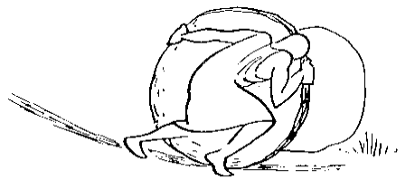

Slide 36
The Case for the Resurrection
And the angel answered and said unto the women, Fear not ye: for I know that ye seek Jesus, which was crucified. He is not here: for he is risen, as he said. Come, see the place where the Lord lay. And go quickly, and tell his disciples that he is risen from the dead; and, behold, he goeth before you into Galilee; there shall ye see him: lo, I have told you. And they departed quickly from the sepulchre with fear and great joy; and did run to bring his disciples word. And as they went to tell his disciples, behold, Jesus met them, saying, All hail. And they came and held him by the feet, and worsh ipped him.
Jesus’ death, burial, and resurrection were predicted by the prophets and Jesus himself
The death and burial of Jesus
  Pre-crucifixion events
  The crucifixion
  Post-crucifixion events
  Final confirmation of death
  Burial place and methods
  Security precautions

Slide 37
Matthew 27:62-66 KJV
Now the next day, that followed the day of the preparation, the chief priests and Pharisees came together unto Pilate, saying, Sir, we remember that that deceiver said, while he was yet alive, After three days I will rise again. Command therefore that the sepulchre be made sure until the third day, lest his disciples come by night, and steal him away, and say unto the people, He is risen from the dead: so the last error shall be worse than the first. Pilate said unto them, Ye have a watch: go your way, make it as sure as ye can. So they went, and made the sepulchre sure, sealing the stone, and setting a watch.

Slide 38
The Case for the Resurrection
And the angel answered and said unto the women, Fear not ye: for I know that ye seek Jesus, which was crucified. He is not here: for he is risen, as he said. Come, see the place where the Lord lay. And go quickly, and tell his disciples that he is risen from the dead; and, behold, he goeth before you into Galilee; there shall ye see him: lo, I have told you. And they departed quickly from the sepulchre with fear and great joy; and did run to bring his disciples word. And as they went to tell his disciples, behold, Jesus met them, saying, All hail. And they came and held him by the feet, and worsh ipped him.
Jesus’ death, burial, and resurrection were predicted by the prophets and Jesus himself
The death and burial of Jesus
  Pre-crucifixion events
  The crucifixion
  Post-crucifixion events
  Final confirmation of death
  Burial place and methods
  Security precautions
Evidence of the resurrection
  The empty tomb

Slide 39
Matthew 28:1-15 KJV
. . . the angel of the Lord descended from heaven, and came and rolled back the stone from the door, and . . . for fear of him the keepers did shake, and became as dead men . . . behold, some of the watch came into the city, and shewed unto the chief priests all the things that were done. And when they were assembled with the elders, and had taken counsel, they gave large money unto the soldiers, saying, Say ye, His disciples came by night, and stole him away while we slept. And if this come to the governor's ears, we will persuade him, and secure you. So they took the money, and did as they were taught: and this saying is commonly reported among the Jews until this day.

Slide 40
The Case for the Resurrection
And the angel answered and said unto the women, Fear not ye: for I know that ye seek Jesus, which was crucified. He is not here: for he is risen, as he said. Come, see the place where the Lord lay. And go quickly, and tell his disciples that he is risen from the dead; and, behold, he goeth before you into Galilee; there shall ye see him: lo, I have told you. And they departed quickly from the sepulchre with fear and great joy; and did run to bring his disciples word. And as they went to tell his disciples, behold, Jesus met them, saying, All hail. And they came and held him by the feet, and worsh ipped him.
Jesus’ death, burial, and resurrection were predicted by the prophets and Jesus himself
The death and burial of Jesus
  Pre-crucifixion events
  The crucifixion
  Post-crucifixion events
  Final confirmation of death
  Burial place and methods
  Security precautions
Evidence of the resurrection
  The empty tomb
  Eyewitness testimony

Slide 41
1 Corinthians 15:3-8 ESV
For I delivered to you as of first importance what I also received: that Christ died for our sins in accordance with the Scriptures, that he was buried, that he was raised on the third day in accordance with the Scriptures, and that he appeared to Cephas, then to the twelve. Then he appeared to more than five hundred brothers at one time, most of whom are still alive, though some have fallen asleep. Then he appeared to James, then to all the apostles. Last of all, as to one untimely born, he appeared also to me.

Slide 42
The Case for the Resurrection
And the angel answered and said unto the women, Fear not ye: for I know that ye seek Jesus, which was crucified. He is not here: for he is risen, as he said. Come, see the place where the Lord lay. And go quickly, and tell his disciples that he is risen from the dead; and, behold, he goeth before you into Galilee; there shall ye see him: lo, I have told you. And they departed quickly from the sepulchre with fear and great joy; and did run to bring his disciples word. And as they went to tell his disciples, behold, Jesus met them, saying, All hail. And they came and held him by the feet, and worsh ipped him.
Jesus’ death, burial, and resurrection were predicted by the prophets and Jesus himself
The death and burial of Jesus
  Pre-crucifixion events
  The crucifixion
  Post-crucifixion events
  Final confirmation of death
  Burial place and methods
  Security precautions
Evidence of the resurrection
  The empty tomb
  Eyewitness testimony
  Circumstantial evidence
  Changed lives

Slide 43
John 7:2-5 ESV
Now the Jews' Feast of Booths was at hand. So his brothers said to him, “Leave here and go to Judea, that your disciples also may see the works you are doing. For no one works in secret if he seeks to be known openly. If you do these things, show yourself to the world.” For not even his brothers believed in him.
Acts 1:14 ESV
All these with one accord were devoting themselves to prayer, together with the women and Mary the mother of Jesus, and his brothers.

Slide 44
Matthew 26:56 ESV
. . . then all the disciples left him and fled.
Acts 4:18-20 ESV
So they called them and charged them not to speak or teach at all in the name of Jesus. But Peter and John answered them, “Whether it is right in the sight of God to listen to you rather than to God, you must judge, for we cannot but speak of what we have seen and heard.”

Slide 45
  . . .men ordinarily speak the truth, when they have no prevailing motive or inducement to the contrary . . . (these witnesses) went against all their worldly interests . . . They could expect nothing but contempt, opposition, revilings, bitter persecutions, stripes, imprisonments, torments and death. Yet this faith they zealously did propagate; and all these miseries they endured . . .”
  – Simon Greenleaf
  The Testimony of the Evangelists: The Gospels Examined by The Rules of Evidence, Eastford, CT., Martino Fine Books, 2019 Reprint of 1874 Edition

Slide 46
1 Timothy 1:12-13 NASB
I thank Christ Jesus our Lord, who has strengthened me, because He considered me faithful, putting me into service, even though I was formerly a blasphemer and a persecutor and a violent aggressor. Yet I was shown mercy because I acted ignorantly in unbelief;

Slide 47
The Case for the Resurrection
And the angel answered and said unto the women, Fear not ye: for I know that ye seek Jesus, which was crucified. He is not here: for he is risen, as he said. Come, see the place where the Lord lay. And go quickly, and tell his disciples that he is risen from the dead; and, behold, he goeth before you into Galilee; there shall ye see him: lo, I have told you. And they departed quickly from the sepulchre with fear and great joy; and did run to bring his disciples word. And as they went to tell his disciples, behold, Jesus met them, saying, All hail. And they came and held him by the feet, and worsh ipped him.
Jesus’ death, burial, and resurrection were predicted by the prophets and Jesus himself
The death and burial of Jesus
  Pre-crucifixion events
  The crucifixion
  Post-crucifixion events
  Final confirmation of death
  Burial place and methods
  Security precautions
Evidence of the resurrection
  The empty tomb
  Eyewitness testimony
  Circumstantial evidence
  Changed lives

