Slide 1
Undesigned Coincidences
John 13:1-20

Slide 2
If I then your Lord and Teacher, have washed your feet, you also ought to wash one another’s feet
John 13:1-20
p1
John 13:1-20

Slide 3
For who is greater, he who sits at the table, or he who serves? Yet I am among you as the One who serves
Luke 22:27
p1
John 13:1-20

Slide 4
For who is greater, he who sits at the table, or he who serves? Yet I am among you as the One who serves
Undesigned Coincidence
Luke 22:27
p1
John 13:1-20

Slide 5
…Jesus lifted up His eyes and see a great multitude said to Philip, “Where shall we buy bread, that these may eat?”
John 6:9
p1
John 13:1-20

Slide 6
…Philip was from Bethsaida, the city of Andrew and Peter
…a deserted place belonging to the city of Bethsaida
Jn 12:21; Lk 9:10
p1

Slide 7
…Philip was from Bethsaida, the city of Andres and Peter
…a deserted place belonging to the city of Bethsaida
Undesigned Coincidence
Jn 12:21; Lk 9:10
p1

Slide 8
Undesigned Coincidence
p2

Slide 9
Evidence
Based Faith
p2

Slide 10
Undesigned Coincidence
p7

Slide 11
Events or details that align in a meaningful way without evident design or intention behind them
Undesigned Coincidence
p8

Slide 12
William Paley
1743-1805
Undesigned Coincidence
p8

Slide 13
J. J. Blunt
1794-1855
Undesigned Coincidence
p8

Slide 14
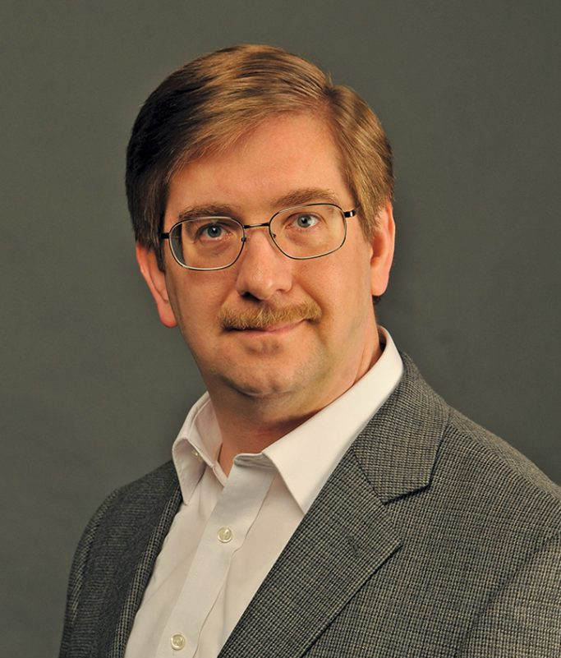
Tim McGrew
Lydia McGrew
Undesigned Coincidence
p8

Slide 15
Lydia McGrew
8

Slide 16
Undesigned Coincidences
John 13:1-20

Slide 17
“He was before me” Jn 1:30
Undesigned Coincidence
John The Baptist is older – Lk 1:26ff
John 13:1-20
p9

Slide 18
“This is the Son of God” Jn 1:34
Undesigned Coincidence
John The Baptist is older – Lk 1:26ff
John 13:1-20
p9

Slide 19
“They immediately left their nets and followed Him” Mt 4:20
Undesigned Coincidence
Met Jesus earlier Jn 1:40-41
John 13:1-20
p10

Slide 20
“Many were coming and going”
Mk 6:30-31
Undesigned Coincidence
Passover was near Jn 6:1-4
John 13:1-20
p10

Slide 21
Sit down in groups on green grass
Mk 6:39
Undesigned Coincidence
Passover was near Jn 6:4
John 13:1-20
P10-11

Slide 22
Herod heard about Jesus and said
to his servants… Mt 14:1-2
Undesigned Coincidence
Herod’s household manager
accompanied Jesus Lk 8:1-3
John 13:1-20
P11

Slide 23
“Began to wash the disciple’s feet”
Jn 13:5
Undesigned Coincidence
Dispute among the disciples about
who was to be greatest Lk 22:24-27
John 13:1-20
P11

Slide 24
“The servant’s name was Malchus”
Jn 18:10
Undesigned Coincidence
John was known to the high priest
Jn 18:15-16
John 13:1-20
P11-12

Slide 25
“Shall I not drink the cup?”
Jn 18:11
Undesigned Coincidence
“…let this cup pass from me…”
Mt 26:39
John 13:1-20
P11-12

Slide 26
“Who is the one who struck you?”
Mt 26:68
Undesigned Coincidence
They had blindfolded Jesus
Lk 22:64
John 13:1-20
P11-12

Slide 27
“Are you the king of the Jews?”
Jn 18:33
Undesigned Coincidence
“…saying that he himself is Christ,
a king” Lk 23:1-3
John 13:1-20
P11-12

Slide 28
“…if My kingdom were of this world, My
servants would fight” Jn 18:36
Undesigned Coincidence
High priest’s servant’s ear was
healed Lk 22:51
John 13:1-20
P12-13

Slide 29
Natural Coincidences
Confirmation Bias
Not Empirical
Textual Questions
Not Popular
No Scholarship
Skeptic & Atheist Responses
p13

Slide 30
Subtle / Nuanced
Explain Approach
Possible Weaknesses
pp13-14

Slide 31
Strongly Textual
Broad Apologetic Apps
It’s Different
Readable Materials
Strengths
p14

